Slide 1
A Predictor for Triangle Mesh Compression Working in Tangent Space
Petr Vaněček, Filip Hácha, Libor Váša
Department of computer science and engineering, Faculty of applied sciences, University of West Bohemia,
29.02.2024
Notes:
Hello, my name is Filip Hácha and I came here from University of West Bohemia ina Czech republic.
And I would like to show you our work we did with my collegues Petr Vaněček and Libor Váša.
My talk will be about compression of static traingle meshes. Concretely I will tell you something about simple, yet effective approach, how we can improve performace of of simple traversal-based compression methods.

Slide 2
Presentation outline
Problem definition
Traversal-based methods in general
Weighted parallelogram
Encoding in a local coordinate system
Experiments
Conclusion
2
Notes:
The outline of my presentation will be following. First I will try to describe a probem we are dealing with. Next I will tell a little bit to the traversal based methods for triangle mesh compression.
I will try to be a little more specific about method called weighted parallelogram, which is currently one of the state of the art methods.
After that I will try to formulate and explain our improvement of this methods.
And then I will show you some experiments.

Slide 3
Problem definition
Compression of triangle mesh $ℳ$ geometry
Encode vertex positions $V$ with the best possible ratio between bitrate and mesh distortion
Traversal, connectivity-first methods
Progressively increasing area of encoded mesh triagnles
Connectivity is available during the geometry prediction
$$ℳ=(V, F)$$
$$V={\left\{v_{i}\right\}}_{i=1}^{n}, v_{i}∈ℝ^{3}$$
3
Notes:
If we speak about compression of triangle meshes, we basicly want to be able to encode and decode geometry and connectivity of the mesh.
By gemetry we mean positions of the vertices and by connectivity we mean, how the vertices are connected toghether, which can be represented by a set of triangle faces.
We often seek for the lossles compression of the connectivity and lossy compression of the geometry. And we are aiming to the best possioble retio between the bitrate and the distortion of the mesh.
There are ofcourse method, that can chagne the connectivity too, durign the compression. But these methods are often called simplification, not compression methods and I will not speak about them.
Insteead of I will speak about traversal-based methods,which means, that the mesh is compressed during some traversal, when the proccessed reagion od mesh is incrementaly expanded and we can therefore use already proccessed parts of the mesh to predict encoded information, such as vertex positions.

Slide 4
Traversal-based methods in general
Based on using prediction schemes, such as:
Parallelogram [1], Dual parallelogram [2]
Valence-based encoding [3], Weighted parallelogram [4]
Idea: Use the already decoded part of the geometry and connectivity to predict the encoded vertex
Encoding correction vector instead of absolute vertex position
v_{L}
v_{O}
v_{pred}
v_{B}
$$v_{pred}=v_{L}+v_{R}−v_{B}$$
v_{R}
$${corr=v_{O}−v}_{pred}$$
4
Notes:
One of the most simple, but still often used traversal-based prediction methods si parallelogram prediction rule, by Touma and Gotsman, where the position od the encoded vertex is predicted as a parallelogram of base triangle.
Instead of encoding global position of vertices, we can then encode just the difference betwee the true position and the predicted postiotion. This difference is call a correction vector.
There are to this day of course more sofisticated prediciton rules, such as dual parallelogram, which can average multipla parallelogram predictions or weighted parallelogram, which can use some additional infromations not just a positions of the vertices of base triangle. Because of that its prediction is more accurate and the bitrate is basically lower.

Slide 5
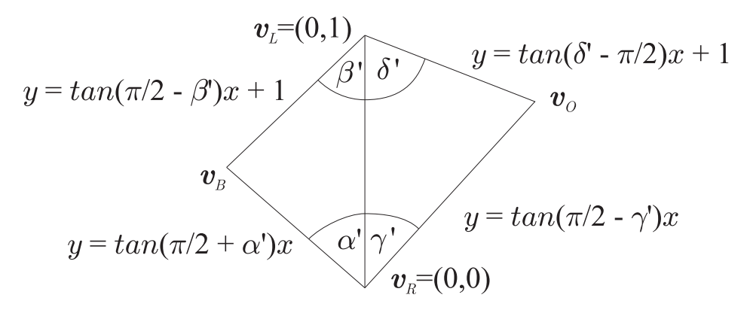
Weighted parallelogram [4]
Prediction based on
Connectivity
Valences of vertices
Known vertex positions (Base, Left, Right)
Known inner angles in decoded triangles
5
Notes:
The weighted parallelogram uses to its prediction positions of the base triangle vertices. It exploits the knowledge of the connectivity using valences of the vertices and it also uses known inner angles in triangles, that were already decoded.

Slide 6
Weighted parallelogram [4] – Inner angles
Inner angles are known in the base triangle
Can be estimated in the current triangle
Assuming zero Gaussian curvature
$α_{i}=\frac{2π}{n\left(i\right)}$
Using known angles
$α_{i}=\frac{2π−\sum{already decoded angles}}{n\left(i\right)−n_{decoded}(i)}$
6
Notes:
During the decompression in weighted parallelogram, we are able to compute weights of linear predictor using the esimates of angles in the triangle, that is being encoded.
To get these estimates we can estimate inner angles based on the valence of vertex as the proportional part of 2 PI, since we assume zero gaussian curvature.
Moreover during the docmpression we have some inner angles already decoded, so we are able to estimate inner angles in encoded triangle more precisely using these values.

Slide 7
Weighted parallelogram [4] – Inner angles
Weighted predictor
$v_{pred}=w_{1}v_{L}+w_{2}v_{R}+\left(1−w_{1}−w_{2}\right)v_{B}$
$\left(w_{1},w_{2}\right)=\left(\frac{\cot\left(β^{′}\right)+\cot\left(δ^{′}\right)}{\cot\left(δ^{′}\right)+\cot\left(γ^{′}\right)},\frac{\cot\left(α^{′}\right)+\cot\left(γ^{′}\right)}{\cot\left(δ^{′}\right)+\cot\left(γ^{′}\right)}\right)$
Correction vectors are quantized and encoded using arithmetic coder (in global coordinate system)
$corr=\left(∆_{x},∆_{y}{,∆}_{z}\right)$
7
Notes:
Using these angles we weighted parallelogram compute weight for the linear predictor as shiwn in this equation and it encodes the correction vector between true and predicted position of the vertex, as was said before.

Slide 8
Local coordinate system
Transform correction vectors into the local coordinate system
Two tangential and one normal basis vectors:
$n=\frac{\left(v_{L}−v_{R}\right)×\left(v_{B}−v_{R}\right)}{\left\|\left(v_{L}−v_{R}\right)×\left(v_{B}−v_{R}\right)\right\|}$
$t_{1}=$ $\frac{v_{L}−v_{R}}{\left\|v_{L}−v_{R}\right\|}$
$t_{2}=n×t_{1}$
$n=\frac{\left(v_{L}−v_{R}\right)×\left(v_{B}−v_{R}\right)}{\left\|\left(v_{L}−v_{R}\right)×\left(v_{B}−v_{R}\right)\right\|}$
$t_{1}=$ $\frac{p_{O}−v_{B}}{\left\|p_{O}−v_{B}\right\|}$
$t_{2}=n×t_{1}$
8
Notes:
Our improvement of this method, but it can also be very simply applied to some other prediction based methods, is to express given correction vector in the local coordinate systém, instead of global coordinate system.
In our work we have experimented with the two possibilaties of construction of the local coordinate systém. Both of them had very simmiliar results, first one was just slightly better.
Both versions of local systems have to consist of one normal vector and two tangential vectors.
One set of basis vectors of local systém can be obtained as the normal of base triangle, the vector with direction given by the diference of the base vartex and the predicted vertex and the cross-product of these two.
Second version is given by the base triangle normal, gate (which is the corrent edge, where the triangle is being predicted) and again their cross-product.
All these vectors are normalized, so the resulting systems are orthonormal.

Slide 9
Local coordinate system
Gumhold and Amjoun, 2003 [9]
Cylindrical system: $(x,y,α)$
Two tangential components and bending angle
$v_{pred}=\frac{(v_{L}+v_{R})}{2}+xx_{2}+\sin\left(α\right)yx_{1}+\cos\left(α\right)yx_{3}$
Problems with uniformity of quantization
9
Notes:
To be completely honest the idea of encoding corretions somehow in local systém is a little bit older. One of the forst attempts is in Gumhold and Amjoun, where the correction vector is expressed in cylindrical systém, but there are some problems, for example there is prolem with the uniformity of the quantization.

Slide 10
Local coordinate system
Correction vectors expressed in local coordinate system
$corr=t_{1}x_{1}+t_{2}x_{2}+nx_{3}$
Uniform quantization
Correction vectors are encoded using adaptive arithmetic coder
Individual components coded into separate contexts
$$corr=\left(\begin{matrix}∆_{x} \\ ∆_{y} \\ ∆_{z}\end{matrix}\right)$$
$$\left(\begin{matrix}t_{1} \\ t_{2} \\ n\end{matrix}\right)$$
$$\left(\begin{matrix}t_{1}^{′} \\ t_{2}^{′} \\ n^{′}\end{matrix}\right)$$
Global to local
Quantization
$t_{1}^{\left(1\right)},t_{1}^{\left(2\right)}$, $t_{1}^{\left(3\right)}$, $t_{1}^{\left(4\right)}$, $t_{1}^{\left(5\right)}$,…, $t_{1}^{\left(n\right)}$
Arithmetic coder
$t_{2}^{\left(1\right)},t_{2}^{\left(2\right)}$, $t_{2}^{\left(3\right)}$, $t_{2}^{\left(4\right)}$, $t_{2}^{\left(5\right)}$,…, $t_{2}^{\left(n\right)}$
$n^{\left(1\right)},n^{\left(2\right)},n^{\left(3\right)}$, $n^{\left(4\right)}$, $n^{\left(5\right)}$,…, $n^{\left(n\right)}$
10
Notes:
The outline of the encoding process is following. We obtain the prediciton of encoded vertex using weighted parallelogram. We compute correction vector and express it in the local coordinate systém. After that the quantization is being performer. The we encode quantized values using adaptive arithmetic encoder.
Here we exploit the ability of decoralaiton between the tangential and normal components. We encode components of correction vectors into separated contexts. This this alone in many cases reduces the bitrate of compression.

Slide 11
Local coordinate system
Transformation of the correction vector to the local coordinate system
Results in sequences with lower entropy
(Original delta coordinates were correlated)
Allows the use of different quantization constants for tangential and normal components coded into separate contexts
If the surface is sufficiently smooth and well-sampled, tangential distortion is less observable than normal distortion
Better results in terms of mechanistic and perceptual metrics (DAME)
11
Notes:
But we can make it even better adding second improvement. We can use different quantization step for tangential and for the normal vectors.
Idea if this step is following. If the surface is of the mesh is sufficiently well-sampled and smooth, then the distortion in a tangetial component will be much less visible, than the distoriton in a normal component.

Slide 12
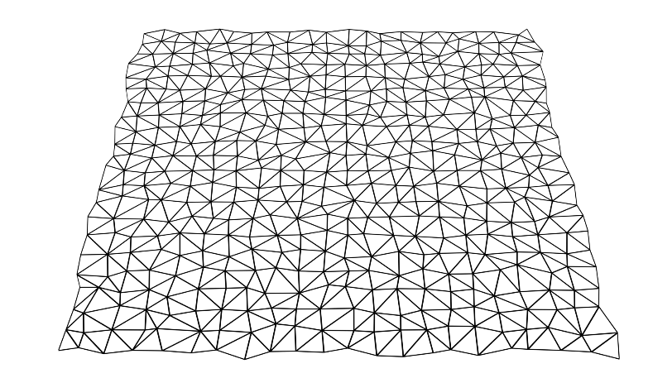
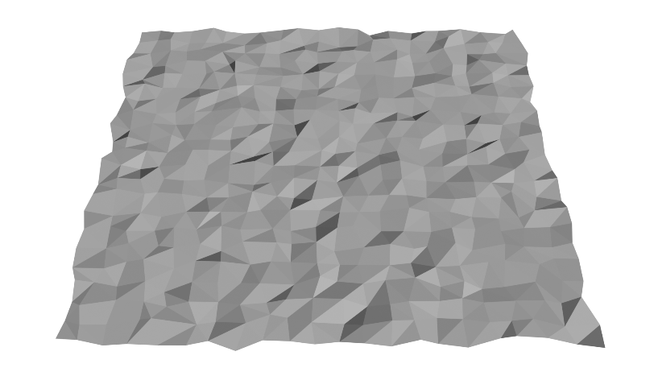
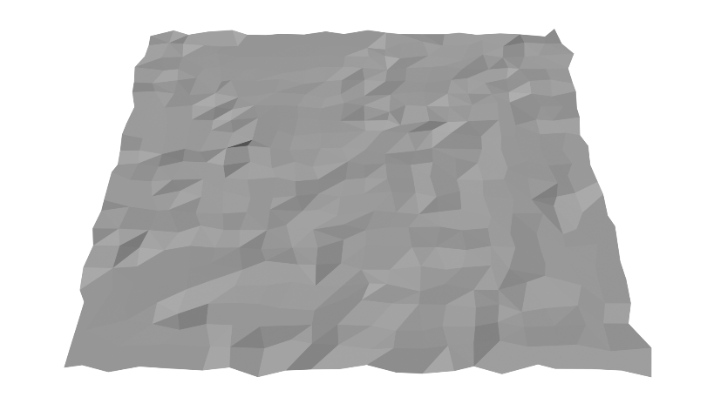
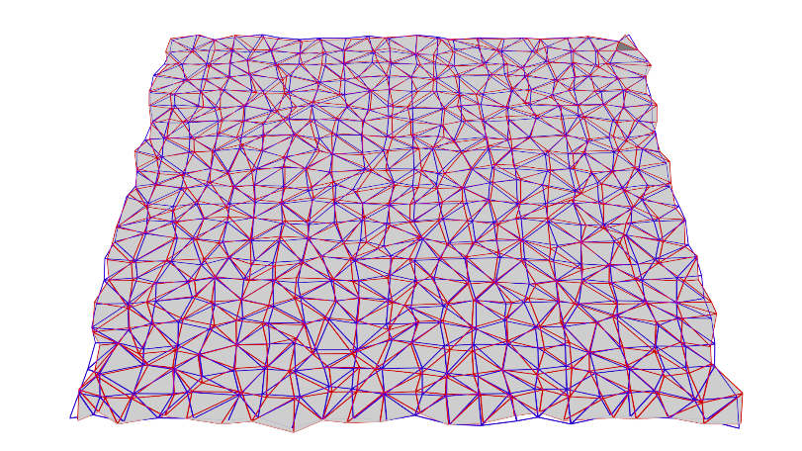
Experiments – Plane quantization
Plane rotated 17,5° around the x-axis, compression rate of approx. 13 bpv
Original mesh (wireframe)
Original mesh (shaded)
Compression in world space
Compression in local space
Compression in local space
(finer quantization of normal)
Precise encoding of
the 1st triangle (8.6 bpv)
12
Notes:
On this slide you can se the comparison of the original method and the method with the local coordinate systém tranformations on a synthetic mesh with a triangulated plane.
On the top left and middle you can se original mesh. On the top right you can see its compressed version using world space coordinates.
On the bottom left you can see the local coordinate version with the same bitrate.
In the middle bottom you can see again the local coordinate version but with the diferent quantization step for the normal and tangetial compoenents.
As you can see there is still some distortion, which is caused by the unprecisely encoding of the first triangle, which has to be encoded in worl space always. If we encode this one triangle without quantization, then all remaining traignles are predicted without any prediction errors and all correction vector are therefore zero.

Slide 13
Experiments – Quality assessment metrics
Mechanistic metrics
Vertex Mean Squared Error (MSE)
$MSE=\sum_{i=1}^{n}{{\left\|v_{i}−v_{i}^{′}\right\|}^{2}}$
Metro – AvgD [5]
Average distance between surfaces
Perceptual metrics
Dihedral Angle Mesh Arror (DAME) [6]
Reference methods
Original Weighted Parallelogram [4]
Draco [8]
Error Propagation Control (EPC) [7] - laplacian mesh compression
13
Notes:
For our experiments we used both mechanistic and the perceptual metric for mesh quality assessment.
From the mechanistic metrics we used mean squared error of vertices positions and average distance between surfaces, which is computed by the well-known metro tool.
As the perceptual metric we used Dihedral Angle Mesh Error.
We compared our version of weighted parallelogram with the original one and also with the Draco, as it is also considered as the state of the art method for single rate compression of triangle meshes and with the Error Propagation Control compression method which aims at the better results in terms of Dihedral Angle Mesh Error more, than in the mechanistic metrics.

Slide 14
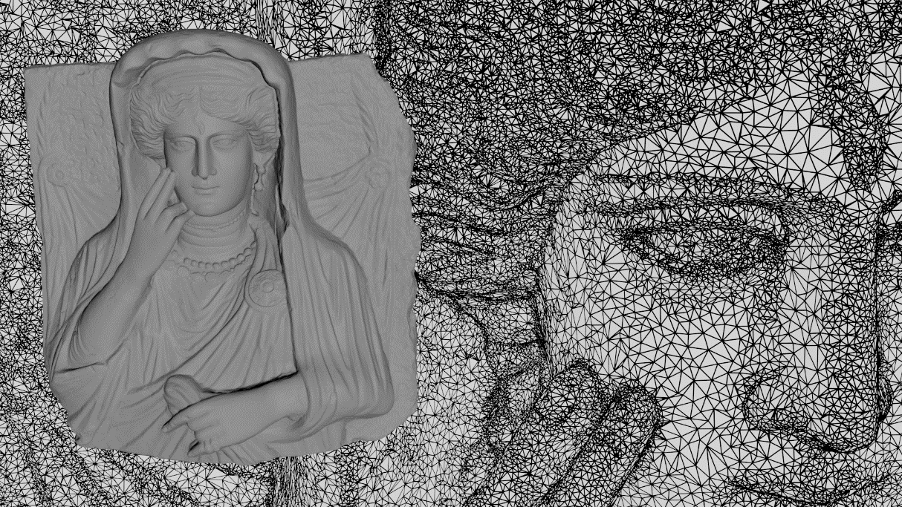
Experiments – Palmyra MSE
14
Notes:
In this picture you can see the rate distoriton curve of a palmyra mesh measured with the mean squared error.
As you can see, the best results were achieved using weighted parallelogram. Our proposed version with local coordinate has a slightly better results than the original one, but the improvement is not that large.

Slide 15
Experiments – Palmyra Metro
15
Notes:
In terms of average surface distance the best results has local coordinates version of weighted parallelogram with a finer quatization of normal components. World-space and the local-space version with the same quantization of all components have very simmiliar results, but local-coordinate version is slightly better.

Slide 16
Experiments – Palmyra DAME
16
Notes:
In terms of perceptual distotion measured with dihedral angle mesh error. Local-space weighted parrallelogram is the best choice for higher bitrates. For lower bitrates it is better to use error propagation control, as expected.

Slide 17
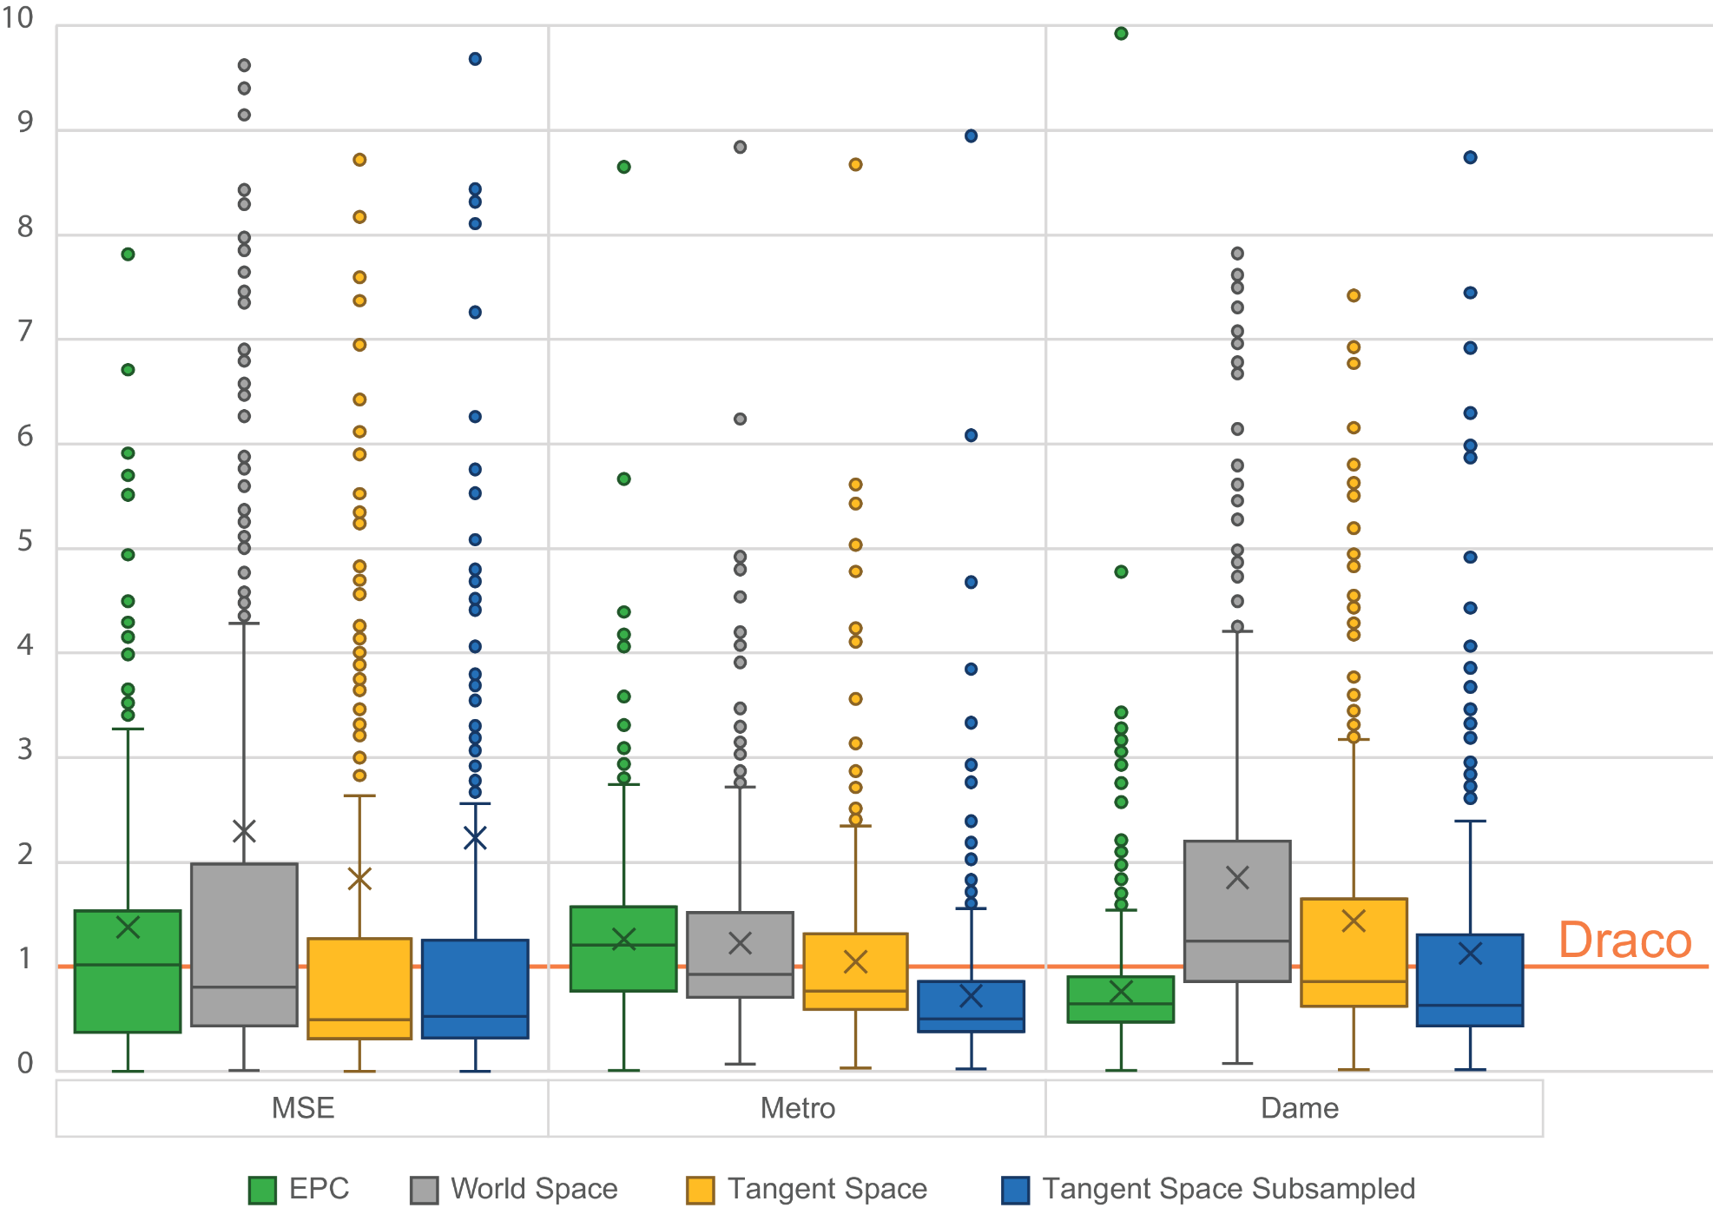
Experiments – Thingi10k dataset
17
Notes:
In this picture you can se the cummulative results on the thingi10k dataset. Results are measured as the relative improvement to to draco compression. Altought our method has worst average relative distortion, we have better median distortion in terms of all quality assessment metric except dihedral angle mesh error, where the error propagation control gives the best results. This is becaus this dataset contains some set of meshes, where the weighted parallelogram prediction is completely wrong, but this set of meshes is really small.

Slide 18
Experiments – Time complexity - compression
18
Notes:
In this picture you can se the encoder time complexity comparison. As you can see. Weighted parallelogram had the shortes encoding time. And you can also see, that transforming correction vector into local coordinate systém does not have significant impact on the encoding time.

Slide 19
Experiments – Time complexity - decompression
19
Notes:
In this picture you can see the same time complexity measurement but this time for the decoder. Again, weighted parallelogram is the fastest method with no significant impact of correction vector tranformation.

Slide 20
Conclusion
Using the Weighted Parallelogram with the local coordinates encoding
requires only a slight change in the implementation
leads to better results than using the global coordinate system
does not have negative impact on compression and decompression time
has comparable or better results than WP, EPC, and Draco in terms of MSE and AvgD
has comparable or better results than WP, and Draco in terms of DAME
20
Notes:
So, I believe that we showed, that using local-coordinate version of weighted parallelogram is beneficial. It requires only small change in the implementation of the orginal method. It lead to the better rate-distoriton ratio than the original method.
We see that weighted parallelogram outcompetes draco in terms of all used metrics and compression and decompression time.
It has comparable results with error propagation control in terms of dihedral angle mesh eror.

Slide 21
References
[1] | Costa Touma and Craig Gotsman. Triangle mesh compression. In Proceedings of the Graphics Interface 1998 Conference, June 18-20, 1998, Vancouver, BC, Canada, pages 26–34, June 1998.
[2] | Jae-Young Sim, Chang-Su Kim, and Sang-Uk Lee. An efficient 3d mesh compression technique based on triangle fan structure. Signal Processing: Image Communication, 18(1):17–32, 2003.
[3] | Felix Kälberer, Konrad Polthier, Ulrich Reitebuch, and Max Wardetzky. Freelence - coding with free valences. Computer Graphics Forum, 24(3):469–478, 2005.
[4] | Libor Vasa and Guido Brunnett. Exploiting connectivity to improve the tangential part of geometry prediction. IEEE Transactions on Visualization and Computer Graphics, 19(9):1467–1475, 2013.
[5] | P. Cignoni, C. Rocchini, and R. Scopigno. Metro: Measuring error on simplified surfaces. Computer Graphics Forum, 17(2):167–174, 1998.
[6] | Libor Váša and Jan Rus. Dihedral angle mesh error: a fast perception correlated distortion measure for fixed connectivity triangle meshes. Computer Graphics Forum, 31(5):1715–1724, 2012.
[7] | Váša, L. and Dvořák, J. (2018), Error propagation control in Laplacian mesh compression. Computer Graphics Forum, 37: 61-70. https://doi.org/10.1111/cgf.13491
[8] | Galligan, F., Hemmer, M., Stava, O., Zhang, F., and Brettle, J. (2018). Google/draco: a library for compressing and decompressing 3d geometric meshes and point Clouds.
[9] | Gumhold, S. and Amjoun, R. (2003). Higher order prediction for geometry compression. In Proceedings of Shape Modeling International 2003, SMI ’03, page 59, USA. IEEE Computer Society.
21
Notes:
Here I have references, I have used during the presentation.

Slide 22
Thank You For Your Attention
Filip Hácha / hachaf@kiv.zcu.cz
Notes:
And thats all. Thank you for your attention.

