Slide 1
Chapter 6 - Statistical Quality Control
Operations Management
by
R. Dan Reid & Nada R. Sanders
4th Edition © Wiley 2010

Slide 2
Learning Objectives
Describe categories of SQC
Explain the use of descriptive statistics in measuring quality characteristics
Identify and describe causes of variation
Describe the use of control charts
Identify the differences between x-bar, R-, p-, and c-charts

Slide 3
Learning Objectives –con’t
Explain process capability and process capability index
Explain the concept six-sigma
Explain the process of acceptance sampling and describe the use of OC curves
Describe the challenges inherent in measuring quality in service organizations

Slide 4
Three SQC Categories
Statistical quality control (SQC): the term used to describe the set of statistical tools used by quality professionals; SQC encompasses three broad categories of:
Statistical process control (SPC)
Descriptive statistics include the mean, standard deviation, and range
Involve inspecting the output from a process
Quality characteristics are measured and charted
Helps identify in-process variations
Acceptance sampling used to randomly inspect a batch of goods to determine acceptance/rejection
Does not help to catch in-process problems

Slide 5
Sources of Variation
Variation exists in all processes.
Variation can be categorized as either:
Common or Random causes of variation, or
Random causes that we cannot identify
Unavoidable, e.g. slight differences in process variables like diameter, weight, service time, temperature
Assignable causes of variation
Causes can be identified and eliminated: poor employee training, worn tool, machine needing repair

Slide 6
Descriptive Statistics
Descriptive Statistics include:
The Mean- measure of central tendency
The Range- difference between largest/smallest observations in a set of data
Standard Deviation measures the amount of data dispersion around mean
Distribution of Data shape
Normal or bell shaped or
Skewed

Slide 7
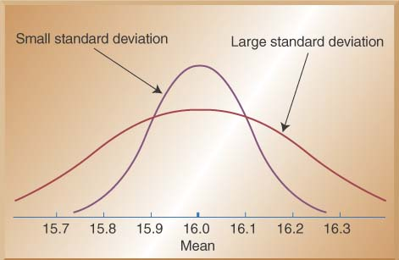
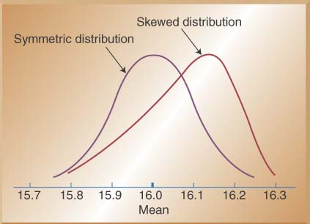
Distribution of Data
Normal distributions
Skewed distribution

Slide 8
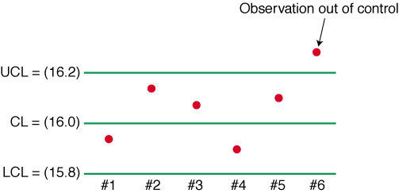
SPC Methods-Developing Control Charts
Control Charts (aka process or QC charts) show sample data plotted on a graph with CL, UCL, and LCL
Control chart for variables are used to monitor characteristics that can be measured, e.g. length, weight, diameter, time
Control charts for attributes are used to monitor characteristics that have discrete values and can be counted, e.g. % defective, # of flaws in a shirt, etc.

Slide 9
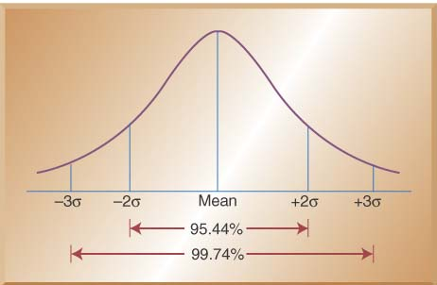
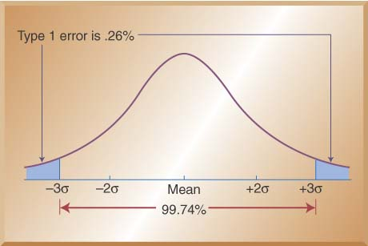
Setting Control Limits
Percentage of values under normal curve
Control limits balance
risks like Type I error

Slide 10
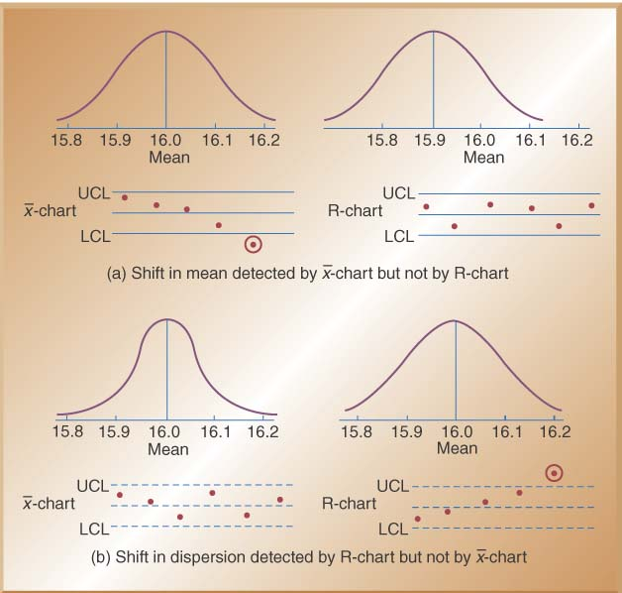
Control Charts for Variables
Use x-bar and R-bar charts together
Used to monitor different variables
X-bar & R-bar Charts reveal different problems
Is statistical control on one chart, out of control on the other chart? OK?

Slide 11
Control Charts for Variables
Use x-bar charts to monitor the changes in the mean of a process (central tendencies)
Use R-bar charts to monitor the dispersion or variability of the process
System can show acceptable central tendencies but unacceptable variability or
System can show acceptable variability but unacceptable central tendencies

Slide 12
Constructing an X-bar Chart: A quality control inspector at the Cocoa Fizz soft drink company has taken three samples with four observations each of the volume of bottles filled. If the standard deviation of the bottling operation is .2 ounces, use the below data to develop control charts with limits of 3 standard deviations for the 16 oz. bottling operation.
Center line and control limit formulas
 | Time 1 | Time 2 | Time 3
Observation 1 | 15.8 | 16.1 | 16.0
Observation 2 | 16.0 | 16.0 | 15.9
Observation 3 | 15.8 | 15.8 | 15.9
Observation 4 | 15.9 | 15.9 | 15.8
Sample means (X-bar) | 15.875 | 15.975 | 15.9
Sample ranges (R) | 0.2 | 0.3 | 0.2

Slide 13
Solution and Control Chart (x-bar)
Center line (x-double bar):
Control limits for±3σ limits:

Slide 14
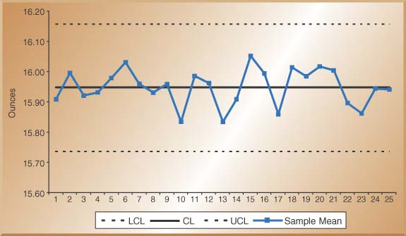
X-Bar Control Chart

Slide 15
Control Chart for Range (R)
Center Line and Control Limit formulas:
Factors for three sigma control limits
Sample Size
(n)
Factor for x-Chart
Factors for R-Chart
A2
D3
D4
2
1.88
0.00
3.27
3
1.02
0.00
2.57
4
0.73
0.00
2.28
5
0.58
0.00
2.11
6
0.48
0.00
2.00
7
0.42
0.08
1.92
8
0.37
0.14
1.86
9
0.34
0.18
1.82
10
0.31
0.22
1.78
11
0.29
0.26
1.74
12
0.27
0.28
1.72
13
0.25
0.31
1.69
14
0.24
0.33
1.67
15
0.22
0.35
1.65

Slide 16
R-Bar Control Chart

Slide 17
Second Method for the X-bar Chart Using R-bar and the A2 Factor
Use this method when sigma for the process distribution is not know
Control limits solution:

Slide 18
Control Charts for Attributes –P-Charts & C-Charts
Attributes are discrete events: yes/no or pass/fail
Use P-Charts for quality characteristics that are discrete and involve yes/no or good/bad decisions
Number of leaking caulking tubes in a box of 48
Number of broken eggs in a carton
Use C-Charts for discrete defects when there can be more than one defect per unit
Number of flaws or stains in a carpet sample cut from a production run
Number of complaints per customer at a hotel

Slide 19
P-Chart Example: A production manager for a tire company has inspected the number of defective tires in five random samples with 20 tires in each sample. The table below shows the number of defective tires in each sample of 20 tires. Calculate the control limits.
Sample | Number of Defective Tires | Number of Tires in each Sample | Proportion Defective
1 | 3 | 20 | .15
2 | 2 | 20 | .10
3 | 1 | 20 | .05
4 | 2 | 20 | .10
5 | 2 | 20 | .05
Total | 9 | 100 | .09
Solution:

Slide 20
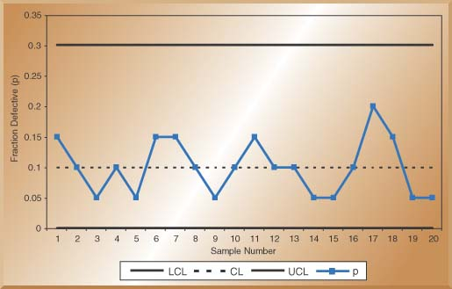
P- Control Chart

Slide 21
C-Chart Example: The number of weekly customer complaints are monitored in a large hotel using a c-chart. Develop three sigma control limits using the data table below.
Week | Number of Complaints
1 | 3
2 | 2
3 | 3
4 | 1
5 | 3
6 | 3
7 | 2
8 | 1
9 | 3
10 | 1
Total | 22
Solution:

Slide 22
C- Control Chart

Slide 23
Process Capability
Product Specifications
Preset product or service dimensions, tolerances: bottle fill might be 16 oz. ±.2 oz. (15.8oz.-16.2oz.)
Based on how product is to be used or what the customer expects
Process Capability – Cp and Cpk
Assessing capability involves evaluating process variability relative to preset product or service specifications
Cp assumes that the process is centered in the specification range
Cpk helps to address a possible lack of centering of the process

Slide 24
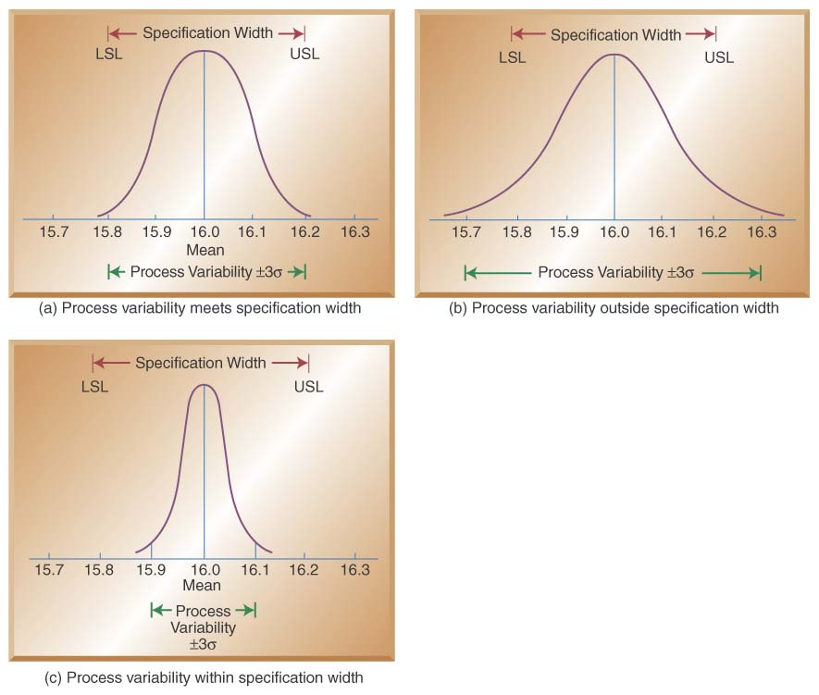
Relationship between Process Variability and Specification Width
Three possible ranges for Cp
Cp = 1, as in Fig. (a), process
variability just meets specifications
Cp ≤ 1, as in Fig. (b), process not capable of producing within specifications
Cp ≥ 1, as in Fig. (c), process
exceeds minimal specifications
One shortcoming, Cp assumes that the process is centered on the specification range
Cp=Cpk when process is centered

Slide 25
Computing the Cp Value at Cocoa Fizz: 3 bottling machines are being evaluated for possible use at the Fizz plant. The machines must be capable of meeting the design specification of 15.8-16.2 oz. with at least a process capability index of 1.0 (Cp≥1)
The table below shows the information gathered from production runs on each machine. Are they all acceptable?
Solution:
Machine A
Machine B
Cp=
Machine C
Cp=
Machine | σ | USL-LSL | 6σ
A | .05 | .4 | .3
B | .1 | .4 | .6
C | .2 | .4 | 1.2

Slide 26
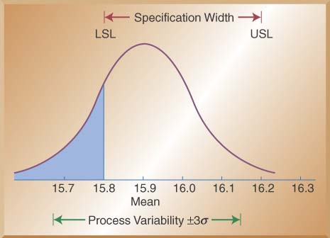
Computing the Cpk Value at Cocoa Fizz
Design specifications call for a target value of 16.0 ±0.2 OZ.
(USL = 16.2 & LSL = 15.8)
Observed process output has now shifted and has a µ of 15.9 and a
σ of 0.1 oz.
Cpk is less than 1, revealing that the process is not capable

Slide 27
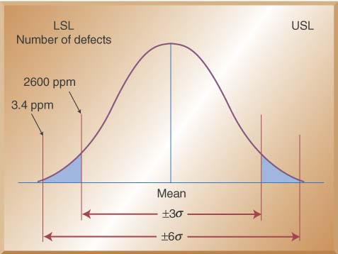
±6 Sigma versus ± 3 Sigma
PPM Defective for ±3σ versus ±6σ quality
In 1980’s, Motorola coined “six-sigma” to describe their higher quality efforts
Six-sigma quality standard is now a benchmark in many industries
Before design, marketing ensures customer product characteristics
Operations ensures that product design characteristics can be met by controlling materials and processes to 6σ levels
Other functions like finance and accounting use 6σ concepts to control all of their processes

Slide 28
Acceptance Sampling
Defined: the third branch of SQC refers to the process of randomly inspecting a certain number of items from a lot or batch in order to decide whether to accept or reject the entire batch
Different from SPC because acceptance sampling is performed either before or after the process rather than during
Sampling before typically is done to supplier material
Sampling after involves sampling finished items before shipment or finished components prior to assembly
Used where inspection is expensive, volume is high, or inspection is destructive

Slide 29
Acceptance Sampling Plans
Goal of Acceptance Sampling plans is to determine the criteria for acceptance or rejection based on:
Size of the lot (N)
Size of the sample (n)
Number of defects above which a lot will be rejected (c)
Level of confidence we wish to attain
There are single, double, and multiple sampling plans
Which one to use is based on cost involved, time consumed, and cost of passing on a defective item
Can be used on either variable or attribute measures, but more commonly used for attributes

Slide 30
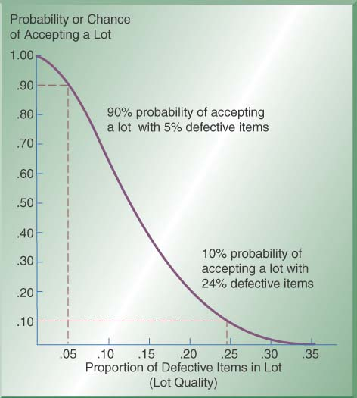
Operating Characteristics (OC) Curves
OC curves are graphs which show the probability of accepting a lot given various proportions of defects in the lot
X-axis shows % of items that are defective in a lot- “lot quality”
Y-axis shows the probability or chance of accepting a lot
As proportion of defects increases, the chance of accepting lot decreases
Example: 90% chance of accepting a lot with 5% defectives; 10% chance of accepting a lot with 24% defectives

Slide 31
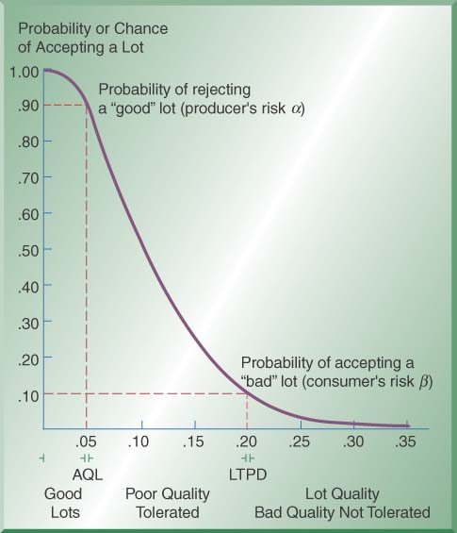
AQL, LTPD, Consumer’s Risk (α) & Producer’s Risk (β)
AQL is the small % of defects that consumers are willing to accept; order of 1-2%
LTPD is the upper limit of the percentage of defective items consumers are willing to tolerate
Consumer’s Risk (α) is the chance of accepting a lot that contains a greater number of defects than the LTPD limit; Type II error
Producer’s risk (β) is the chance a lot containing an acceptable quality level will be rejected; Type I error

Slide 32

Developing OC Curves
OC curves graphically depict the discriminating power of a sampling plan
Cumulative binomial tables like partial table below are used to obtain probabilities of accepting a lot given varying levels of lot defectives
Top of the table shows value of p (proportion of defective items in lot), Left hand column shows values of n (sample size) and x represents the cumulative number of defects found
Table 6-2 Partial Cumulative Binomial Probability Table (see Appendix C for complete table) Proportion of Items Defective (p)
 |  | .05 | .10 | .15 | .20 | .25 | .30 | .35 | .40 | .45 | .50
n | x
5 | 0 | .7738 | .5905 | .4437 | .3277 | .2373 | .1681 | .1160 | .0778 | .0503 | .0313
Pac | 1 | .9974 | .9185 | .8352 | .7373 | .6328 | .5282 | .4284 | .3370 | .2562 | .1875
AOQ |  | .0499 | .0919 | .1253 | .1475 | .1582 | .1585 | .1499 | .1348 | .1153 | .0938

Slide 33
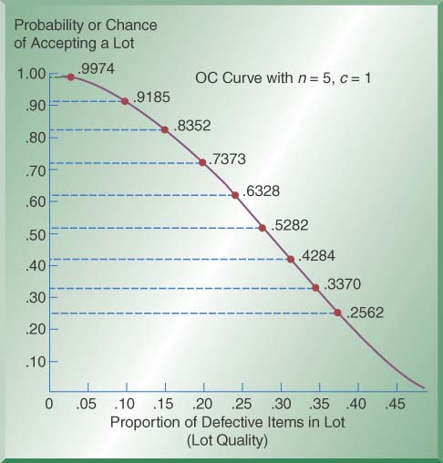
Example: Constructing an OC Curve
Lets develop an OC curve for a sampling plan in which a sample of 5 items is drawn from lots of N=1000 items
The accept /reject criteria are set up in such a way that we accept a lot if no more that one defect (c=1) is found
Using Table 6-2 and the row corresponding to n=5 and x=1
Note that we have a 99.74% chance of accepting a lot with 5% defects and a 73.73% chance with 20% defects

Slide 34
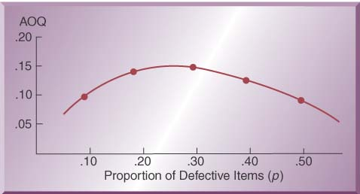
Average Outgoing Quality (AOQ)
With OC curves, the higher the quality of the lot, the higher is the chance that it will be accepted
Conversely, the lower the quality of the lot, the greater is the chance that it will be rejected
The average outgoing quality level of the product (AOQ) can be computed as follows: AOQ=(Pac)p
Returning to the bottom line in Table 6-2, AOQ can be calculated for each proportion of defects in a lot by using the above equation
This graph is for n=5 and x=1 (same as c=1)
AOQ is highest for lots close to 30% defects

Slide 35
Implications for Managers
How much and how often to inspect?
Consider product cost and product volume
Consider process stability
Consider lot size
Where to inspect?
Inbound materials
Finished products
Prior to costly processing
Which tools to use?
Control charts are best used for in-process production
Acceptance sampling is best used for inbound/outbound

Slide 36
SQC in Services
Service Organizations have lagged behind manufacturers in the use of statistical quality control
Statistical measurements are required and it is more difficult to measure the quality of a service
Services produce more intangible products
Perceptions of quality are highly subjective
A way to deal with service quality is to devise quantifiable measurements of the service element
Check-in time at a hotel
Number of complaints received per month at a restaurant
Number of telephone rings before a call is answered
Acceptable control limits can be developed and charted

Slide 37
Service at a bank: The Dollars Bank competes on customer service and is concerned about service time at their drive-by windows. They recently installed new system software which they hope will meet service specification limits of 5±2 minutes and have a Capability Index (Cpk) of at least 1.2. They want to also design a control chart for bank teller use.
They have done some sampling recently (sample size: 4 customers) and determined that the process mean has shifted to 5.2 with a Sigma of 1.0 minutes.
Control Chart limits for ±3 sigma limits

Slide 38
SQC Across the Organization
SQC requires input from other organizational functions, influences their success, and used in designing and evaluating their tasks
Marketing – provides information on current and future quality standards
Finance – responsible for placing financial values on SQC efforts
Human resources – the role of workers change with SQC implementation. Requires workers with right skills
Information systems – makes SQC information accessible for all.

Slide 39
Chapter 6 Highlights
SQC refers to statistical tools t hat can be sued by quality professionals. SQC an be divided into three categories: traditional statistical tools, acceptance sampling, and statistical process control (SPC).
Descriptive statistics are used to describe quality characteristics, such as the mean, range, and variance. Acceptance sampling is the process of randomly inspecting a sample of goods and deciding whether to accept or reject the entire lot. Statistical process control involves inspecting a random sample of output from a process and deciding whether the process in producing products with characteristics that fall within preset specifications.

Slide 40
Chapter 6 Highlights – con’t
Two causes of variation in the quality of a product or process: common causes and assignable causes. Common causes of variation are random causes that we cannot identify. Assignable causes of variation are those that can be identified and eliminated.
A control chart is a graph used in SPC that shows whether a sample of data falls within the normal range of variation. A control chart has upper and lower control limits that separate common from assignable causes of variation. Control charts for variables monitor characteristics that can be measured and have a continuum of values, such as height, weight, or volume. Control charts fro attributes are used to monitor characteristics that have discrete values and can be counted.

Slide 41
Chapter 6 Highlights – con’t
Control charts for variables include x-bar and R-charts. X-bar charts monitor the mean or average value of a product characteristic. R-charts monitor the range or dispersion of the values of a product characteristic. Control charts for attributes include p-charts and c-charts. P-charts are used to monitor the proportion of defects in a sample, C-charts are used to monitor the actual number of defects in a sample.
Process capability is the ability of the production process to meet or exceed preset specifications. It is measured by the process capability index C_{p} which is computed as the ratio of the specification width to the width of the process variable.

Slide 42
Chapter 6 Highlights – con’t
The term Six Sigma indicates a level of quality in which the number of defects is no more than 2.3 parts per million.
The goal of acceptance sampling is to determine criteria for the desired level of confidence. Operating characteristic curves are graphs that show the discriminating power of a sampling plan.
It is more difficult to measure quality in services than in manufacturing. The key is to devise quantifiable measurements for important service dimensions.

Slide 43
Chapter 6 Homework Hints
6.4: calculate mean and range for all 10 samples. Use Table 6-1 data to determine the UCL and LCL for the mean and range, and then plot both control charts (x-bar and r-bar).
6.8: use the data for preparing a p-bar chart. Plot the 4 additional samples to determine your “conclusions.”
6.11: determine the process capabilities (CP_{k}) of the 3 machines and decide which are “capable.”

