Slide 1
DEVELOPING SOLUTIONS FOR THE NUTRITION OF A GROWING MANKIND –
PROCESS TECHNOLOGY IN MODERN INDOOR AQUACULTURE PLANTS

Slide 2
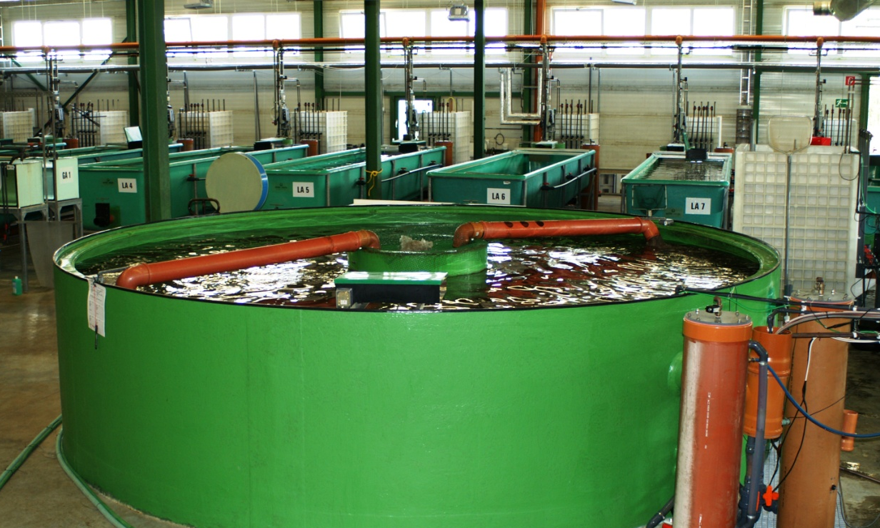
Contents
Introduction
  Modern Aquaculture versus traditional fishery
  Project partners – RAS in Thierbach, Germany
Heterotrophic ammonium assimilation
Application of membrane technology
  Microfiltration for biomass separation
  Membrane bioreactor (MBR)
Aspects of gas exchange and water transport
  Hydrodynamic oxygenation
  Application of airlift pumps
Further ideas and project approaches
  Plant automation
  …
Contents

Slide 3
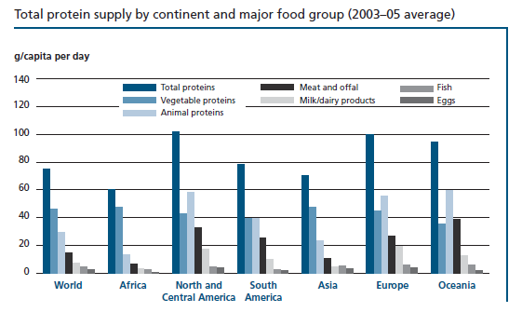
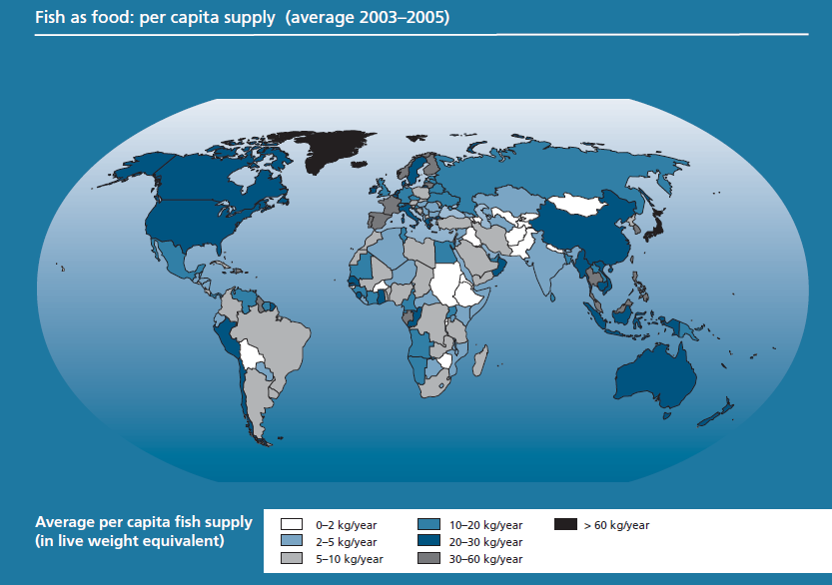
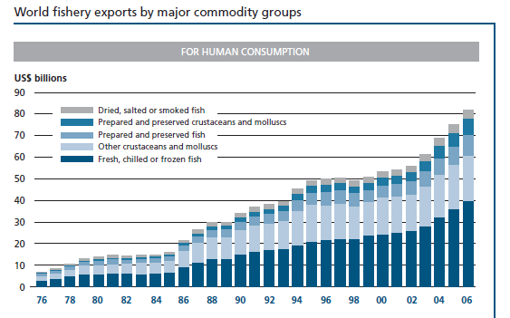
Modern Aquaculture versus Traditional Fishery – Rising Demand…
Reasons for additional demand for fish products:
Growing of world’s population
Changing nutritional behavior in industrialized countries
Introduction
[FAO, 2009]

Slide 4
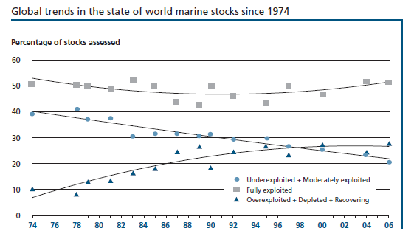
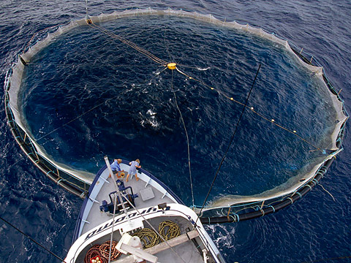
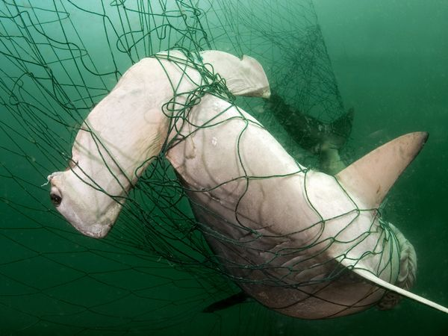
Modern Aquaculture versus Traditional Fishery – Increasing Resources…
Environmental impacts of traditional fishery:
Overfishing of stocks
Habitat modification
(especially by destructing fishing
practices)
Bycatch (incidental capture of
endangered animals, non-target
species etc.)
Introduction
[www.nationalgeographic.com], [FAO, 2009]

Slide 5
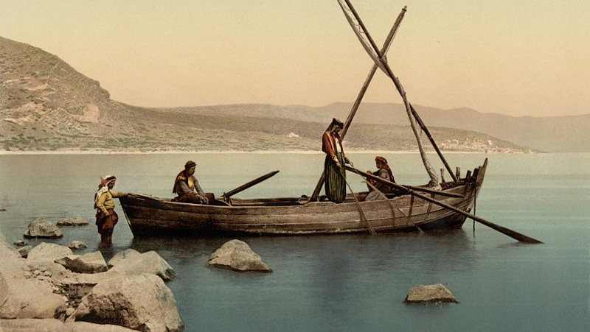
Modern Aquaculture versus Traditional Fishery – Even in Bible (Luke 5)
1 … He was standing by the lake of Gennesaret; …
4 … He said to Simon, “Put out into the deep water and let down your nets for a catch.”
5 Simon … said, “Master, we worked hard all night and caught nothing, but I will do as You say and let down the nets.”
6 … they enclosed a great quantity of fish, and their nets began to break;
7 … signaled to their partners … and filled both of the boats, so that they began to sink.
“scientific explanation”?
nutrition-rich streams,
where fish is concentrating
sort of marine (lake) aquaculture …?
Introduction
[http://en.wikipedia.org/wiki/Sea_of_Galilee ; 9/14/2008]

Slide 6
Modern Aquaculture versus Traditional Fishery – Aquaculture as Answer?
Aquaculture has the most efficient feed conversion in animal farming sector [Hart, 2009]:
with 1 t of feed you can produce
  approx. 150 kg beef, 300 kg pork, 500 kg chicken or
  … almost 1 t of fish
BUT: Aquaculture can cause serious negative impacts on environment, because of
Extensive demand for fish meal and oil in diet for carnivores (aquaculture can even contribute to overfishing)
Pollution of coastal environment and rivers (by fecal matter, antibiotics etc.)
Threatening of wild population (e.g. by escaping genetically modified animals)
Introduction

Slide 7
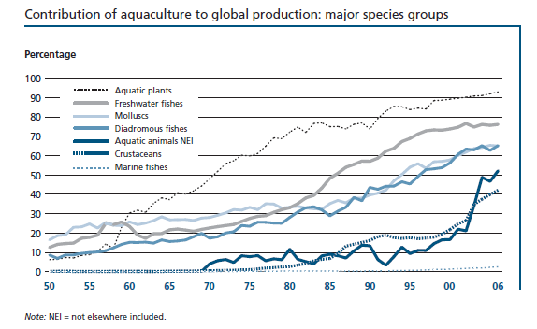
Modern Aquaculture versus Traditional Fishery – Aquaculture as Answer!
Negative impact on environment can be avoided!
Sustainable Aquaculture
Implementation of suitable farming systems, e.g. recirculating aquaculture systems (RAS)
Application of state-of-the-art water cleaning technologies
Responsible selection
of species
…
Introduction
[FAO, 2009]

Slide 8
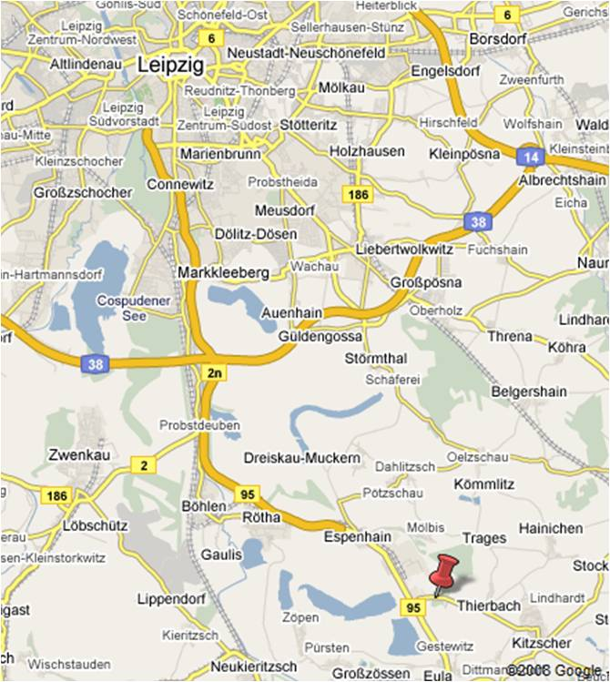
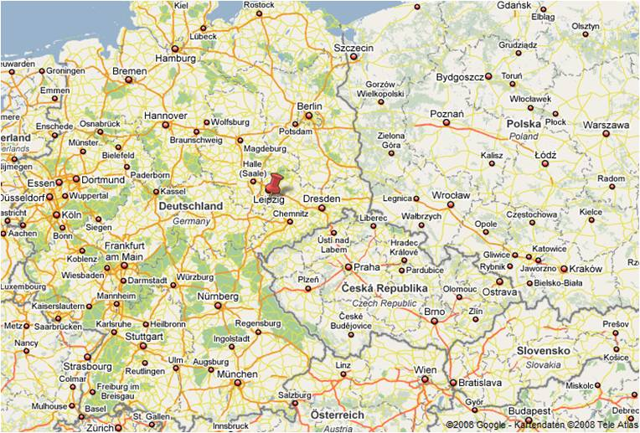
RAS in Thierbach, Germany
Indoor aquaculture plant in
Thierbach (near Leipzig, Germany)
Started operation in November 2006
Designed as recirculating aquaculture
system (RAS)
Introduction

Slide 9
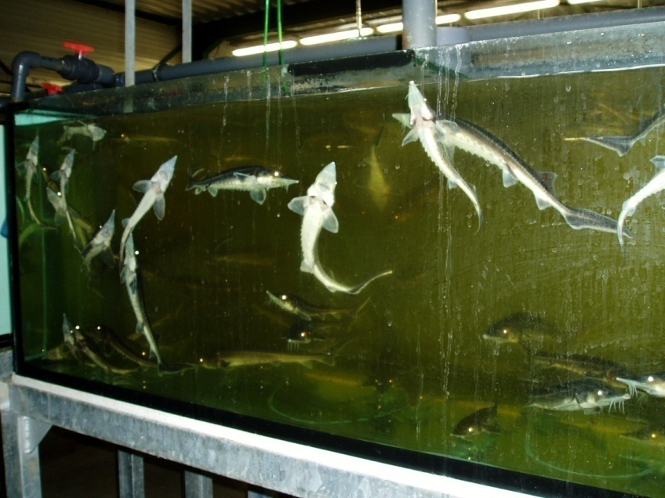
RAS in Thierbach, Germany – Object of Plant/Venture
Breeding of fry and production
of seedlings
Stock for other aquaculture
plants
Types of fish hatched:
Freshwater fish
(sturgeon, pikeperch,
hybrid striped bass,
catfish, carp, tilapia)
Salt water fish
(sea bass)
Introduction

Slide 10
RAS in Thierbach, Germany – General Aspects of Plant Design
Office, laboratories and social rooms
Stocking
Breeding basins
Hatchery
Raceway basins
Workshop
Compressor/ emergency power supply
Round basins
Well water treatment
(de-ironing)
Water storage tanks
Membrane cleaning station
Introduction

Slide 11
Heterotrophic Ammonium Assimilation – Motivation
„Conventional“ water cleaning technology:
Separation of particles using screen filters, drum filters, filter mats
Control of nitrogen compounds in circulating water by applying nitrification (packed bed filters)
Disadvantages:
Accumulation of nitrate (additional denitrification not standard)
Lag periods at starting biological treatment (growth/adaption of microorganisms)
Technical problems (blocked filters, beds etc.)
Heterotrophic Ammonium Assimilation

Slide 12
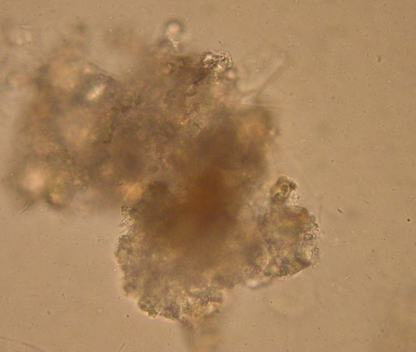
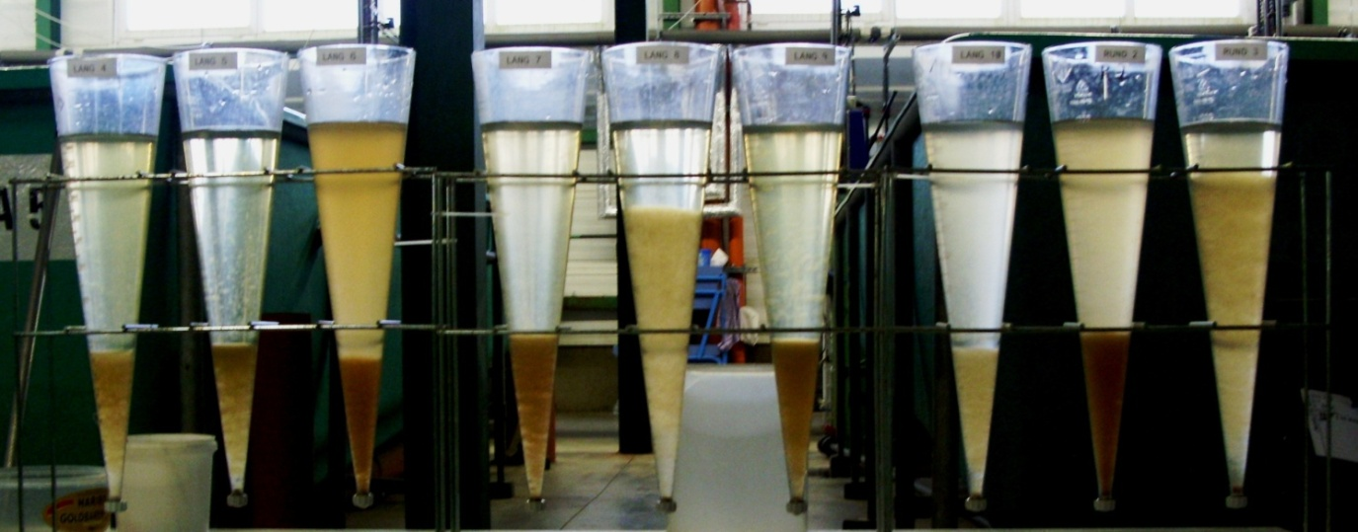
Heterotrophic Ammonium Assimilation – (Biological) Mechanism
Oxygen
C-Source
Oxygen
Unutilised feed
Fish
Faeces, urine
Heterotrophic bacteria
Fish feed
Ammonium
Heterotrophic Ammonium Assimilation
Heterotrophic Bacteria:
Bacillus sp., Pseudomonas sp.
C(arbon)-Source:
Saccharose , Acetate etc.
CO₂
CO₂
P-Source

Slide 13
Heterotrophic Ammonium Assimilation – Advantages
Virtually no occurrence of fish toxic nitrogen compounds (ammonia, nitrous acid) in circulating water
No accumulation of nitrate in circulating water
No lag phases at starting new water circuits (fast growing of biomass because of short generation times of bacteria)
High flexibility and tolerance towards interferences (high conversion rates)
Less occurrence of fish diseases (established microbial population represses pathogens)
Incorporation of biomass (especially by fish fry)
Different approaches for utilisation of separated surplus biomass (e.g. biogas production, …)
Heterotrophic Ammonium Assimilation

Slide 14
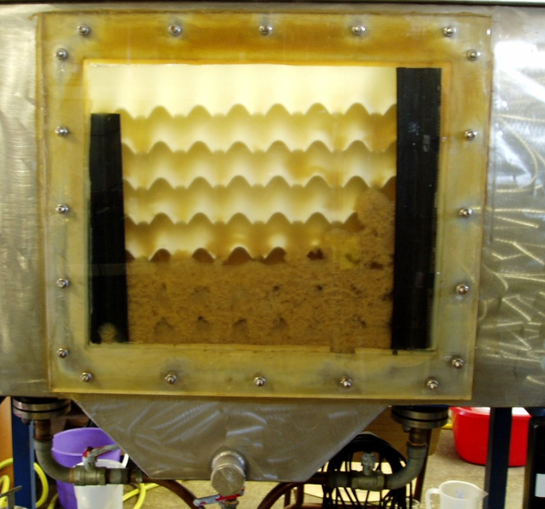
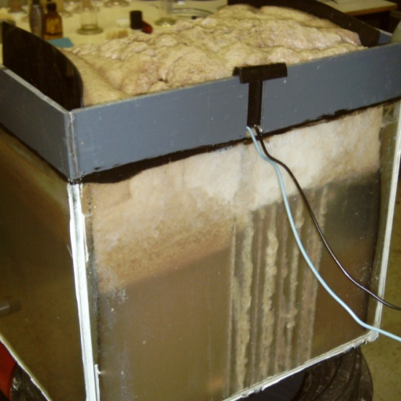
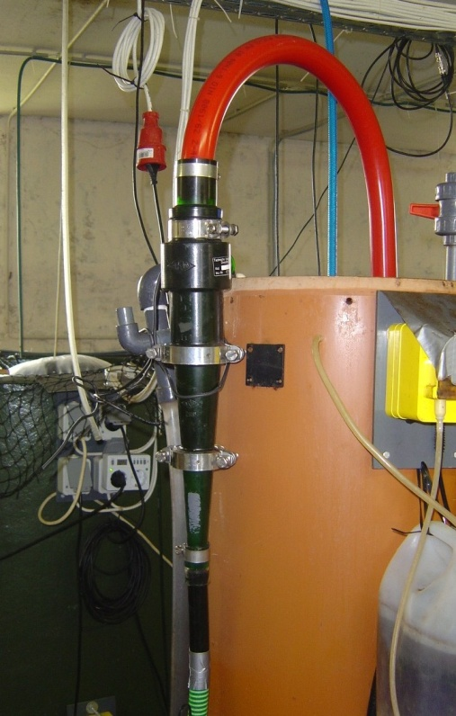
Heterotrophic Ammonium Assimilation – Removal of Surplus Biomass
Tested separation techniques:
Sedimentation
Filtration
Flocculation
Electro-coagulation
Hydrocycloning
Drawbacks of tested techniques:
Clogging, foam, “dead” (anaerobic) zones …
Breakthrough of colloids, microorganisms ...
Solution: Membrane separation
(microfiltration, pore size approx. 0.1 µm)
Heterotrophic Ammonium Assimilation

Slide 15
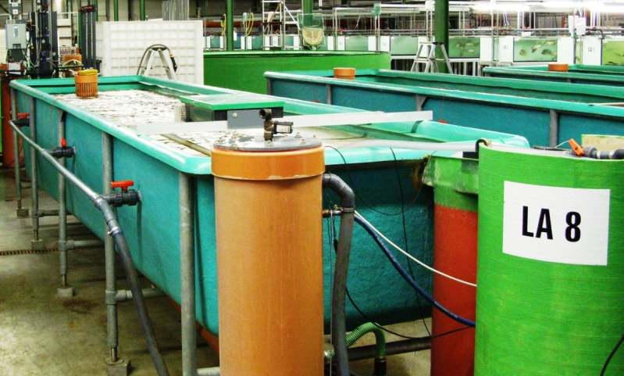
Microfiltration for Biomass Separation – Membrane Separation in Bypass
Microfiltration in recirculation water flow
Application of Membrane Technology

Slide 16

Microfiltration for Biomass Separation – Microfiltration Membrane Module
Principle:
Objectives:
Low TMP (trans-membrane pressure): 0.05…0.07 bar (just water level/height!)
Biomass (bacteria) content
  In fish basin:
  0.1…0.3 g/l (sufficient/optimal microbial activity)
  In microfiltration unit:
  5…15 g/l (for utilization as fermentation substrate, feed supplement etc.)
Detail: Submerged hollow fibre membrane
Permeate
Surplus biomass
Application of Membrane Technology
Feed (water from fish basin) and aeration

Slide 17
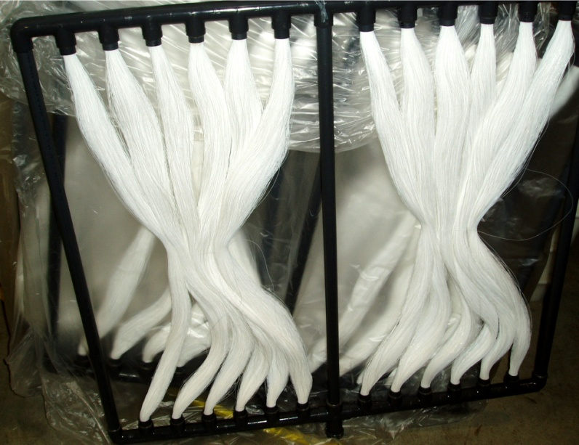
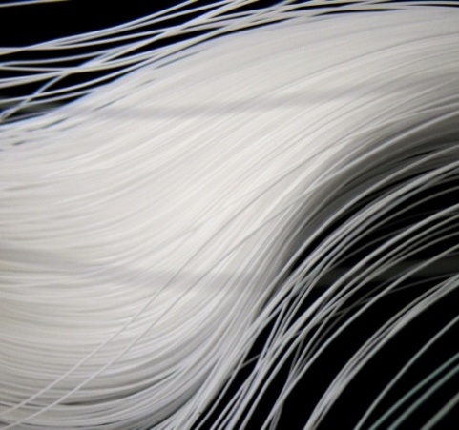
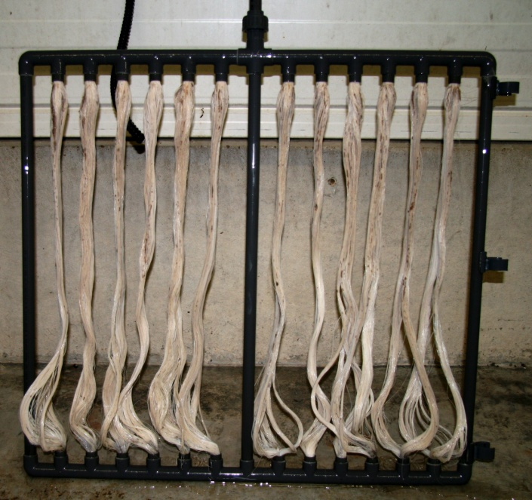
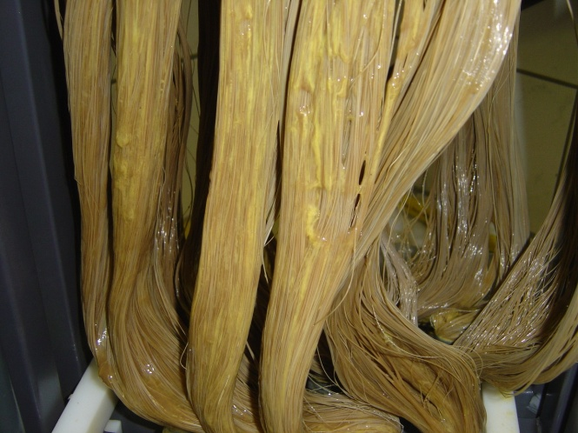
Microfiltration for Biomass Separation – Tested Membranes
Parameter | ZENA/EIDOS HF PP-M6
Membrane Type | Hollow fibre membrane
Material | Polypropylene - hydrophilic
Dimension | Outer diameter 0.3 mm
Pore Size | Slot pores: 0.1 by 0.7 µm up to maximal 0.2 by 0.9 µm
TMP | Small mean positive pressure by the water column: 0.03 to 0.07 bar
Aeration | Intermittent, short air pressure blows (4 bar positive pressure; 1 s all 30 or 60 s)
Cleaning | No back-flush Mechanically by high pressure water jet Chemically (detergent, sodium hydroxide and hypochlorite, citric acid solutions) after flux decay
Application of Membrane Technology

Slide 18
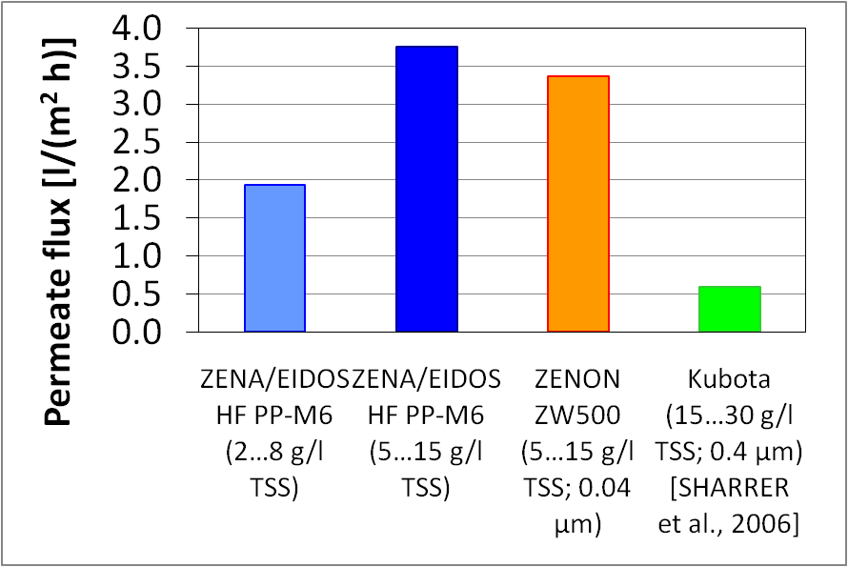
Microfiltration for Biomass Separation – Summary and Conclusions
Best performance and economic figures: ZENA/EIDOS
BUT: Too high biomass content in fish basin …
  High oxygen demand (competition between fish and bacteria)
  Limitation of fish species to be bred
Application of Membrane Technology

Slide 19
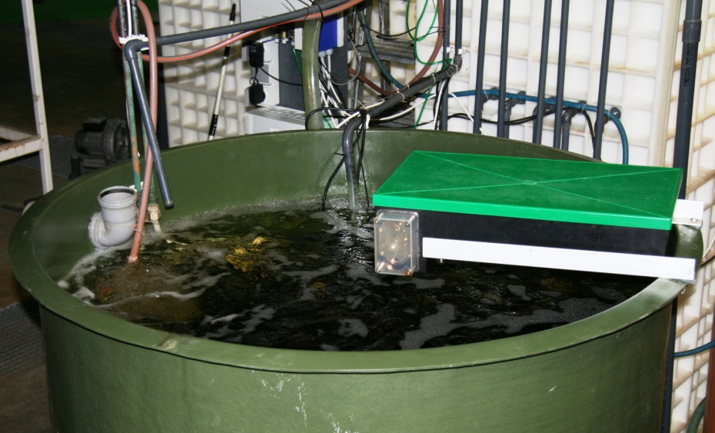
Membrane Bioreactor (MBR)
Water treatment outsourced in bioreactor
with submerged membrane modules
11
Application of Membrane Technology

Slide 20
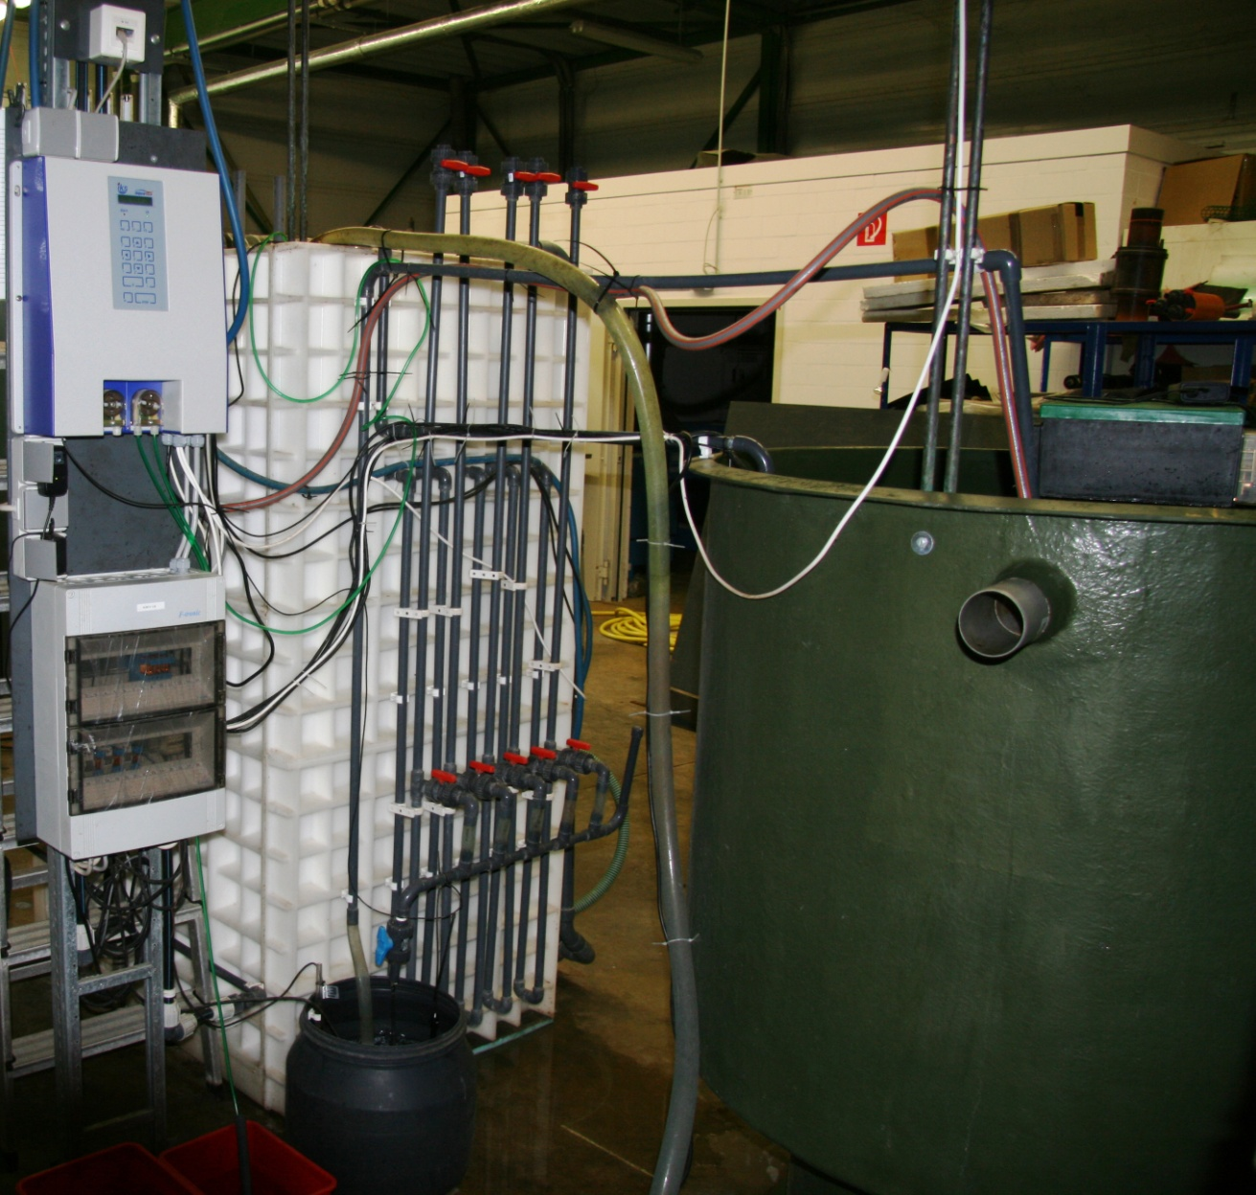
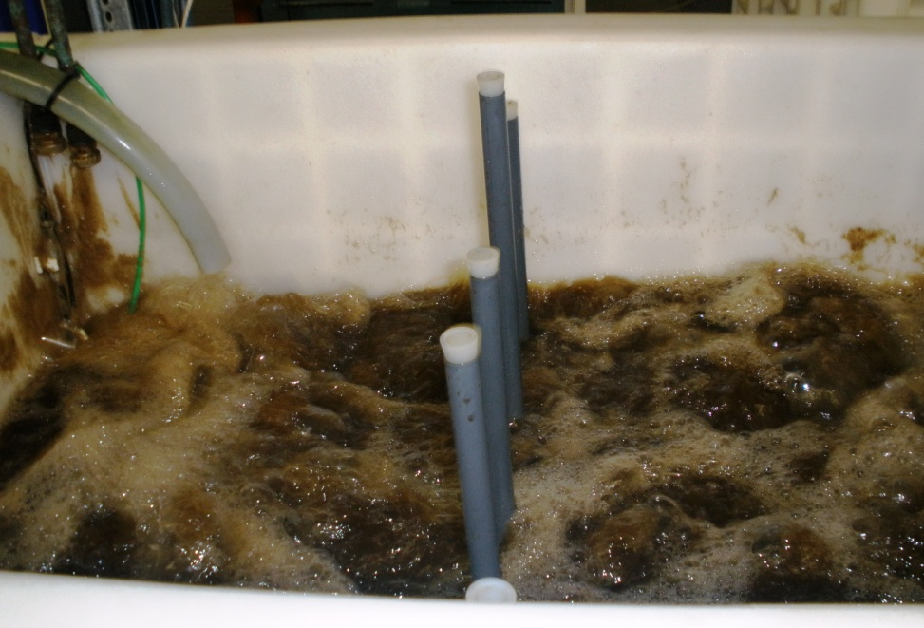
Membrane Bioreactor (MBR) – Experimental Setup
Microfiltration unit (water volume 0.8 m³; membrane area 10…50 m²)
Process control
Fish basin (water volume 1 m³)
View into microfiltration unit (aeration phase)
Application of Membrane Technology
Permeate buffer tank

Slide 21
Membrane Bioreactor (MBR) – (First) Results
Stable process established under fresh water and salt water conditions
Biomass (bacteria) content
  In fish basin: < 0.005 g/l (clear water, no turbidity measurable)
  In MBR: 8…10 g/l (stable values for constant ammonia removal)
Optimum stocking density (for Tilapia): 60…80 kg/m³ (maximum values up to approx. 110 kg/m³ possible)
Successful implementation of alternative carbon sources (by-products of food processing industry) – instead of saccharose
Application of Membrane Technology

Slide 22
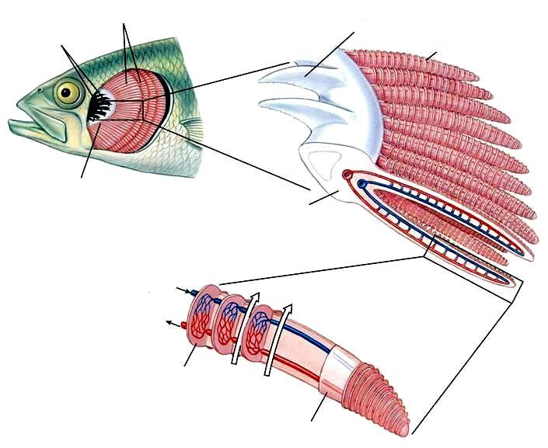
  Hydrodynamic Oxygenation – Breathe…
Average adult human beings (having lungs)…
… take breath 12…15 times a minute (in state of rest)
0.5 l per breath make minimum 276.000 m³ air during a life time (70 years)
  BUT: Only 4 percent decrease of oxygen content…
  Alternative:
  Fish (having gills)…
  use 60…80 percent of
  respirated oxygen
  and
  need approx. 50 % of
  energy for breathing
  (in state of rest)
Gill filaments
Gill rakes
Filaments with lamellas
Gill rakes
Aspects of Gas Exchange and Water Transport
Gill arches
Gill arch
Blood stream
Water stream
Lamella
[Hickman et al., 2008]
Filament

Slide 23
  Hydrodynamic Oxygenation – Oxygen Demand in Aquaculture Facilities (1)
Conditions/parameters determining oxygen demand:
Fish species, stage of development and metabolic activity
  Example: for carps and trout between 0.5 mg/(kg h) and 100 mg/(kg h) for base metabolism and 150 mg/(kg h) up to 470 mg/(kg h) during active periods
Water temperature, stocking density, particulate matter etc.
  Tolerable values of oxygen content: in general between approx. 7.0 mg/l and 30 mg/l
Type of Fish | Critical Value of Oxygen Content
Trout, Perch | < 4 mg/l
Sturgeon, Eel, Catfish | < 3 mg/l
Carp | < 2 mg/l
Aspects of Gas Exchange and Water Transport
[Schäperclaus, 1990], [Schreckenbach, 2002]

Slide 24
Hydrodynamic Oxygenation – Oxygen Demand in Aquaculture Facilities (2)
Consequences of oxygen deficits:
Chronic oxygen deficits:
  Growing depressions, bad general condition
  Susceptibility for infections and diseases
Acute oxygen deficits:
  Unrest, feed refusal, loss of weight, abnormal respiration (oxygen content < 4 mg/l for trout/< 2 mg/l for carps)
  Death caused by energy deficit after failure of adaption mechanisms (oxygen content < 0.5 mg/l for trout/< 1.5 mg/l for carps)
  Oxygen deficits are one of the main reasons for impairment and even total loss of fish stock in aquaculture
Aspects of Gas Exchange and Water Transport
[Schäperclaus, 1990], [Schreckenbach, 2002]
Notes:
Adaption mechanisms:
increase of erythrocyte number and hemoglobin content
swelling of erythrocytes
pH- and electrolyte-shift in blood
„Eine Überschreitung des oberen Grenzbereiches von 35 mg/l Sauerstoff (SCHRECKENBACH et al. 1987) verursacht eine CO₂-Anreicherung im Blut, was zur Ausfällung von Kalzium- und Magnesiumsalzen in der Niere (Nephrokalzinose) führen kann. Bei 40...43 mg O₂/l wird die Überlebensfähigkeit von Karpfen (5 g) eingeschränkt, bei 68 mg O₂/l treten nach 48 Stunden 50 % Verluste auf und bei 72 mg O₂/l zeigt sich
bereits nach 45 min Apathie. Sauerstoffgehalte von 60...65 mg/l (650...700 % Sättigung) haben meist tödliche Wirkungen (TAEGE 1984).“
[Schreckenbach, 2002]

Slide 25
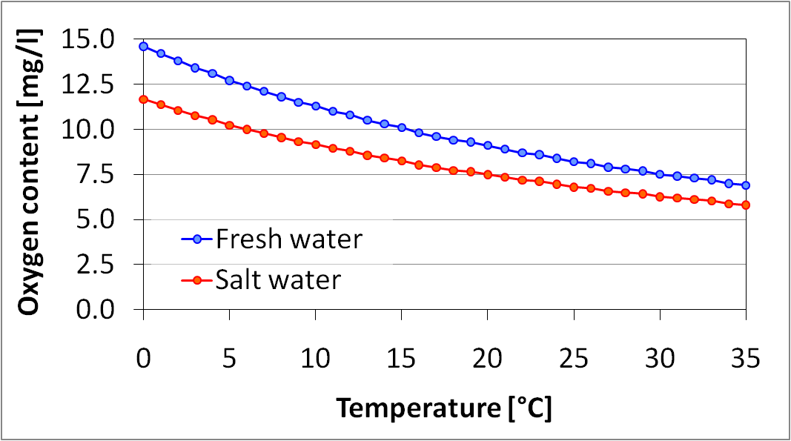
Hydrodynamic Oxygenation – Oxygen Demand in Aquaculture Facilities (3)
Solubility of oxygen depending on water temperature:
Values are applying for fresh and salt water (conductivity 5 S/cm), respectively, in contact to air with standard pressure of (1013.25 hPa = 760 mm Hg)
Aspects of Gas Exchange and Water Transport
[ Lewis, 2006]

Slide 26
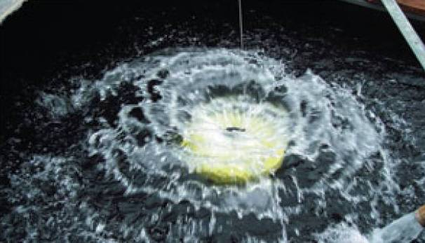
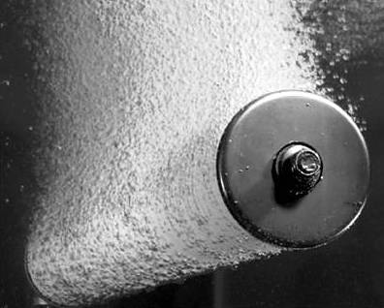
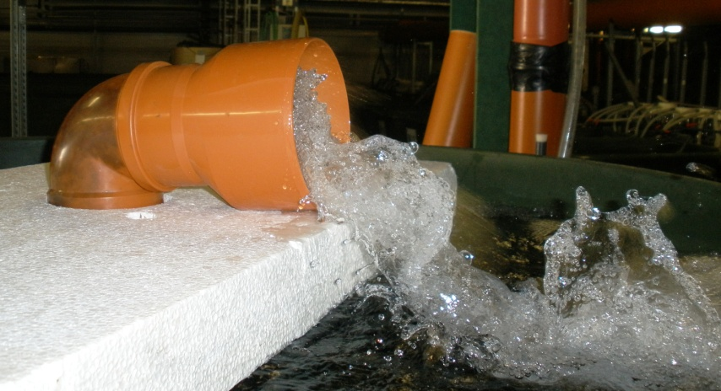
  Hydrodynamic Oxygenation – Common Oxygenation Technologies
Packed Columns
Surface Aerators
Diffusers
Injectors/
Aspirators
Special Methods
Effective and simple
Low energy consumption
Simultaneous CO₂ degasifica-tion
Low oxygen transfer efficiency
Types: paddlewheel, propeller etc.
Increasing contact area between water and air
Cause disturbing turbulences
Gas bubbles introduced using sintered materials or perforated rubber
Efficiency depending on bubble size
Direct introduction of (mainly) pure oxygen or using hydrodynamic effects for mixing water and air/oxygen
Various efficiencies
Downflow bubble contactor
U-tube diffuser
Multi-stage low head oxygenators
Airlifts
…
Aspects of Gas Exchange and Water Transport
[www.alita.com], [www.linn-geraetebau.de]

Slide 27
  Hydrodynamic Oxygenation – Necessity of Further Development?
Many solutions on the market…
BUT: Systems have several disadvantages!
  Limited/low efficiencies of oxygen transfer
  Solutions for large water flow rates (> 10 m³/h)
  Causing disturbing turbulences, problems with fouling…
Claims for a new approach:
Flexible system – especially for small to medium size tanks
Operation in bypass
Robust system (biomass etc.), compact construction
High oxygen transfer efficiency
Low energy consumption
Aspects of Gas Exchange and Water Transport

Slide 28
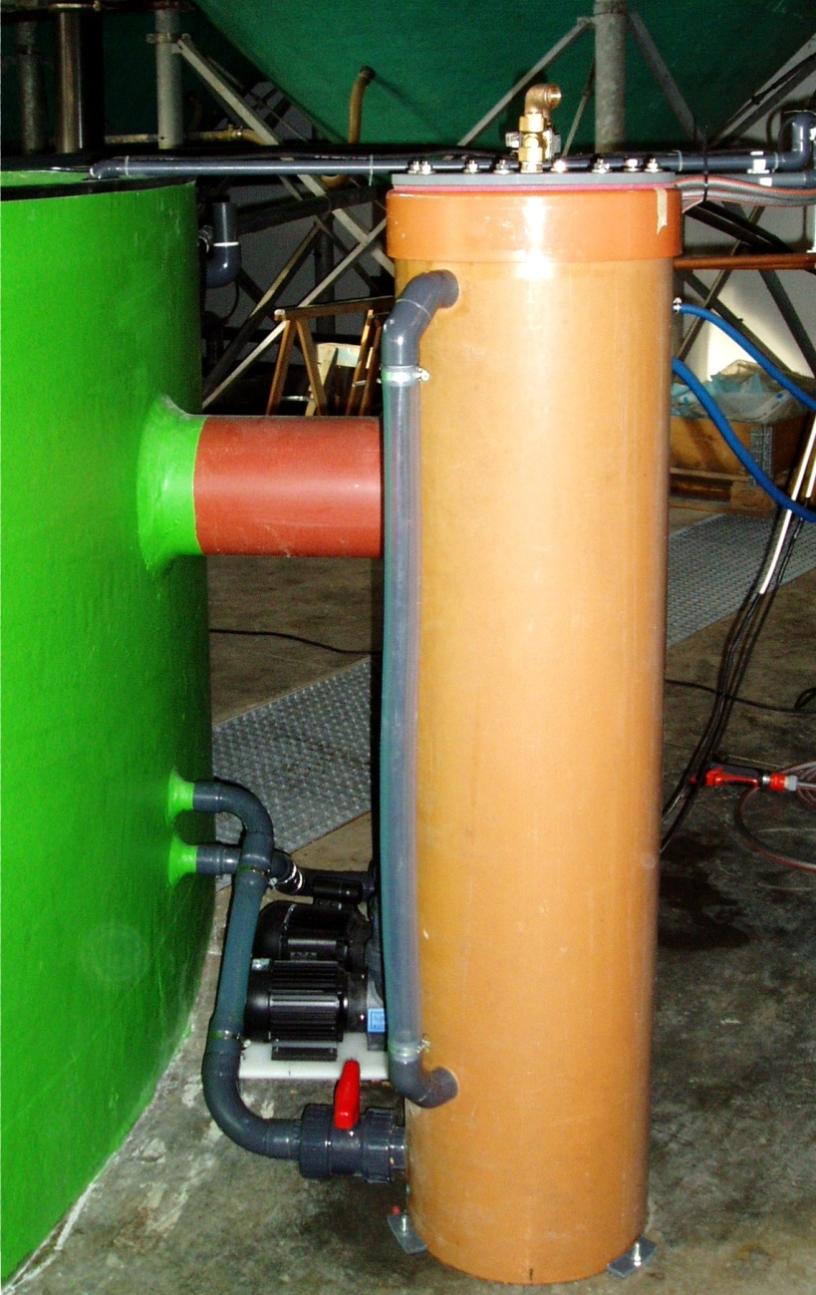
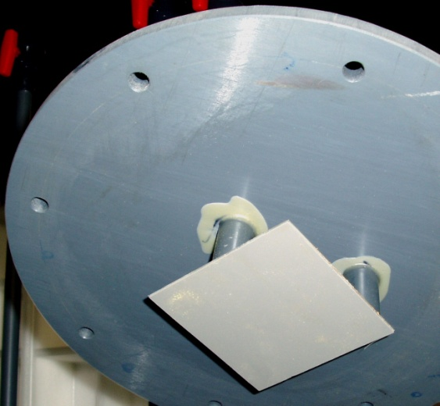
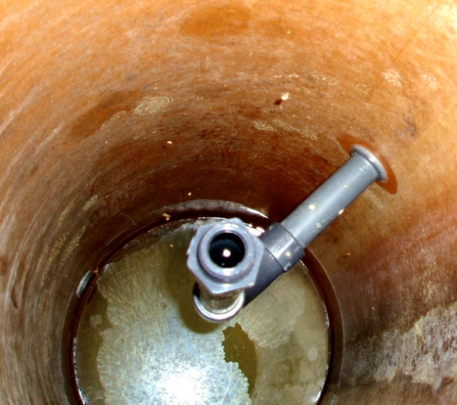
  Hydrodynamic Oxygenation – Functional Principle of Oxygenator
Magnetic valve
Baffle at cover inside
Oxygen supply
Central outlet
Aspects of Gas Exchange and Water Transport
Size: 1.4 m high, diameter 0.3 m
Inlet pump: 500 W
Oxygen flow rate: 8 l/min
Oxygen pressure: 1.2…1.3 bar
Inlet pump
Oxygenator outlet

Slide 29
  Hydrodynamic Oxygenation –Oxygenator Component Optimization
Straight outlet
Variable distance/ inclination of baffles
Aspects of Gas Exchange and Water Transport
Injector (hydrodynamic principle)
Modifications:
Comparison of nozzles and injectors
Variation of type, position etc. of baffles
Adjustment of water flow rate

Slide 30
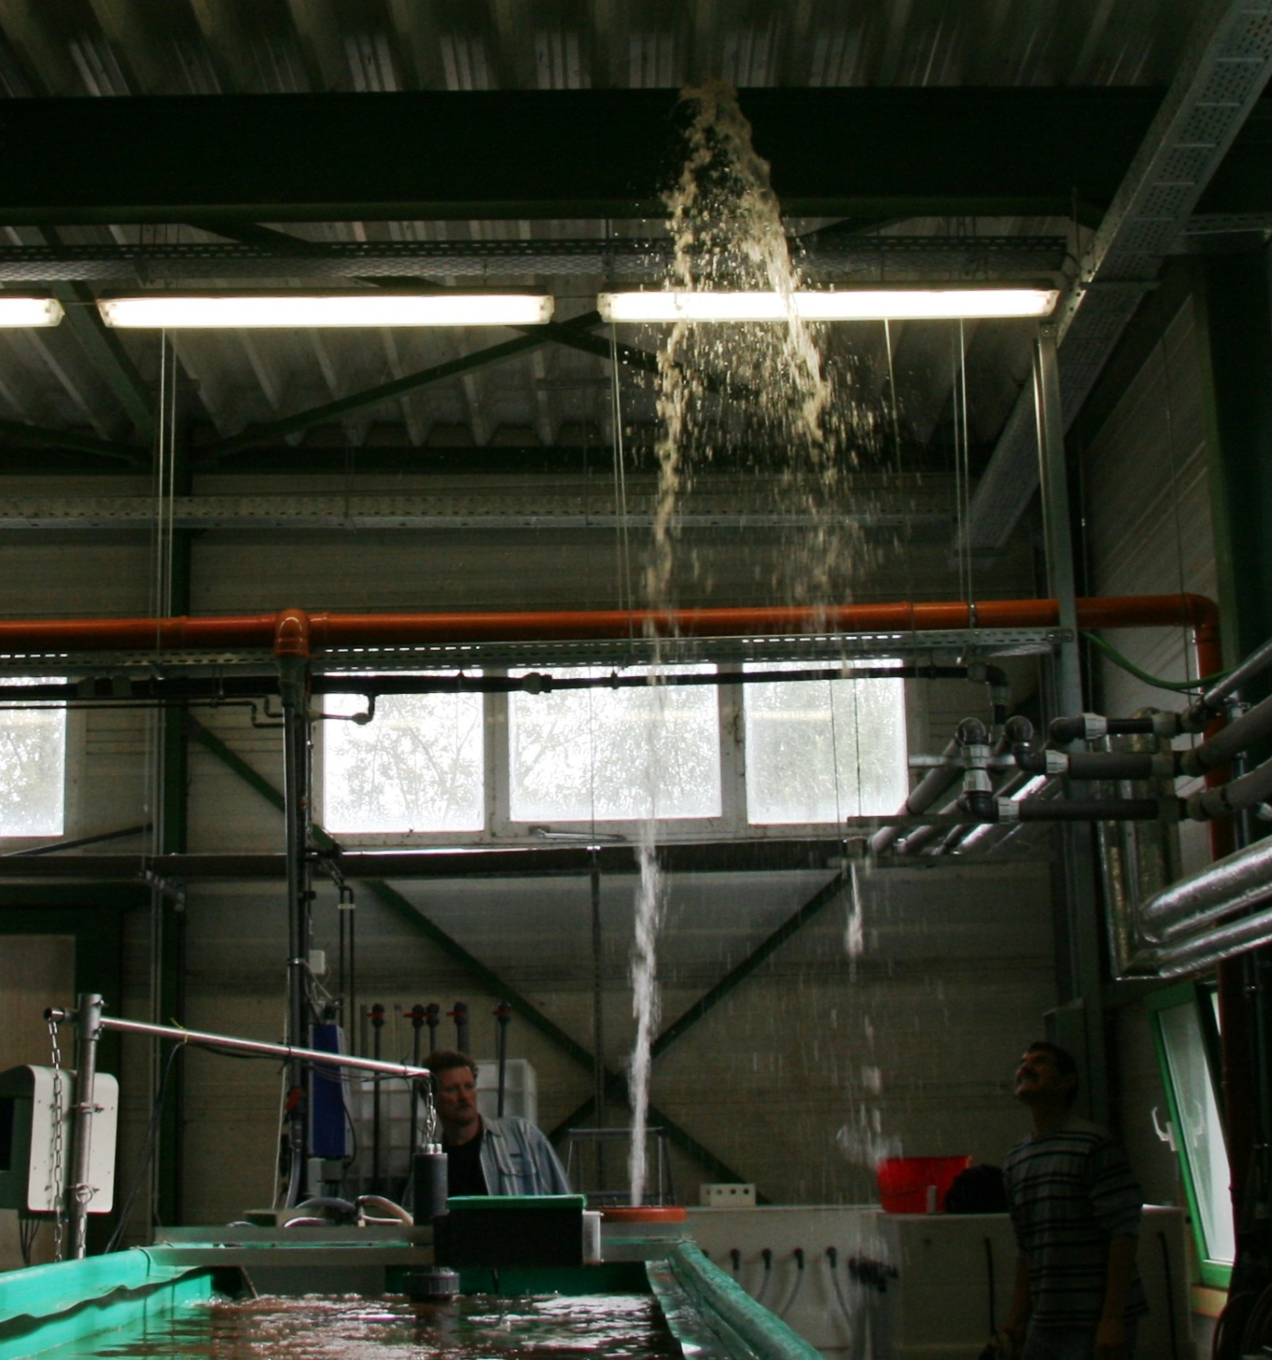
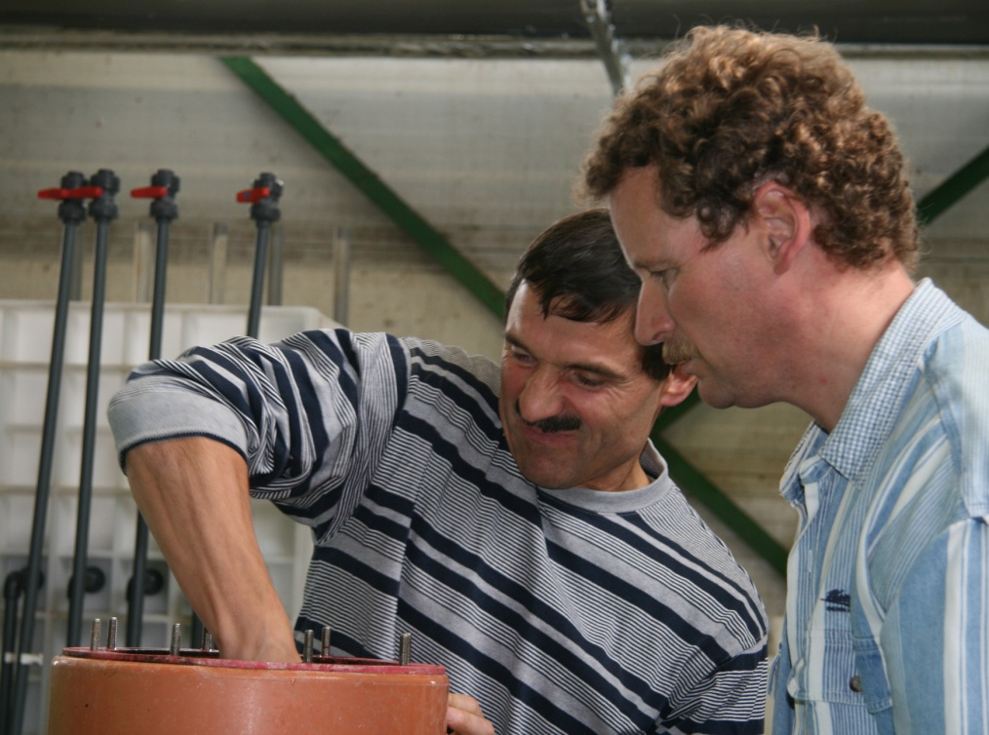
  Hydrodynamic Oxygenation –Impression from Testing
Aspects of Gas Exchange and Water Transport

Slide 31
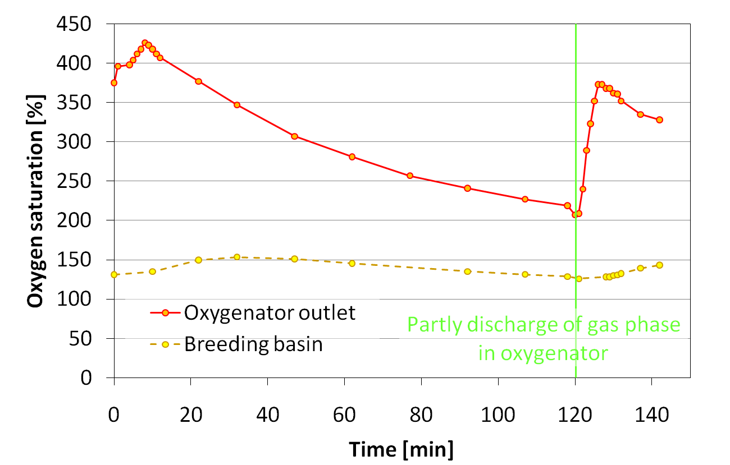
  Hydrodynamic Oxygenation – Test Results
Oxygen flow rate: 8 l/min
Pressure inside oxygenator: 1.3 bar
(raceway basin no. 10; stock approx. 150 kg catfish and carp)
Aspects of Gas Exchange and Water Transport
Notes:
Parameters:
maximum oxygen saturation 425 %
decrease because of enrichment of carbon dioxide in gas phase
water temperature 19 °C

Slide 32




  Hydrodynamic Oxygenation – Measurement and Process Control
Opening/closing of magnetic valves
Oxygen supply (pressurized gas bottle)
Process control
Gas discharge
Water level
Flow rate, pressure drop
Oxygen saturation
Level probe
Inlet pump
Water with low oxygen content
Aspects of Gas Exchange and Water Transport
Oxygen probe
Oxygen enriched water
Breeding basin

Slide 33
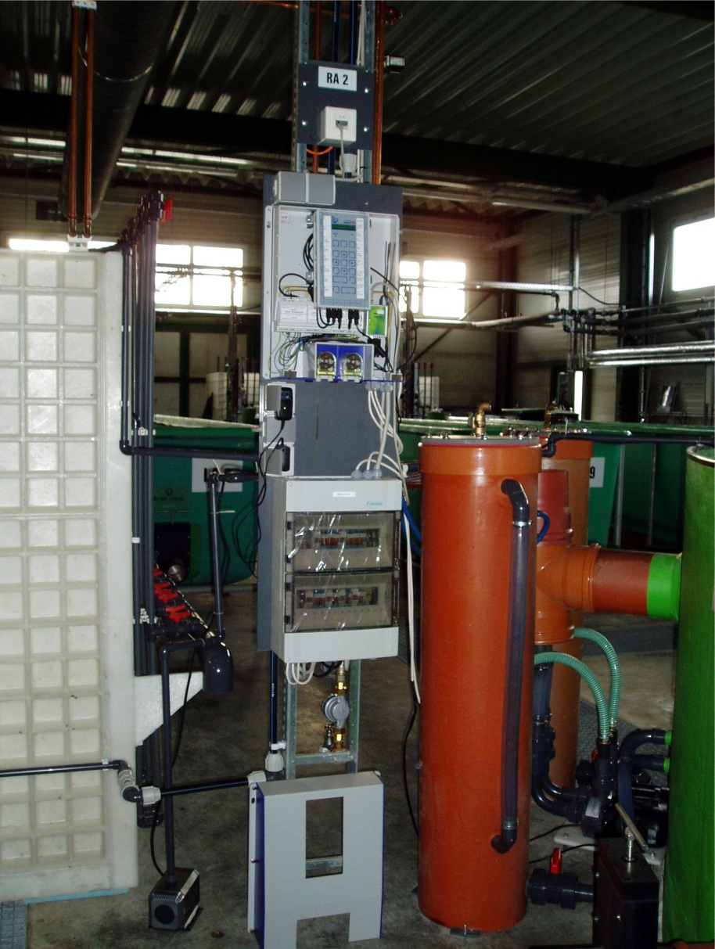
  Hydrodynamic Oxygenation – Summary and Conclusions
Result of work:
Development and successful
application of oxygenator based
on hydrodynamic principle for
application in RASs
Performance Parameters:
Oxygen saturation: average 300 %
(absolute value 26 mg/l at 23 °C)
Oxygen utilization ratio: > 94 %
Water flow rate: 4.0…4.5 m³/h
Energy consumption: < 500 W pumping energy
Aspects of Gas Exchange and Water Transport

Slide 34
  Application of Airlift Pumps – Combination of Process Steps
Introduction of oxygen and water transport/circulation:
Most essential/sensitive and energy consumptive processes in aquaculture plants
Necessity of pumping high water volumes
  Water transport (to and from water treatment units)
  Establishing circulation inside the basins (gas exchange, feed supply, avoiding dead zones for biomass etc.)
  Usually application of conventional mechanical pumps (centrifugal or plunger pumps)
Realization of gas exchange
  Oxygen supply and CO₂ removal
  Many different technologies used…
Combination of both issues: Application of airlifts
Aspects of Gas Exchange and Water Transport

Slide 35
  Application of Airlift Pumps – Principle and Experimental Setup
90° elbow
Air injection
(PVC hose or pipe)
Drain
Pressure gauge
Pontoon element
Buffering tank
Lift pipe
Balance
80.0
Aspects of Gas Exchange and Water Transport
Rotameter
Stabilization elements
Water tank
(nominal volume 1 m³)
Air injection device
(e.g. sintered plastic material with fixing element)
Compressor

Slide 36
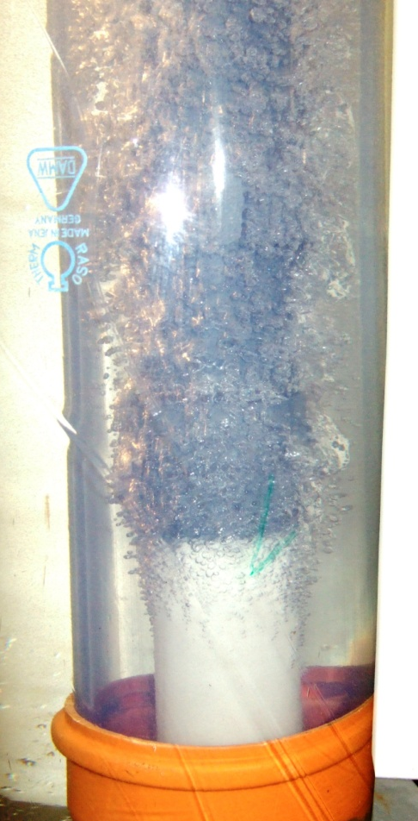
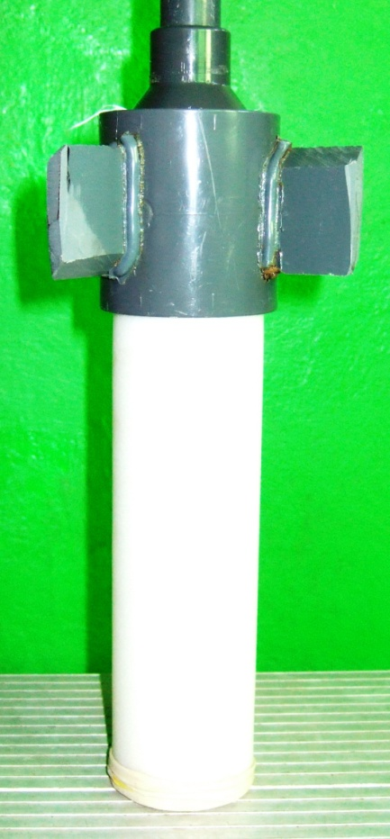
  Application of Airlift Pumps – Air Injection Devices
Objectives:
Maximizing pumping efficiency
(relation of water flow and air injection rate)
Improving oxygen transfer
  Air injection techniques
  characterized by
  generation of fine bubbles
  (lower rising speed;
  high surface/volume ratios)
Aspects of Gas Exchange and Water Transport

Slide 37
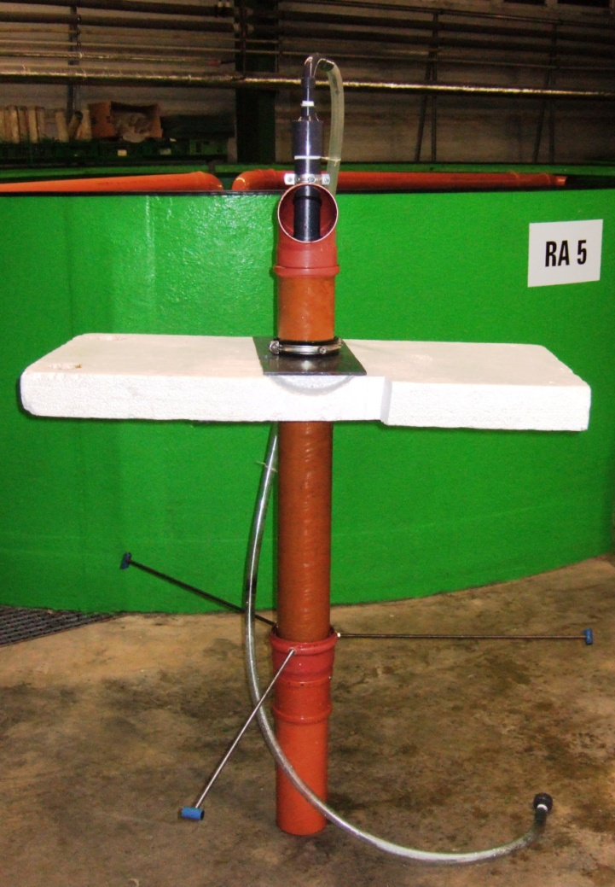
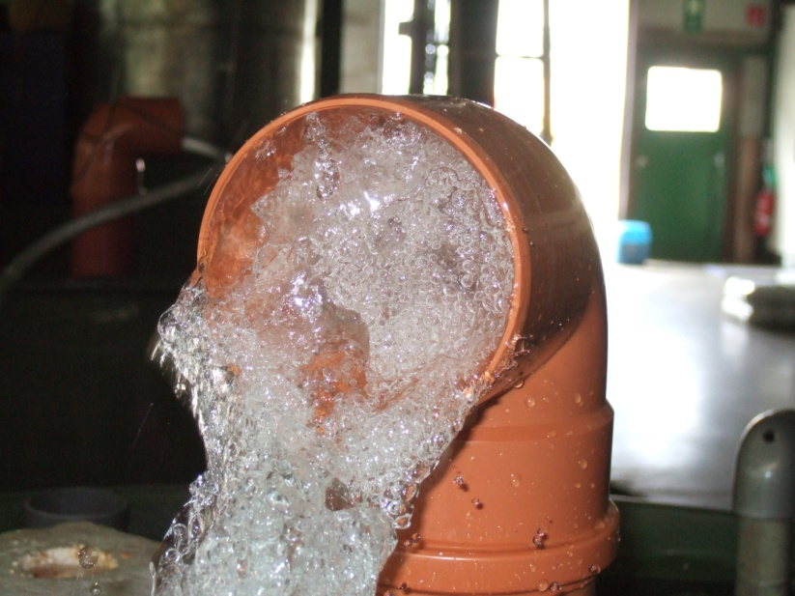
  Application of Airlift Pumps – Parameter Optimization
  Optimization of construction parameters:
Geometrical Parameter | Variation
Lift Pipe Diameter | DN 100 to DN 125 (100...125 mm)
Diameter of Air Injection Pipe | DN 20 to DN 75 (20...75 mm)
Submergence (Depth of Air Injection) | 40...80 cm
Lift Height of Water | 10...30 cm
Form of Water Outlet | 90° elbow, T-pipe
Aspects of Gas Exchange and Water Transport

Slide 38
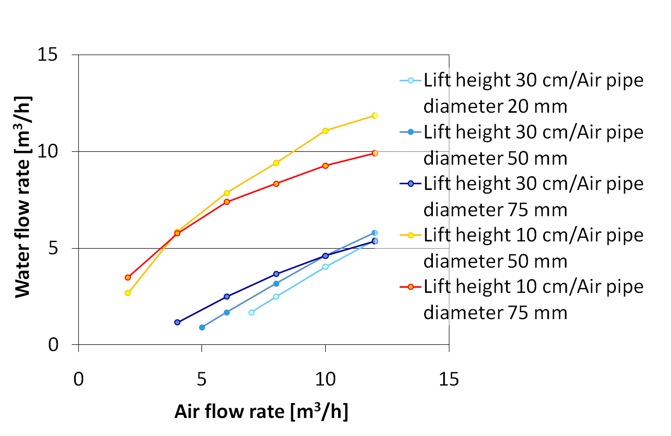
Application of Airlift Pumps – (First) Results
Lift pipe diameter: 100 mm
Depth of air injection: 80 cm
(central air pipe in lift pipe, diffuser made of sintered plastics)
Aspects of Gas Exchange and Water Transport

Slide 39
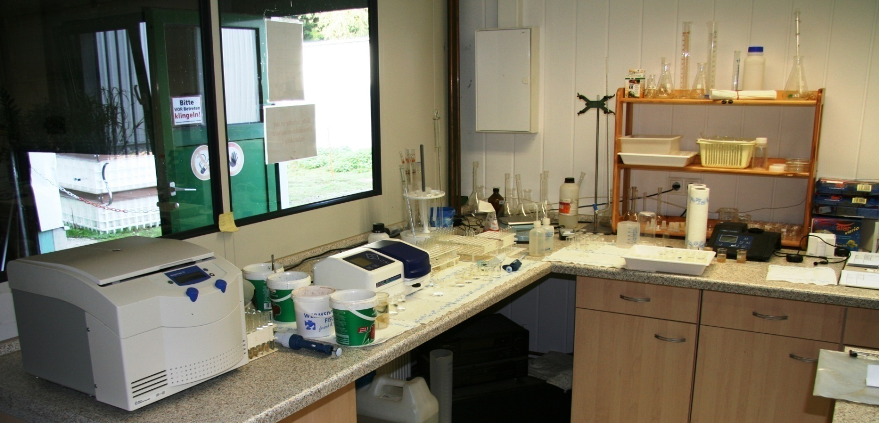
Plant Automation – Monitoring of Water Quality (Laboratory Tests)
Parameter | Measuring Method | Measuring Interval
Ammonium Concentration | Standard photochemical tests (Merck Spectroquant)/ Jenway model 6310 spectrophotometer | < 1 day
Nitrite Concentration |  | 1…2 days
Nitrate Concentration |  | 1…2 days
Phosphate Concentration |  | Weekly/on demand
Iron Concentration |  | On demand
Turbidity | WTW Turb 550 | Weekly/on demand
Dry Mass Content | Denver Instrument IR-35 Moisture Analyzer | Weekly/on demand
Further Ideas and Project Approaches
Aim: Minimize extend of (time consuming/expensive) manual measurements

Slide 40
Plant Automation – Monitoring of Water Quality (Process Measurement)
Parameters measured/registered off-line:
pH-value
Conductivity
Flow rates/water exchange rates
(basins, air/oxygen supply, water cleaning equipment)
Concentration of dissolved CO₂
Several control mechanisms
(e.g. addition of buffering substances, adjusting of degasification, cleaning of filters and membranes)
Further Ideas and Project Approaches

Slide 41
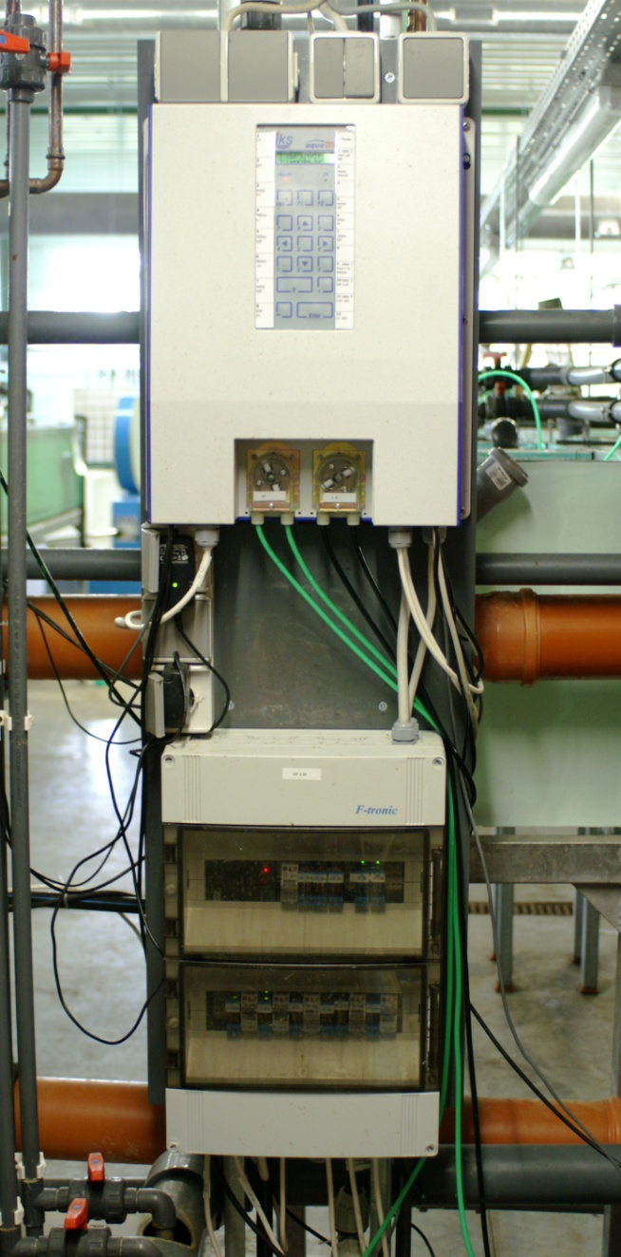
Plant Automation – Optimization of Control and Automation Strategies
Parameters measured/controlled on-line:
Oxygen saturation (Clark probes)
Adjusting of air pressure
(bubble aerators)/flow rate
(„oxygen reactor“)
Temperature (thermal elements)
Control of heating
Rising level of automation:
PLC-control units for each water circuit
Central data processing and storage
On-line alarm systems
Further Ideas and Project Approaches

Slide 42
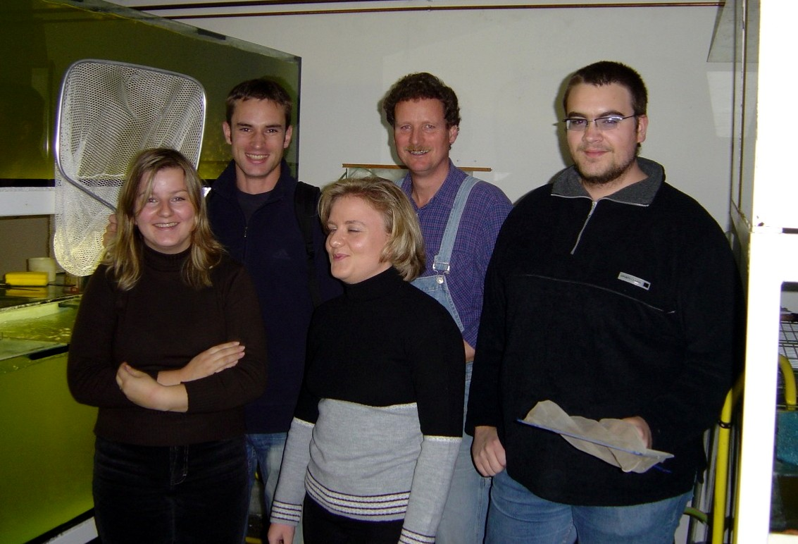
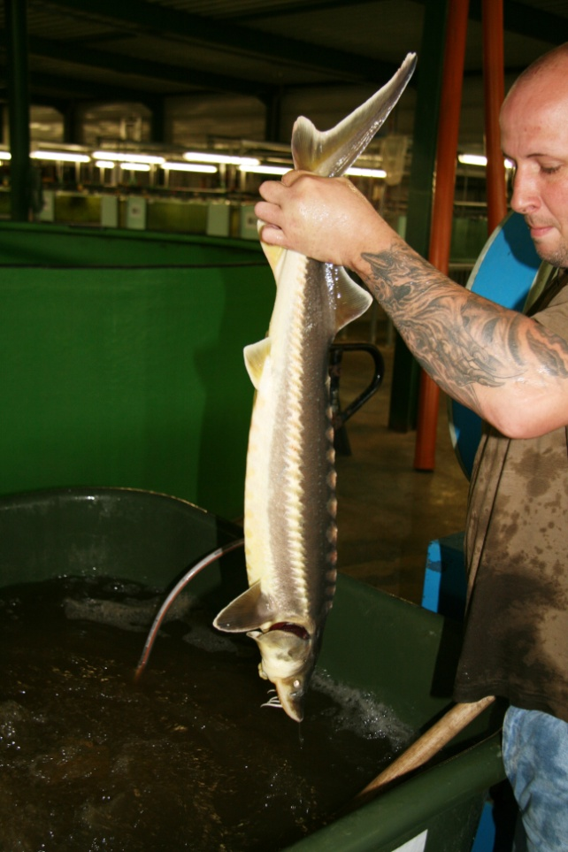
Give a man a fish, and he'll eat
for a day.
Teach him how to fish and he'll
eat forever.
Chinese Proverb
… teach him how to breed fish …
Thank you for your attention!
Thanks for Attention

Slide 43
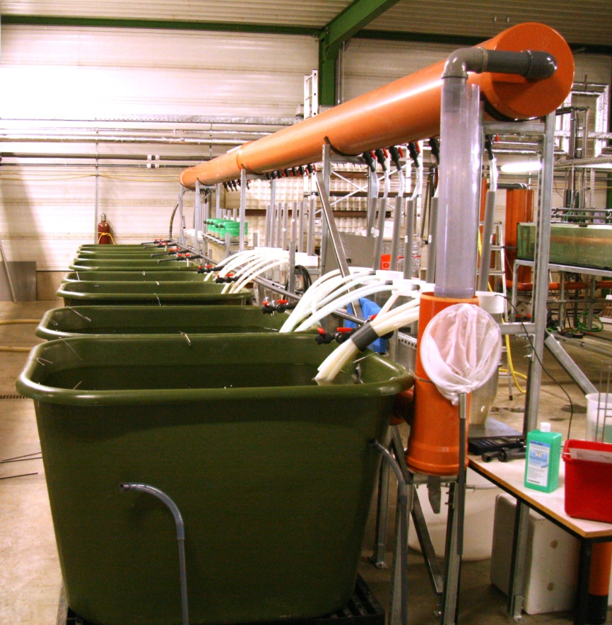
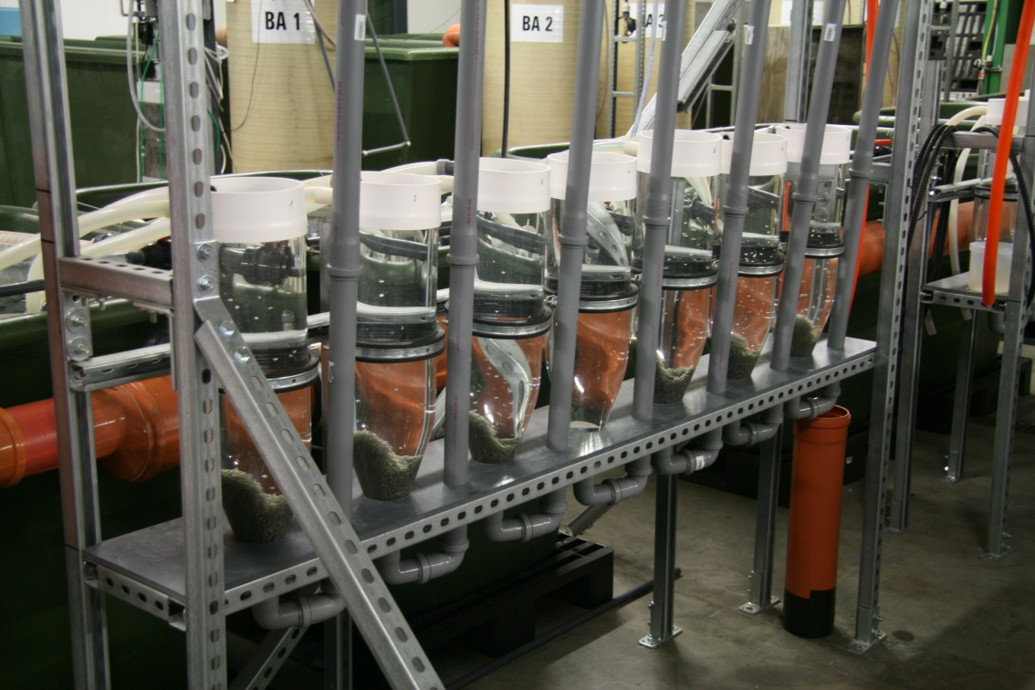
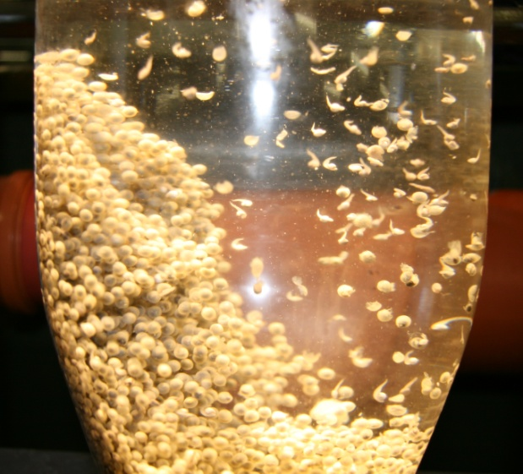
Hatchery
Hatch of eggs and fry
4 assemblies with 6 Zuger glass jars each and 8 incubating basins
6 hatching trays
Water cleaning: mechanical filtration using filter mats, nitrification in packed bed filters
Plant Design – General Aspects

Slide 44


Breeding Basins
Rearing of fry to the size of fingerlings
6 plants (12 basins each) with separate water circuit
Water volume: ca. 0.5 m³/basin
Basin size: 0.5 m x 2.2 m
Depth: 0.5 m, water level 0.45 m
Water cleaning: mechanical filtration using filter mats; nitrification in packed bed
filters
Oxygen introduced using air
stones/membrane aerators
Optional microfiltration
module (membrane area
50 m²) at 4 plants
Plant Design – General Aspects

Slide 45


Raceway Basins
Growing of fingerlings to the size
of seedlings
10 basins with separate water circuit
Water volume: 5 m³
Width: average 1.15 m
Length: 5.8 m
Depth: from 0.75 m (intake)
to 0.5 m (drain)
Area of microfiltration
membranes: ca. 50 m²
Oxygenation carried out
in „oxygen reactor“
Integrated heating and water transport using airlift pump
Plant Design – General Aspects

Slide 46


Round Basins
Growing of seedlings
6 basins with separate
water circuit
Water volume: ca. 20 m³
Diameter: 6 m
Depth: 1.3 m,
0.9 m water level
Area of microfiltration
membranes: ca. 100 m²
Oxygenation carried out
using 2 „oxygen reactors“
Optional heating
(external heater coil)
2 airlift pumps (centre)
generating circular flow
Plant Design – General Aspects

