Slide 1
mHealth and wearable devices
Theory and practice
Martin Úbl
2025

Slide 2
Table of contents
Introduction, context, diabetes treatment
DIY vs. certified approach
mHealth and device requirements
Wearable devices and data collection
SmartCGMS

Slide 3
Introduction and context
Diabetes
Type 1, 2 and others
We focus on Type 1 Diabetes
Autoimmune
Manifests in early childhood
Insulin treatment
Currently requires a substantial amount of wearable electronics
https://diabetes.zcu.cz/

Slide 4
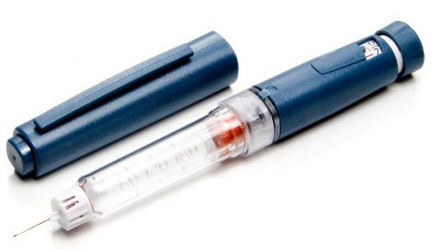
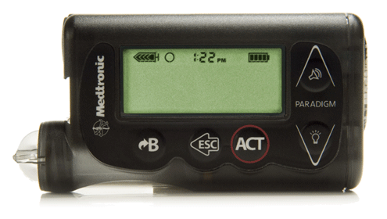
Diabetes treatment
Insulin (Type 1, newly even for type 2)
Insulin pen
Insulin pump
Subcutaneous
Intradermal
Antidiabetic drugs (Type 2)

Slide 5
Insulin dosing
Bolus
Manual
Basal
Manual
Automatic
How?

Slide 6
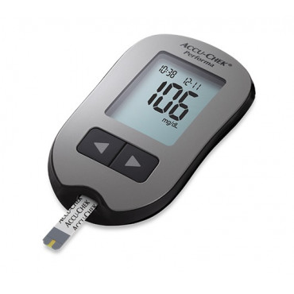
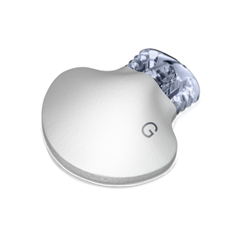
Measurement
Glucose concentration
In blood
Glucometer
Sporadic
Subcutaneously
CGM sensor
„continuous“

Slide 7
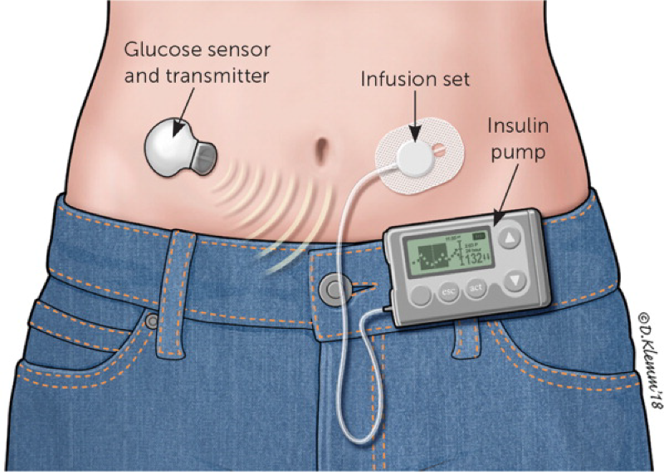
Typical „setup“
Sensor
Insulin pump
Infusion set
Controller (device)
Optional
Resides between the pump and the sensor
Mobile phone, smart watch
Discussion: Lots of wearable devices, how does it influence patient‘s mental state (e.g., in children patients)?
Source: https://diabeteson.com/technical-devices-that-improve-risk-factors-care-and-quality-of-life/

Slide 8

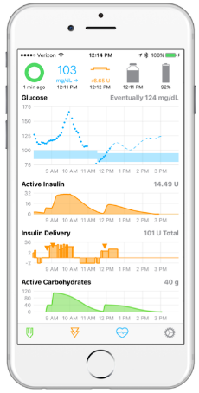
Closed control loop → artificial pancreas

Slide 9
Controller development
Certified
„the correct and safe one“
DIY
„the immediatelly deployed one“

Slide 10
DIY
Last 15-20 years
Patients themselves develop a treatment loop
„Gluing together“ a number of components
Algorithm prototyping
Is not a subject of certification
Risks vs. advantages?

Slide 11
DIY in diabetes treatment
OpenAPS
open-source, JavaScript, Python
oref0 algorithm
AndroidAPS
open-source, Java
Runs the oref0 algorithm (JavaScript)
Loop
iOS variant, Objective-C (later Swift)

Slide 12
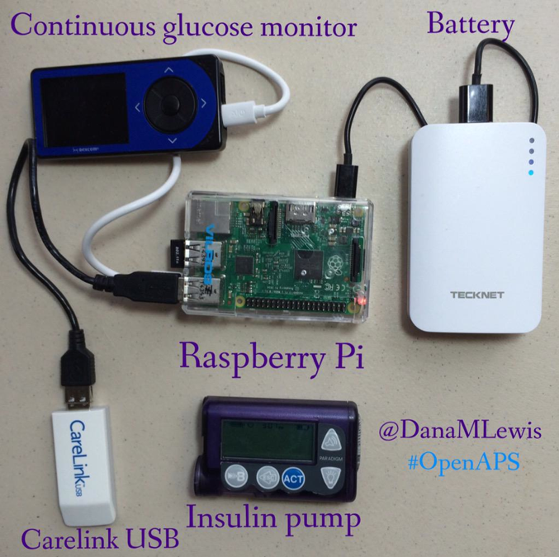
OpenAPS
mHealth?
Wearable electronics?
Safety?
Old, deprecated devices
JavaScript
What if it fails?

Slide 13
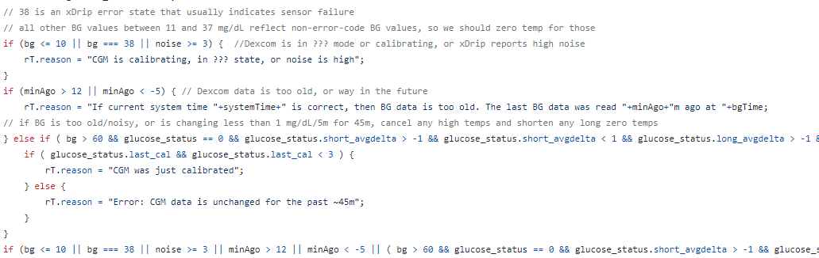


OpenAPS - failure
How do we detect and/or solve a failure?
OpenAPS code does not look like a safe code…
Console logging
No attempt of recovery after failure
…80 lines of code…

Slide 14
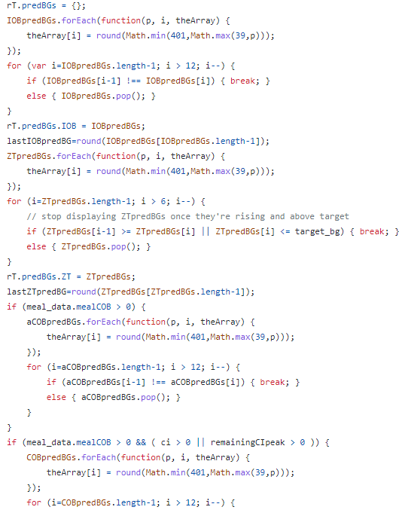
OpenAPS – will not fail?
„OpenAPS cannot fail“
Really?
Statement supported by „tens of thousands of run-time“
We can partially avoid failure by verification
OpenAPS has not been verified
To be verifiable, the code needs to be prepared for it
„spaghetti“ code of appx. 1600 lines of JavaScript certainly does not look like it is prepared

Slide 15
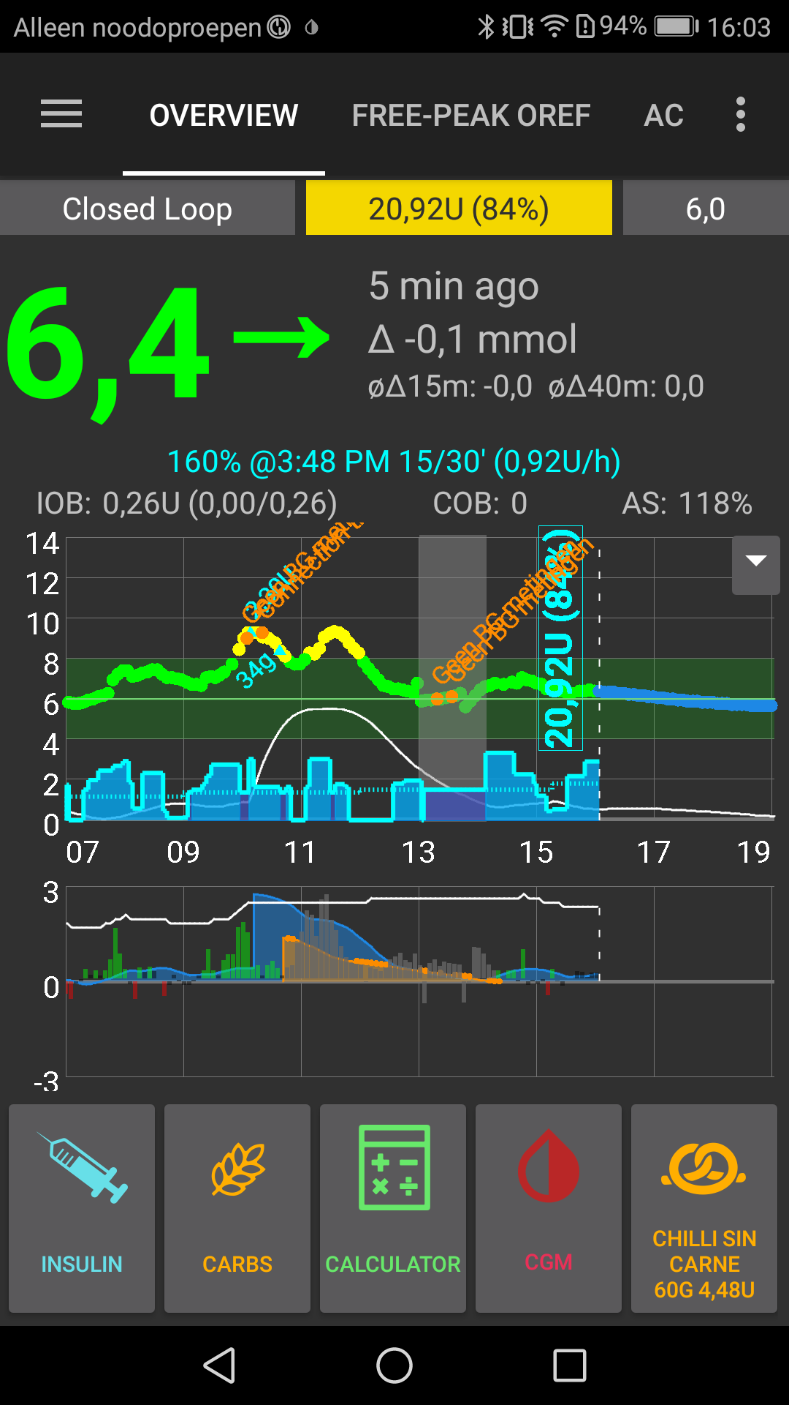
AndroidAPS
Similar situation
Java aplication for Android
Runs JavaScript for insulin dose calculation
Author trusts his own software to a degree, when he set it up in a closed loop mode for his own daughter (10 years old)
The code is in a similar state, as the OpenAPS one
Author himself proclaims, that he is „not a good programmer“

Slide 16
All systems
Wearable electronics
Requires a communication protocol (network)
DIY systems use old, deprecated hardware
A number of exploits in the protocol
Buggy
No warranty
Who is responsible for injuries?
Patient sets it up on his/her own
A physician (diabetologist) tolerates the use, sometimes even encourages it

Slide 17
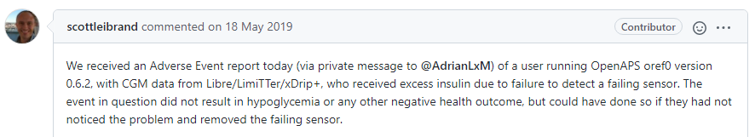
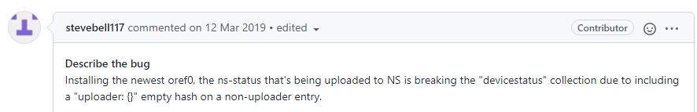
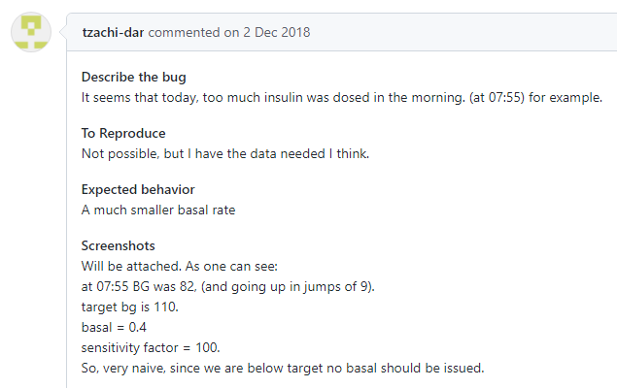
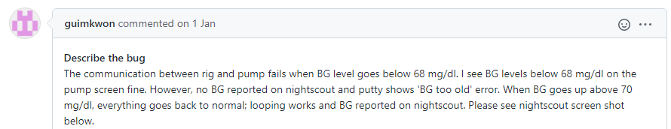
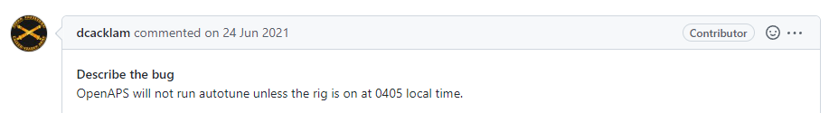
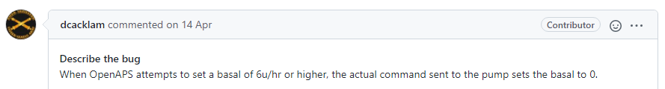
DIY systems fail
Too much insulin due to sensor failure
In fact, pretty often
A selection of recent issues in the OpenAPS repository
Insufficient testing (CI/CD)
Contradictory control rules
Bugs in code due to its unmaintainability
Silent failure of OpenAPS
Weird runtime requirements

Slide 18
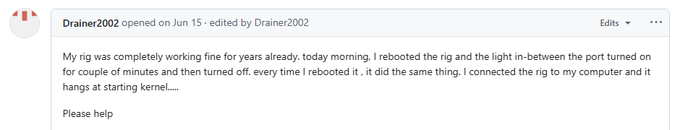
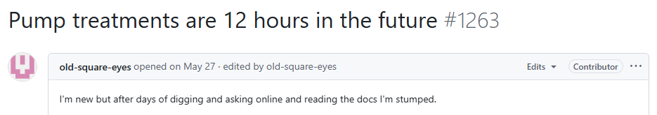
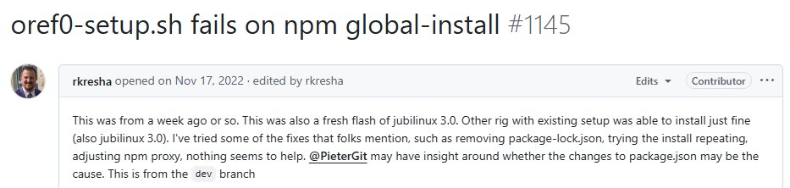
DIY systems fail
Hardware wears out, no continuous diagnostics (self-tests, POST, …)
Authors haven‘t considered timezones (local times) at all!
Used technologies are hard to maintain and prone to dependency-related errors

Slide 19
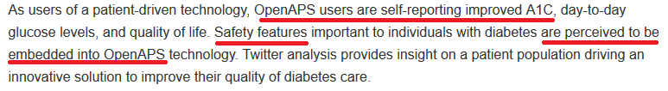

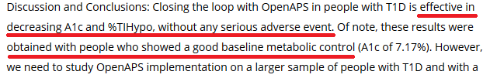

According to what is DIY „safe“?
https://doi.org/10.1177/1932296818795705
https://doi.org/10.1111/dme.13816
https://openaps.org/2016/06/11/real-world-use-of-open-source-artificial-pancreas-systems-poster-presented-at-american-diabetes-association-scientific-sessions/
https://dx.doi.org/10.1177%2F1932296816665635
https://doi.org/10.2337/db18-993-P
https://doi.org/10.1177/1932296815583334

Slide 20
Physicians love DIY
Most physicians only see the results
Results are mostly good
Psychological aspect?
„ends justify the means?“, knowingly ignoring technical imperfections

Slide 21
Requirements for mHealth devices
Algorithms are formally correct
Verification
Thorough testing within precisely bulit scenarios
in-silico (pre-clinical)
in-vivo (clinical)
Fault-tolerance and recovery
Fault-tolerant properties
Verification
Security
Lifecycle
warranty, updates, regular technical maintenance, …

Slide 22
Certification
FDA (USA), EMA (Europe)
Very difficult process
Long
Years of work (paperwork and additional work towards formal requirements)
Expensive
Even tens of millions $
Laborious
Certified devices can guarantee certain degree of safety and correctness

Slide 23
Classification of medical equipment (FDA)
Class I
Minimal to no risk, do not directly affect patient‘s health
E.g., fitness bands, thermometers, … even bandages and similar
Class II
Moderate risks, may affect patient‘s health
E.g., blood pressure meter, insulin pump (open-loop), glucometer, … even scalpels and needles
Class III
High risk, affects patient‘s health, may cause serious injury or even death
E.g., automatic insulin pump (closed-loop), CGM sensor, pacemaker, … even cochlear implant and joint replacement

Slide 24

Equipment approval
Class I
Register your product by the FDA
Some exceptions may include additional paperwork
Class II
Performance and effectivity is evaluated; even on market, they require collecting feedbacks and monitoring (for adverse effects and similar)
Devices must have a unique serial number, patients must be registered
Class III
Must undergo exhaustive testing and verification process
Clinical studies with large number of participants
Intentionally is a long process
If there is a bug in device code or hardware, the longer time, the greater probability of failure

Slide 25
Verification of algorithms and devices
Systematic testing of all possible states and validating responses
Simple example:
Two-parametric controller
Cartesian product of stepped parameter values in some (safe) boundaries
Metric evaluation on a number of scenarios
Attempt to identify „faulty“ combinations
Alternatively, the implementation might be verified formally/mathematically (like the seL4 kernel)
This is rarely possible

Slide 26
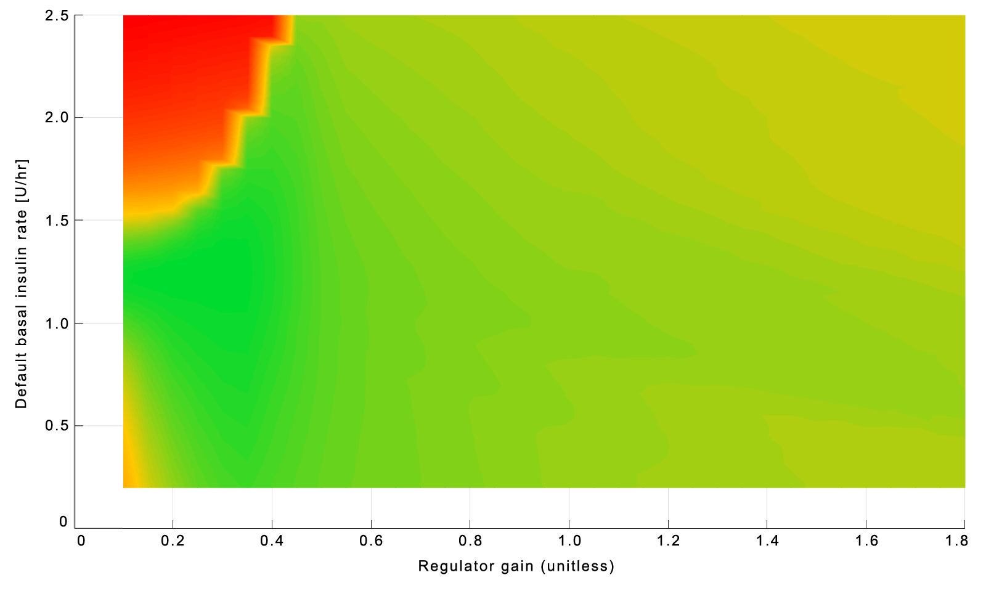
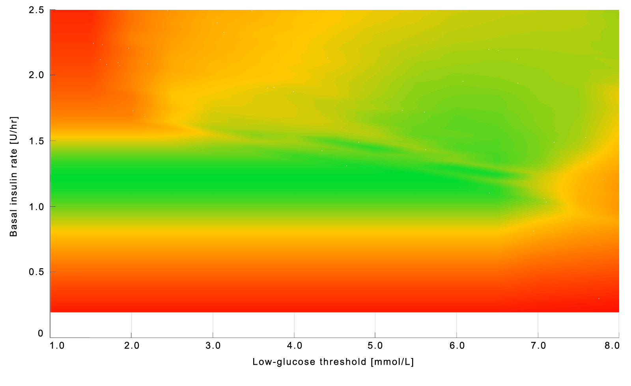
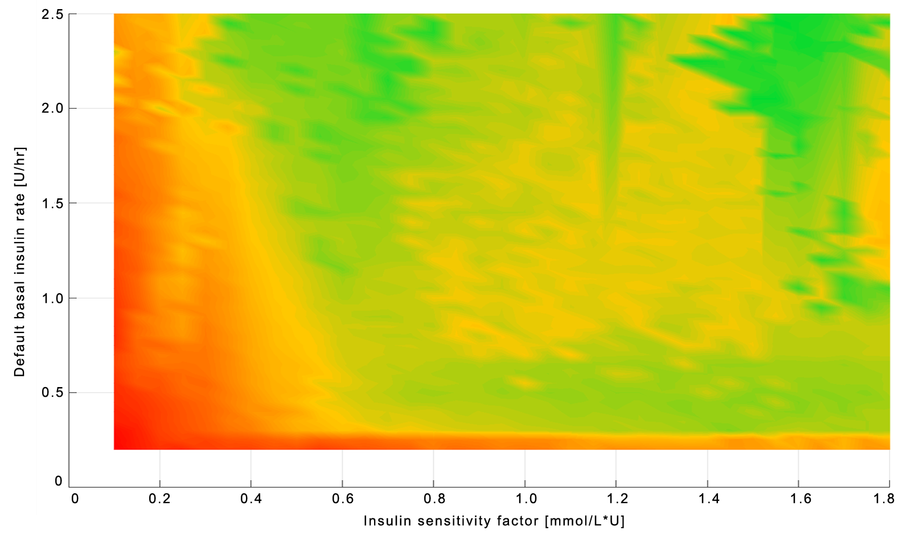
Simple example
BetaPID – adaptive PID controller
3 controllers, all having 2 parameters
Only 2 of them have visible safe regions
Legend:
Red – probably lethal
Yellow – edge case, potentially dangerous
Green – the best the controller can do
LGS – treatments standard, certified
OpenAPS/oref1 – DIY

Slide 27
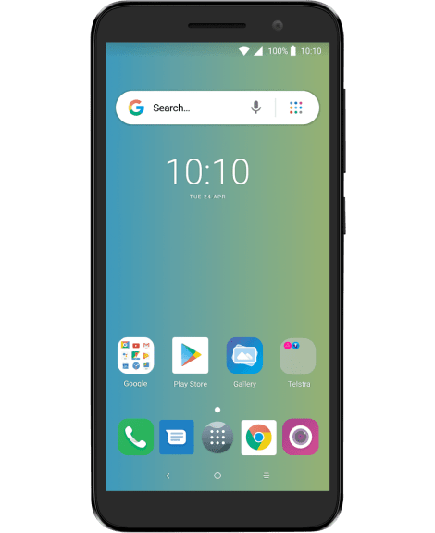
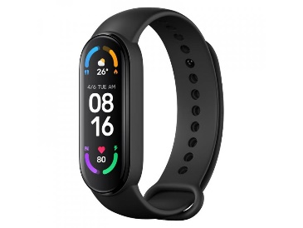
Wearable devices
Mobile phone, smart watch, fitness bands, but also CGM sensorts and more
A lot of sensors
Lots of data
Lots of possibilities
Accelerometer
Magnetometer
Ambient light sensor
GPS
Heartbeat sensor
Electrodermal activity sensor
Blood pressure sensor
Oxymeter
…

Slide 28
Wearable devices - data
Personalized medicine?
Treatment model personalization
Telemedicine?
Physicians always have recent data
A parent always sees recent data of his/her child
Development of new physiological/treatment models?
Datasets for initial cross-validation

Slide 29

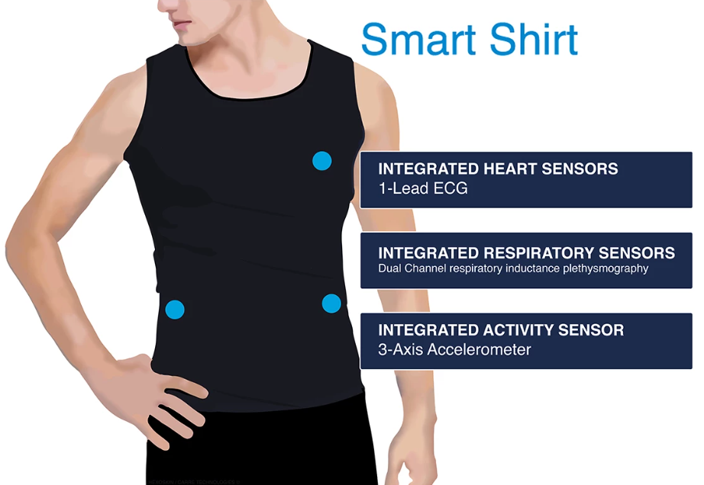
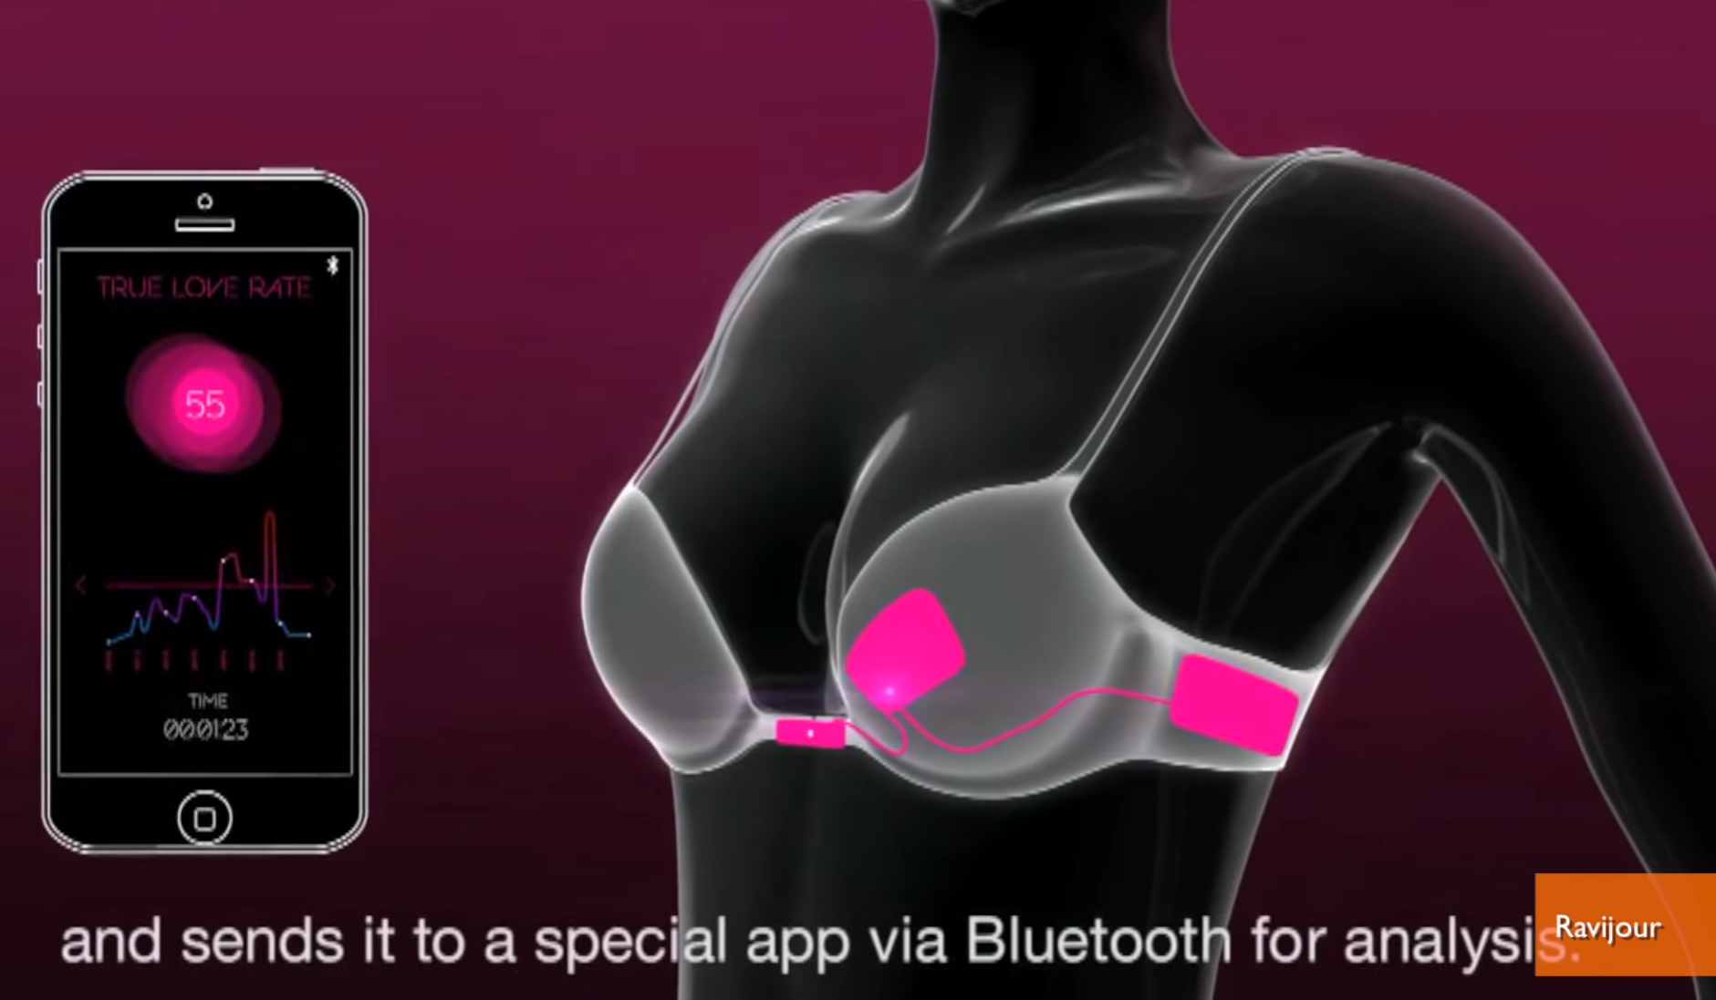
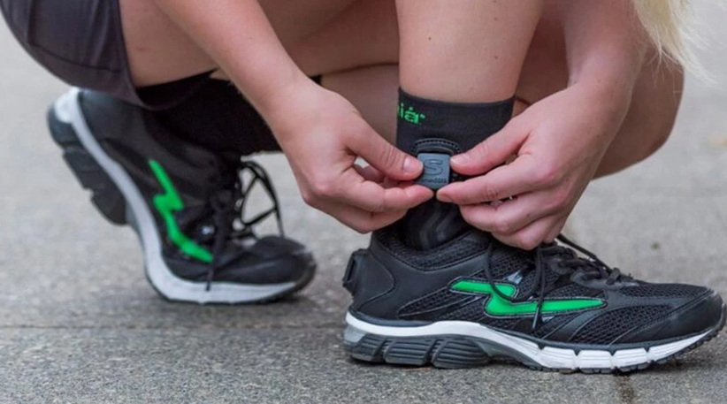
Smart clothes
Not exactly a recent trend
Development of electronics-enhanced clothes
Health monitoring
Work assistance, safety
Cool effects

Slide 30
Wearable devices - data
Problems?

Slide 31

SmartCGMS
Framework designed and implemented on our department
Signal analysis framework and architecture
Built in such a way, that it may reach production qualities
Fault-tolerance
Verifiability
Simplicity
Stability
Multi-platform
Effectivity, low-power
Supports simulations and real-time use

Slide 32
SmartCGMS
Implementation split into modules of various types
Filter
Model
Signal
Solver
Metric
…
Every module can be verified separately
Simplifies the verification process
New module = verification of a single module
It is not necessary to verify the whole system
From simulation to real-world in just a few steps
Matter of a single module swap

Slide 33
SmartCGMS
Linear connection of filters
Message passing („from left to right“)
struct TDevice_Event {
NDevice_Event_Code event_code;
GUID device_id;
GUID signal_id;
double device_time;
int64_t logical_time;
uint64_t segment_id;
union {
double level;
IModel_Parameter_Vector* parameters;
wstr_container* information;
};
};

Slide 34
SmartCGMS
Fulfills a role of the back-end – framework, set of components and SDK
Front-ends
gpredict3 – science and development
SmartCGMS Mobile – patient monitoring
Games - Icarus has Diabetes, DiaAdventure
Pump-Trainer – education of newly diagnosed patients
Web simulator – WASM-based online simulator

Slide 35
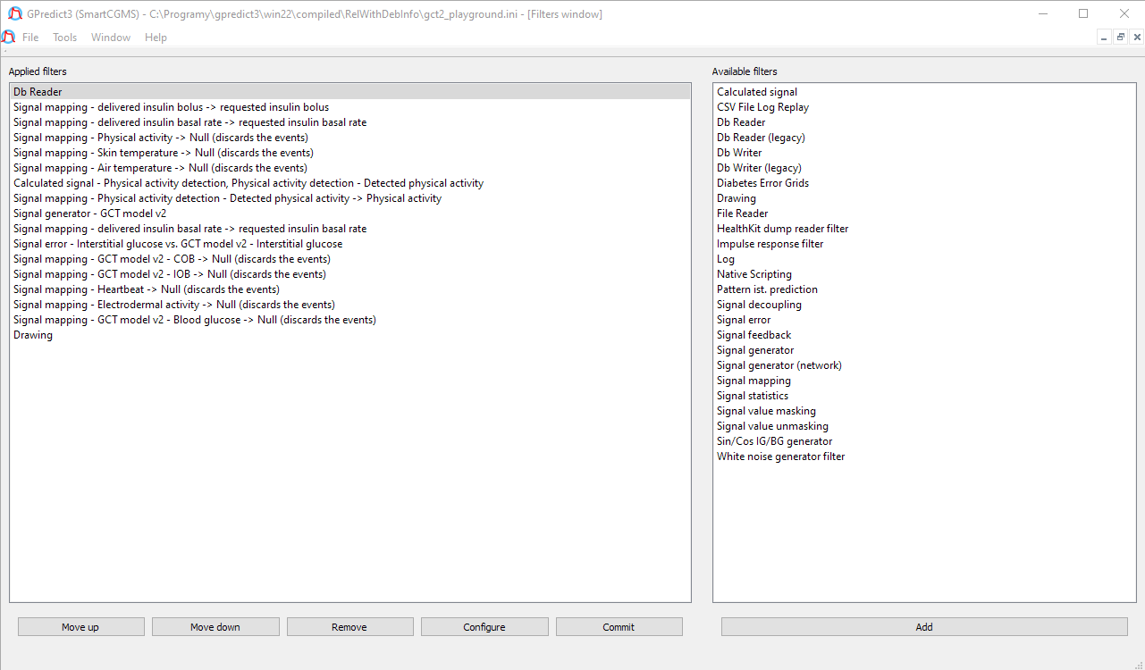
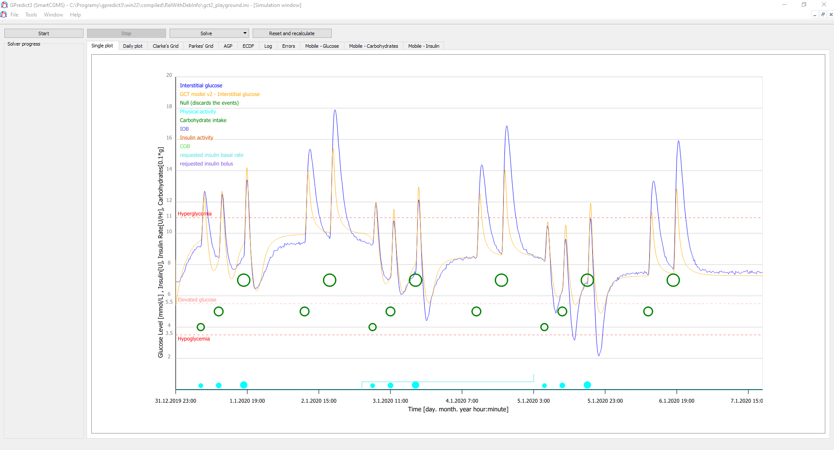
SmartCGMS – gpredict3

Slide 36
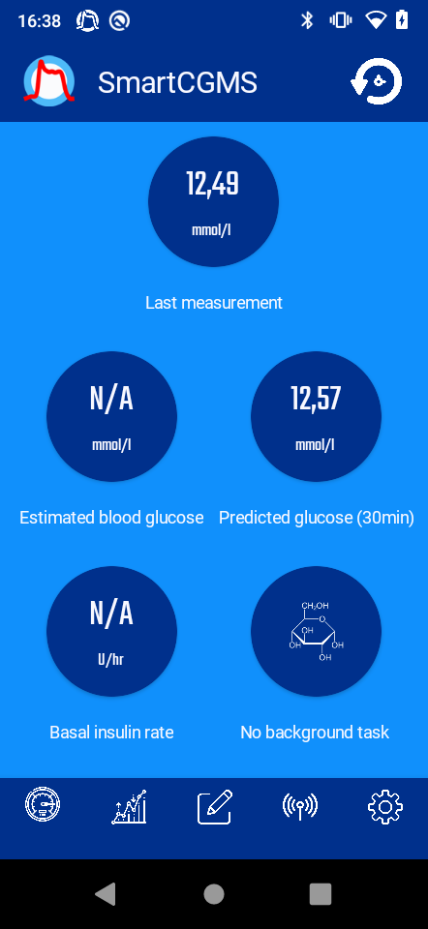
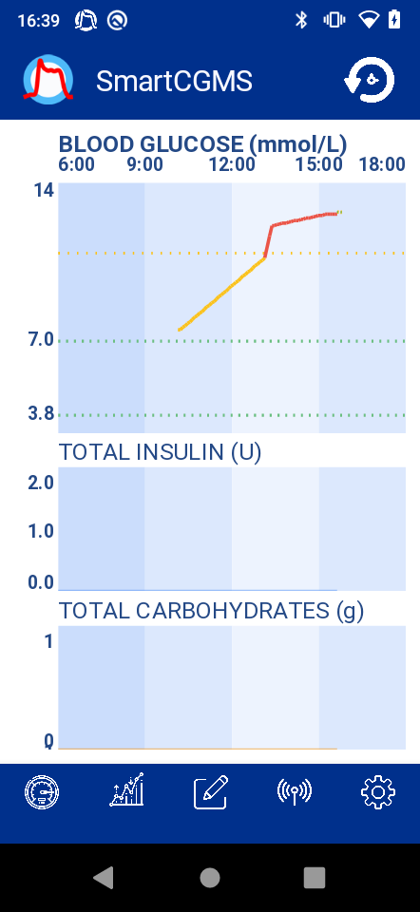
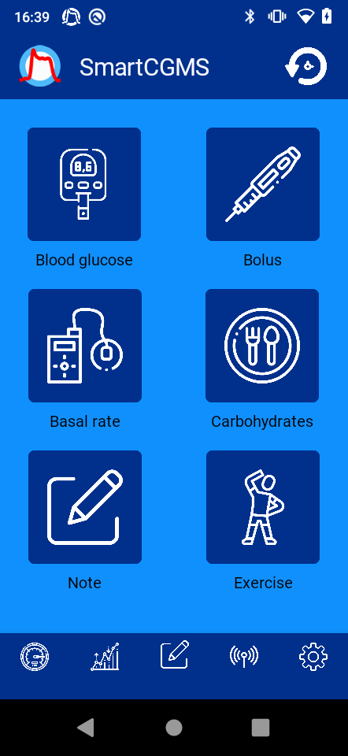
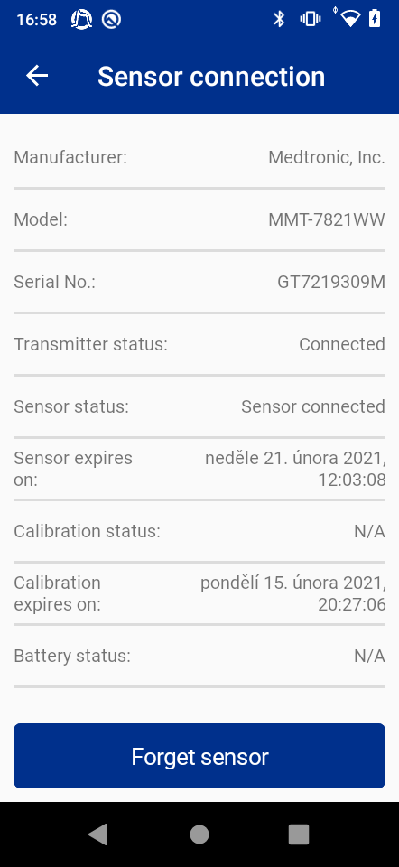
SmartCGMS – Mobile

Slide 37
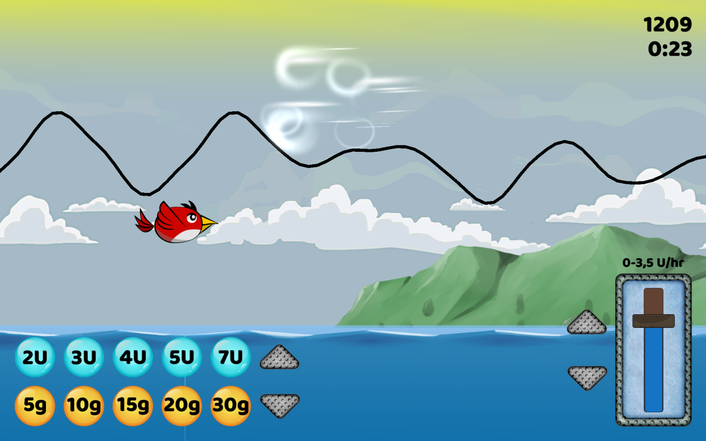
SmartCGMS – Icarus has Diabetes

Slide 38

SmartCGMS – DiaAdventure

Slide 39
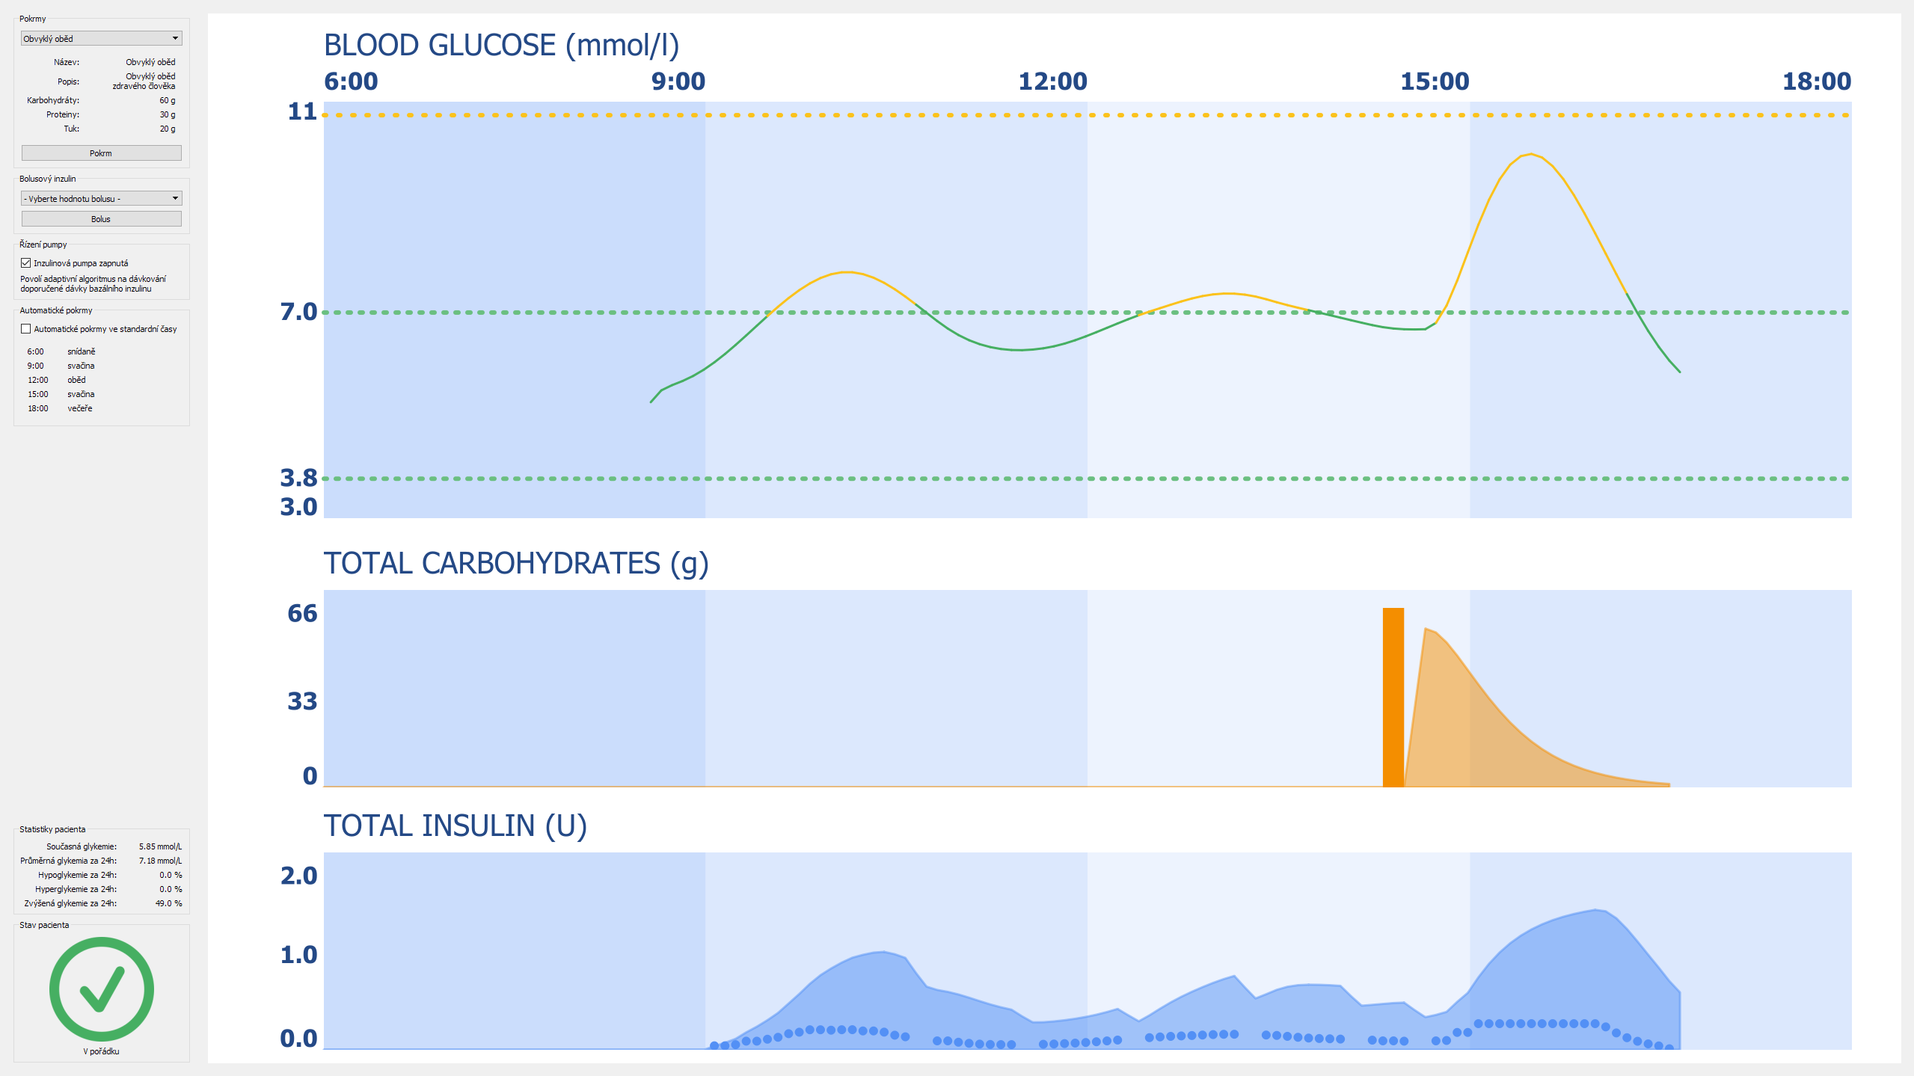
SmartCGMS – Pump-Trainer (old)

Slide 40
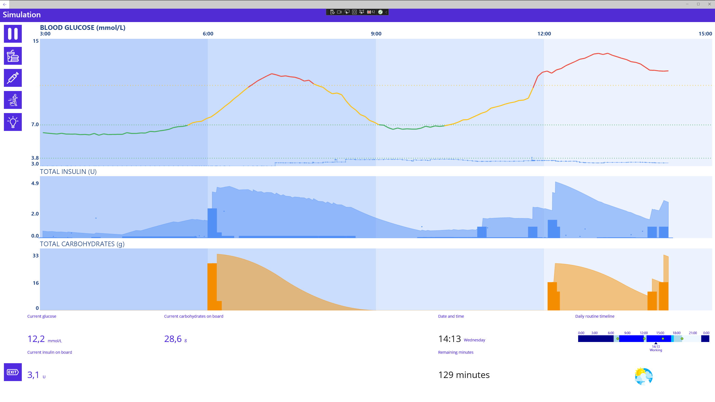
SmartCGMS – Pump-Trainer (new)

Slide 41

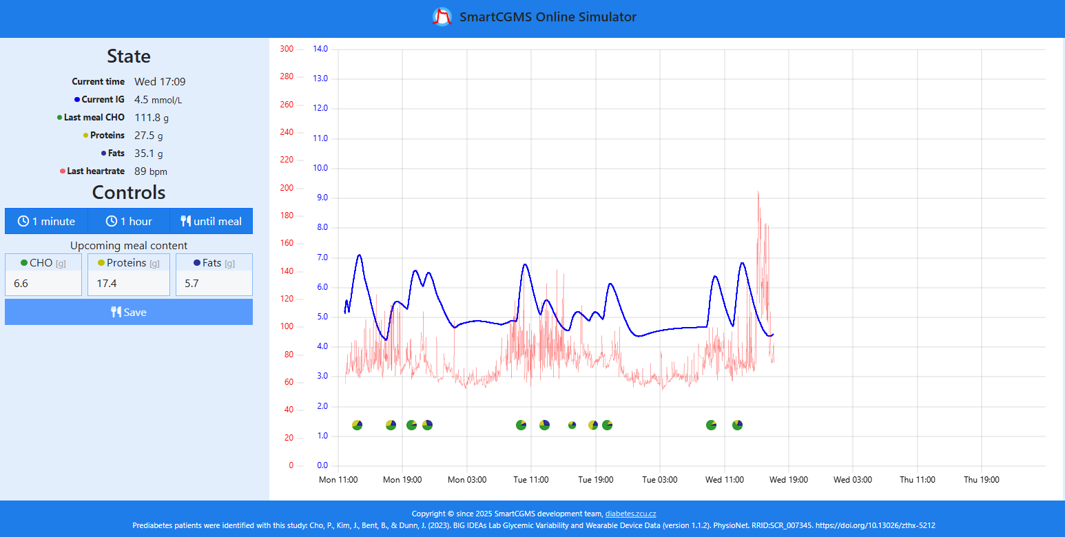
SmartCGMS – Web simulator

Slide 42
Thank you for your attention
Questions, discussion, …
Martin Úbl
ublm@kiv.zcu.cz

