Slide 1
Fluid Mechanics
Prof. Václav Uruba
uruba@fst.zcu.cz
http://home.zcu.cz/~uruba/vyuka/FM/
UWB FME, KKE
Institute of Thermomechanics ASCR, CTU in Prague FME, CU FFM

Slide 2
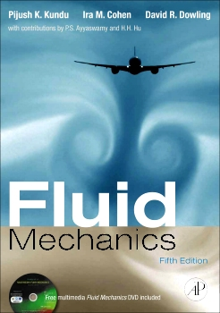




Literature
Linhart, Jiří, Mechanika tekutin I , Plzeň, Západočeská univerzita v Plzni, 2009.
Brdička M; Samek L; Sopko B, Mechanika kontinua, Praha, 2000.
Spurk JH, Aksel N, Fluid Mechanics, Springer 2008.
Durst F., Fluid Mechanics - An Introduction to Theory of Fluid Flows, Springer 2008.
Douglas JF, Fluid Mechanics, Pearson, 2005
Kundu PK, Cohen IM, Dowling DD, Fluid Mechanics, Elsevier, 2011
Cengel Y, Cimbala J, Fluid Mechanics Fundamentals and Applications, McGraw-Hill, 2013.
F. White, Fluid Mechanics, McGraw-Hill, 2010.
Munson BR, Okiishi TH, Huebsch WW and Rothmayer AP, Fluid Mechanics, 7 Edition SI Version, Wiley, 2013.
…

Slide 3

Multimedia
Multimedia Fluid Mechanics DVD-ROM
2nd Edition
EDITOR: G. M. Homsy
G. M. Homsy, H. Aref, K. S, Breuer, John W. M. Bush, Christophe Clanet, Marc Fermigier, Simone Hochgreb, J. R. Koseff, B. R. Munson, K. G. Powell, David Quere, J. J. Riley, C. R. Robertson, A. J. Smits, S. T. Thoroddsen, J. M. Wallace
DATE PUBLISHED: April 2008

Slide 4
Fluid Mechanics - lectures
Introduction, concepts, definitions
Statics
Kinematics
Dynamics
Bernoulli equation
Shear regions
External flows
Internal flows
Flow machines
Turbulence
Compressible flows and acoustics
Physical modelling
Mathematical modelling

Slide 5
Fluid Mechanics - lectures
Introduction, concepts, definitions
Statics
Kinematics
Dynamics
Bernoulli equation
Shear regions
External flows
Internal flows
Flow machines
Turbulence
Compressible flows and acoustics
Physical modelling
Mathematical modelling

Slide 6
Introduction, concepts, definitions
  Fluid mechanics (definitions, applications)
  Methods in FM (analytical, experimental, CFD)
  Properties of fluids (liquids, gases)
  Fluid particle (molecule, material)
  Hypothesis on continuity
  Earth atmosphere
  Viscosity, Newtonian and non-Newtonian fluids
  No-slip condition
  Reynolds number
  Physical quantities (density, viscosity, thermal expansivity, compressibility, velocity of sound)
  Ideal liquid, gas

Slide 7
Fluid mechanics
Physics
Mechanics
Mechanics of fluids
Mechanics of bodies
Fluid Dynamics
Thermodynamics
Statics
Electricity and magnetisms
...
Elasticity
Gas Dynamics
Quantum mechanics
Optics

Slide 8


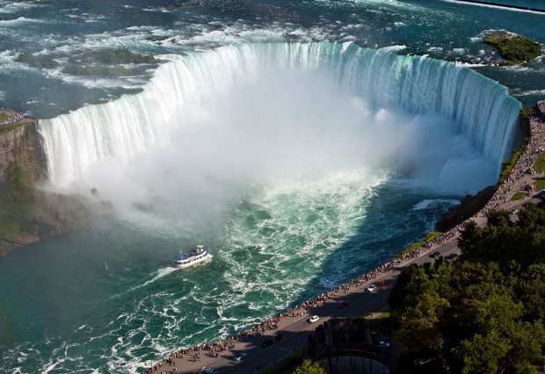

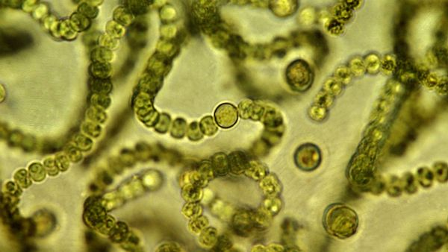

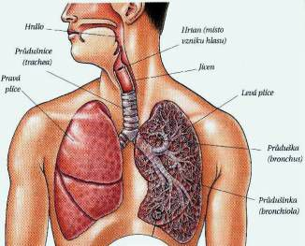
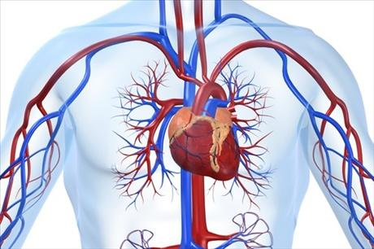
Fluid mechanics
Nature
  Environment
  Fauna, flora
  Human body

Slide 9
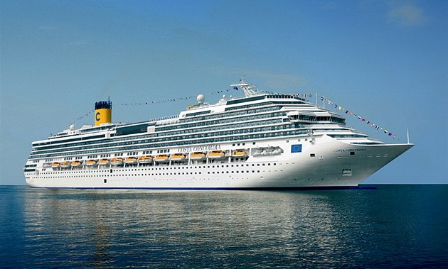


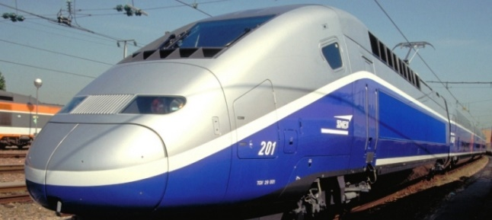
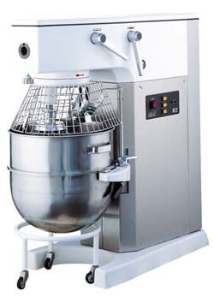
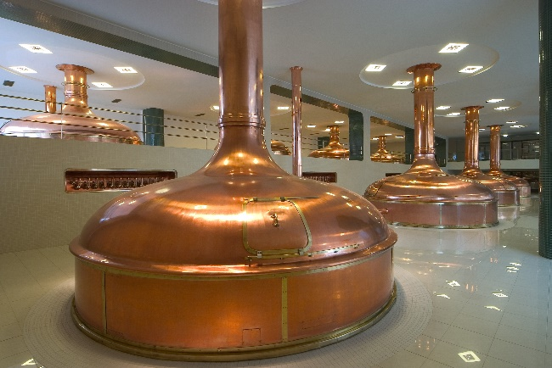
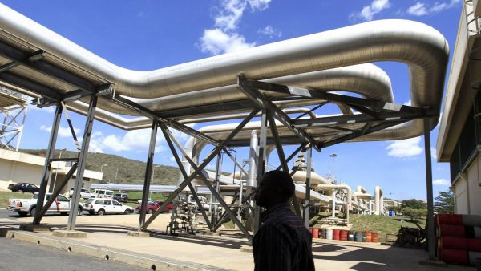
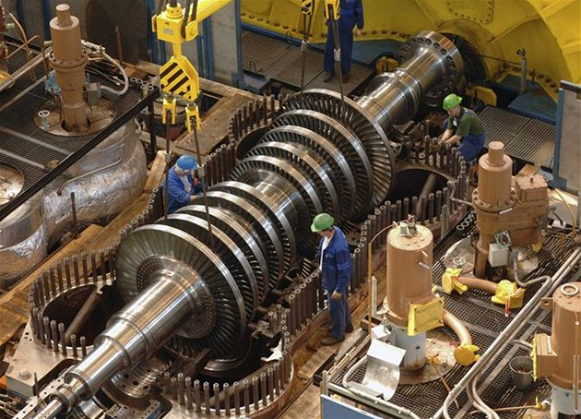
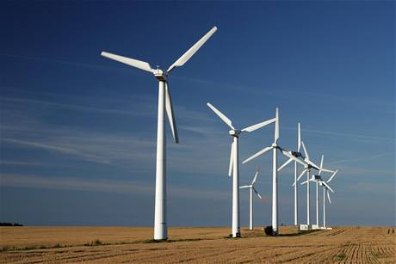
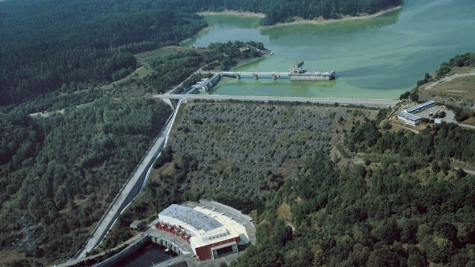

Fluid mechanics
Industry
  Transport
  Processing industry
  Energetics

Slide 10
Methods i fluid mechanics
Experiments in situ
Physical modelling – experiments
    Basic research
    Validation of computations
    Quantification
Mathematical modelling
  Analytical methods
    Statics: OK
    Dynamics
      Unrealistic simplification
      Problem understanding
      Qualitative estimate
  Statistical methods – kinetic theory of gases
    Physical nature
  Graphical methods, analogies
      Unrealistic simplification
      Qualitative estimate
  Mathematical simulations CFD
    Standard method in engineering
STATICS
DYNAMICS
Computer Fluid Dynamics

Slide 11
Fluid
Substance
Phase of matter
  Solid
  Liquid
  Gas
  Plasma
Consists of particles – molecules
Interaction between particles
  Collisions – elastic spheres
  Cohesion forces – attractive
FLUID

Slide 12
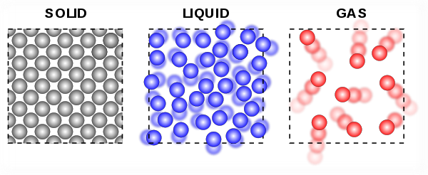
Molecular forces
 | Cohesion forces | Thermal amplitude | Molecules motion | Statistics
Solids | Strong | << d₀ | Ordered | quantum
Liquids | Intermediate | ≈ d₀ | Partly ordered | Quantum + classic
Gases | Weak | >> d₀ | Random | Classic

Slide 13
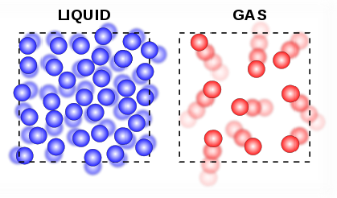
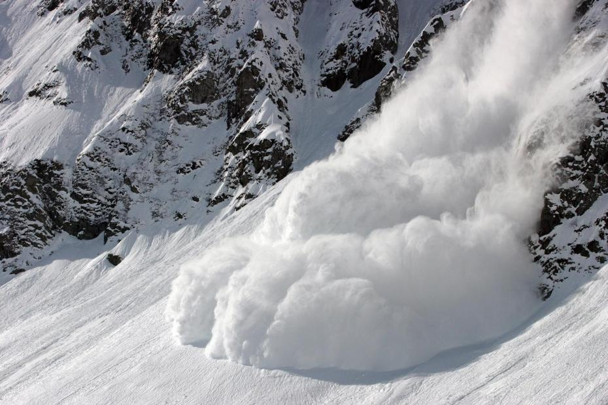

Fluid
Liquid
Gas
Particles in interaction

Slide 14
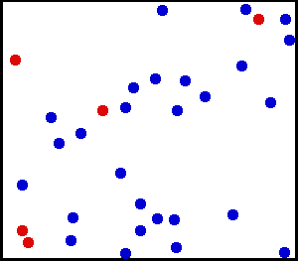

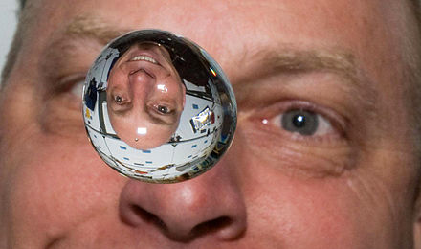
Molecular interactions
Collisions (gas)
Cohesion (liquids)
d₀
Intermo-lecular forces
d
expulsion
d
d₀
attraction
Compare:
Adhesion

Slide 15
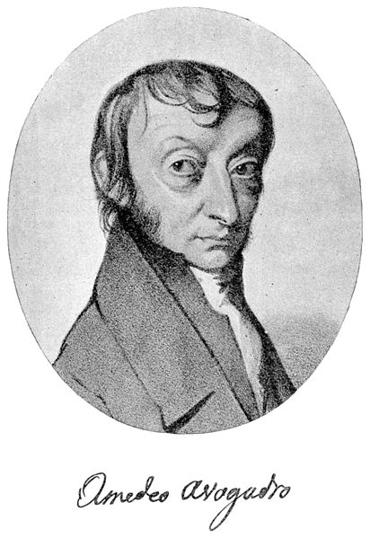
Molecular structure
Avogadro constant
No. of molecules in 1 mol
1 mol of ideal gas:
  24.465 L/mol for 25 °C, 1 bar
N_{A} = 6.022x10²³ = 2⁷⁹
2.5x10²⁵ n/1m³, 2.5x10⁷ n/1μm³
„fluid materiál particle“
1776-1856

Slide 16
Macroscopic quantities
Forces
  Pressure force
    Gas: molecules collisions
    Liquid: external acceleration (gravitation)
  Shear force
    Gas: Exchange of molecules
    Liquid: cohesion forces inside
  Surface tension
    Liquid: cohesion forces on interface with gas
Temperature – kinetic energy of molecules
Velocity – group velocity of molecules

Slide 17

Pressure force on a wall
Gas
Result: molecules impinging to wall (elastically)
Momentum exchange, 1 impact: ~2mc
Pressure ~ number of molecules for area unit and time unit (density x c) x momentum transfer: p ~ k₁ρc²
Temperature: T ~ k₂c² → p ~ kρΤ
Liquid
Adhesion forces
Weight
Momentum transferred towards a body
Equation of state!!!

Slide 18
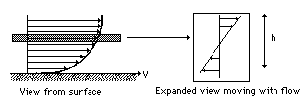

Friction force
Gas
  Exchange of molecules between areas with different group velocity
Liquid
  Cohesion forces
Surface observer Moving observer
Friction stress = rate of momentum change
Proportional to molecules velocity

Slide 19

Air (in atmosphere)
„Normal” conditions: 25 °C, 1 bar
Molecule: d ≈ 10⁻¹⁰m = 1Å
Mean distance: l_{m} ≈ 3.10⁻⁹m (30 d)
Mean free path: λ ≈ 6.10⁻⁸m (600 d)
Mean collision period: τ ≈ 10⁻¹⁰s
Mean velocity: c ≈ 330m/s (≈ 1mm/s)

Slide 20
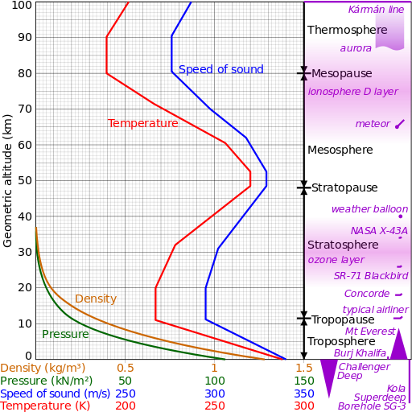
Earth atmosphere
Dia 12 700 km
Perimeter 40 000 km
1,3 10⁴⁴ of molecules

Slide 21
Continuity hypothesis
Fluid movement – length-scale l
„Material fluid particle”:
  1 μm³ (25 000 000 of molecules)
Knudsen number
Continuity: Kn << 1
order of magnitude
λ ≈ 6.10⁻⁸m
l = 1 μm → Kn ≈ 0.06

Slide 22

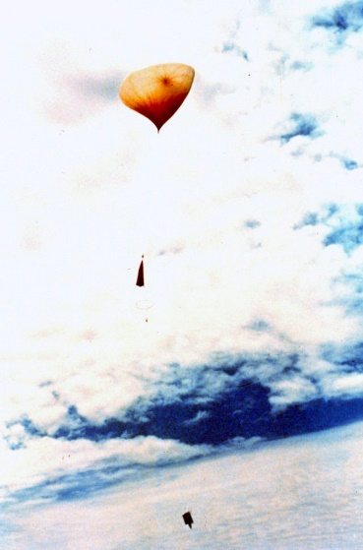
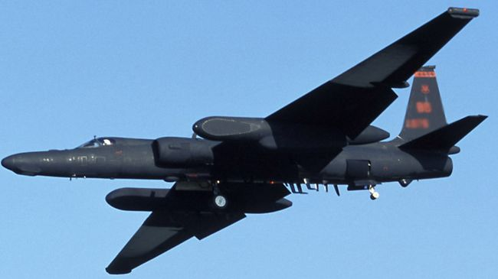

Mean free path – atmosphere
Altitude
0 km (sea level)
20 km (U2 let)
50 km (meteorological balloons)
150 km („low orbit“)
λ [m] p [Pa]
10⁻⁸ 100 000
10⁻⁶ 6 000
10⁻⁴ 80
1 5.10⁻⁵

Slide 23
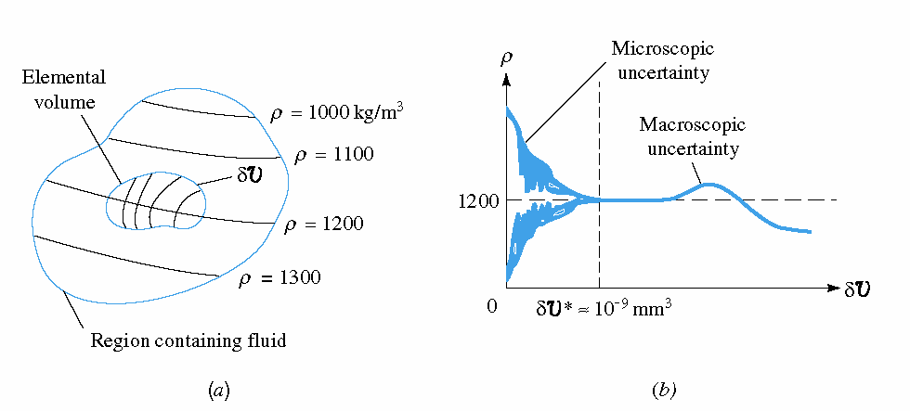
Macroscopic quantities
Density ρ

Slide 24
Physical quantities
State quantities
Static pressure
Static temperature
Fluid behavior
Velocity
Total, dynamic pressures and temperatures
Material quantities
Density
Viscosity
Velocity of sound
Specific heat
…
Problem definition
Boundary conditions
Initial conditions

Slide 25
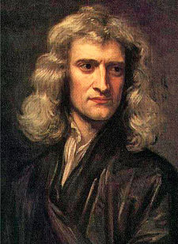
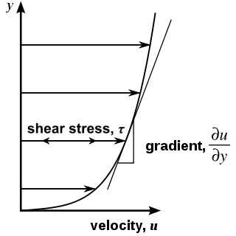
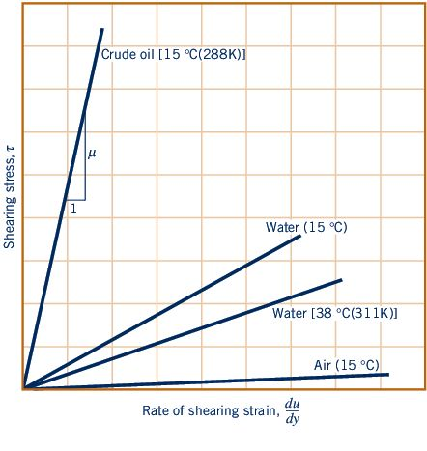
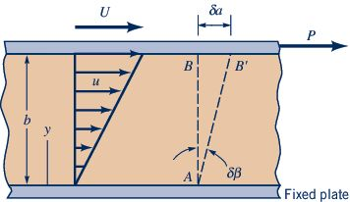

Newton law – viscosity
Dynamic viscosity
Isaac Newton
1643-1727

Slide 26
Viscosity
Determinates shear friction in flowing fluid.
It acts on a wall in flow direction.
Skin friction vanishes if:
  Fluid is still
  Viscosity is 0 – inviscid fluid (ideal gas)
  In flowing fluid out of shear regions (velocity is constant in traversal direction)
It is reason of no slip on a wall
Wall force interaction – shear force, tangential
Responsible for dissipation („losses“)
Next, pressure force (not viscosity dependent)
is perpendicular to a wall

Slide 27
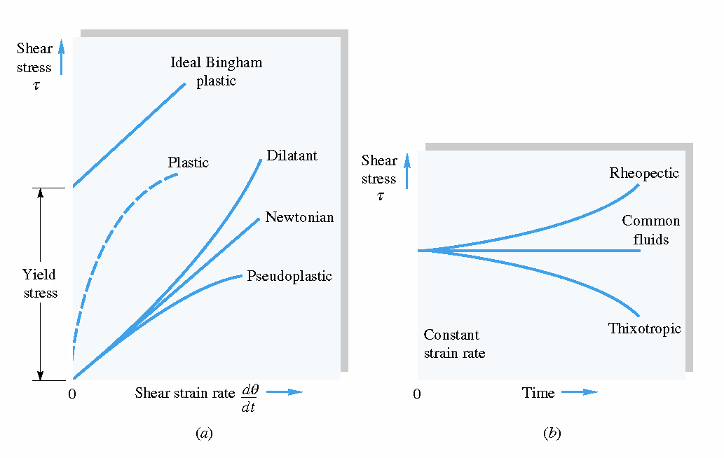
Fluids types
Newtonian: μ = const. – most of technical fluids (gases, pure liquids,…)
Non-Newtonian: μ = f(∂u/∂y, t) – organic fluids, suspensions,…

Slide 28
Viscosity
Dynamic viscosity: [kg m⁻¹s⁻¹] = [N s m⁻²] = [Pa s]
Kinematic viscosity: 10⁴ St = 1 m²/s
 | Air | Water | Mercury | Paraffin oil
Dynamic viscosity [kg / (m s)] | 1,78.10⁻⁵ | 1,14.10⁻³ | 1,55.10⁻³ | 1,9
Kinematic viscosity [m² / s] | 1,46.10⁻⁵ | 1,14.10⁻⁶ | 1,15.10⁻⁷ | 2,38.10⁻³

Slide 29
Viscosity
Property of a fluid
Determinated by a fluid state
State quantities:
  Temperature
  Pressure
Gases:
  μ(T), T↑ pressure independent
  ν(T,p), T↑ p↓
Liquid – incompressible – pressure independent:
  μ(T), T↓
  ν(T), T↓
Static!!!

Slide 30
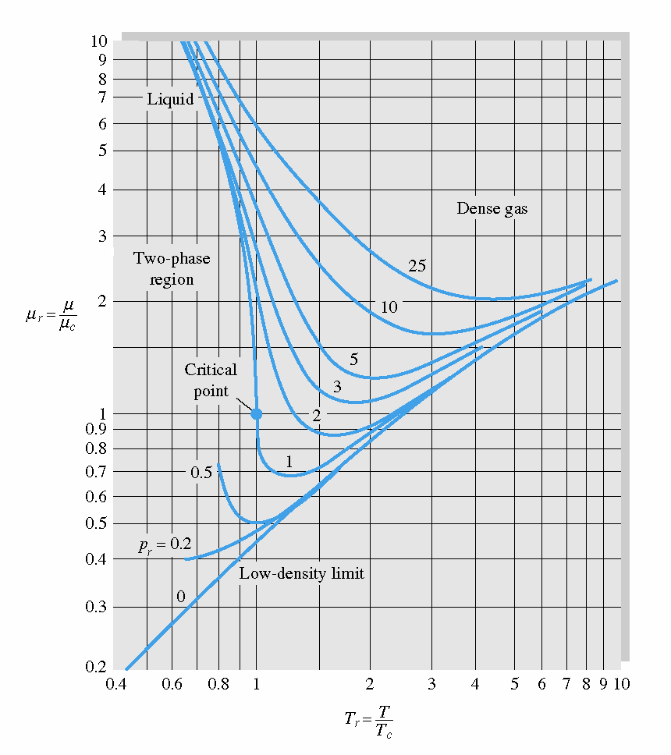
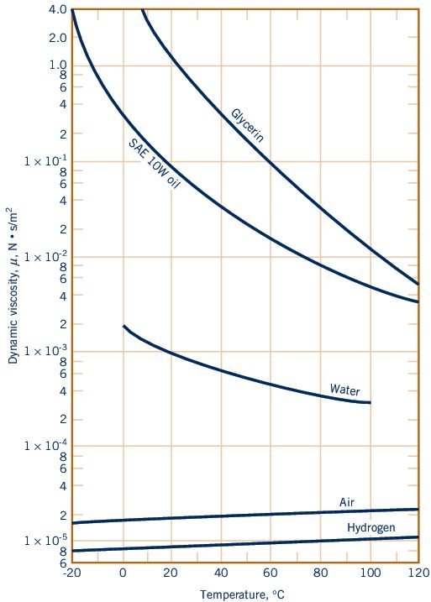
Role of temperature
μ = μ (T,p)
liquid
gas

Slide 31
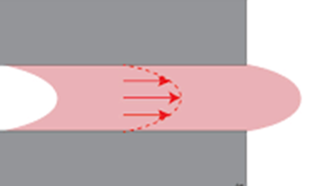
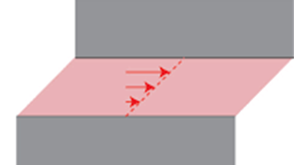
„no slip condition“ on a wall
Effect of viscosity
Zero relative velocity of fluid and wall
Reasons:
  Molecules reflection (gas)
  Adhesion (liquids)
Boundary condition of a wall
in mathematical modelling
Adhesion = attractice force between molecules of gas and solid
Fixed wall
Moving wall
Fixed wall
Fixed wall

Slide 32

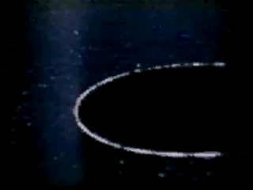
No slip on a wall

Slide 33
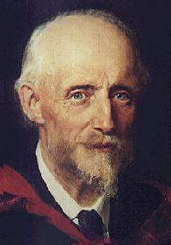
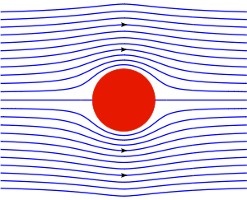
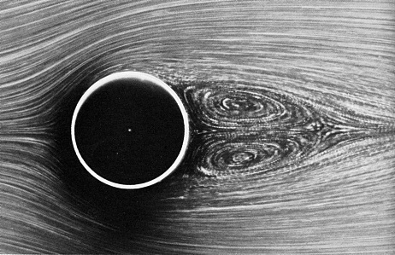
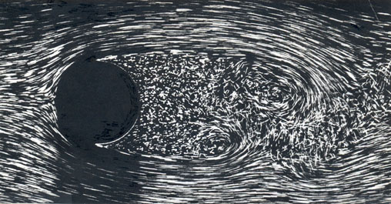
Reynolds number
Dimensionless
Scales ratio: convection and diffusion
Determinates flow topology
  „small“ (~1) – creep
  „intermediate“ (~30) – laminar flow
  „big“ (>200) – turbulent flow
1842 – 1912

Slide 34

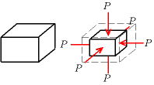
Speed of sound
In general:
Ideal gas:
Air: c = 331,3 + 0,606 * t m/s
Water: c ≈ 1 500 m/s
K: modulus of volume elasticity, compressibility
Air: 1,1 10⁵ Pa
Water: 2,2 10⁹ Pa
Steel: 1,6 10¹¹ Pa
M = 0,0289645 kg/mol (molar mass)
R = 8,314510 J (K mol)⁻¹

Slide 35
Compressibility
U << c : incompressible flow (compressibility is neglected)
  ρ = const.
U „high enough“: compressible flow
  ρ = f(U)
Air, normal conditions (t = 20°, p = 10⁵ Pa)
  c = 330 m/s
  Incompressible:
    Laboratory: U < 50 m/s
    Practice: U < 100 m/s
Water: always incompressible (velocity over 1000 m/s is not realistic)

Slide 36
Ideal fluids
Ideal gas
  Compressible
  Inviscid
Ideal liquid
  Incompressible
  Viscous
Next simplifications:
  Stationary flow
  2D geometry
  …
Reality: compressible, viscous, nonstationary, 3D
Gas dynamics
Thermodynamics
Fluid dynamics

Slide 37
Thanks for attention

