Slide 1
Fluid Mechanics
Prof. Václav Uruba
uruba@fst.zcu.cz
http://home.zcu.cz/~uruba/vyuka/FM/
UWB FME, KKE
Institute of Thermomechanics ASCR, CTU in Prague FME, CU FFM

Slide 2
Fluid Mechanics - lectures
Introduction, concepts, definitions
Statics
Kinematics
Dynamics
Bernoulli equation
Shear regions
External flows
Internal flows
Flow machines
Turbulence
Compressible flows and acoustics
Physical modelling
Mathematical modelling

Slide 3
Fluid Mechanics - lectures
Introduction, concepts, definitions
Statics
Kinematics
Dynamics
Bernoulli equation
Shear regions
External flows
Internal flows
Flow machines
Turbulence
Compressible flows and acoustics
Physical modelling
Mathematical modelling

Slide 4
Statics of fluids
Surface tension (capillary)
Laws: Pascal, Euler and Archimedes
Manometers
Hydraulics
Earth atmosphere
Stability of a flowing body (metacenter)

Slide 5
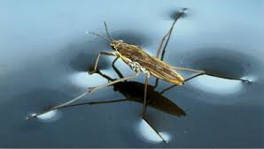
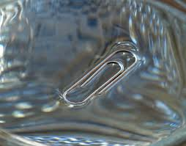
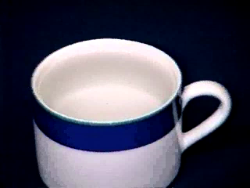
Surface tension

Slide 6
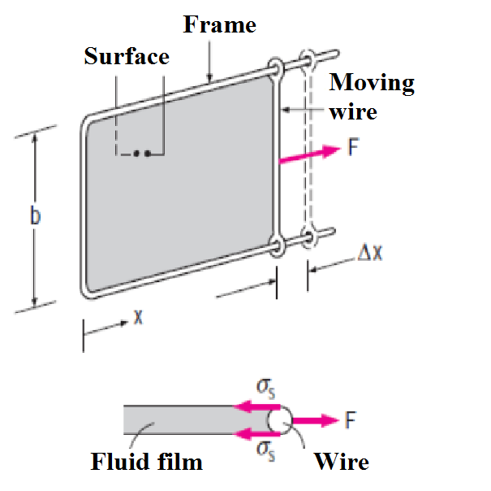
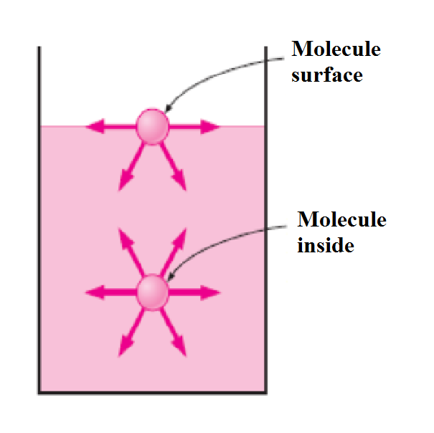
Surface tension
F
Liquid σs [N/m]
Water:
0°C 0.076
20°C 0.073
100°C 0.059
300°C 0.01
Glycerin 0.063
SAE 30 oil 0.035
Mercury 0.440
Alcohol 0.023
Blood, 37°C 0.058
Gasoline 0.022
Soap water 0.025
Kerosene 0.028

Slide 7
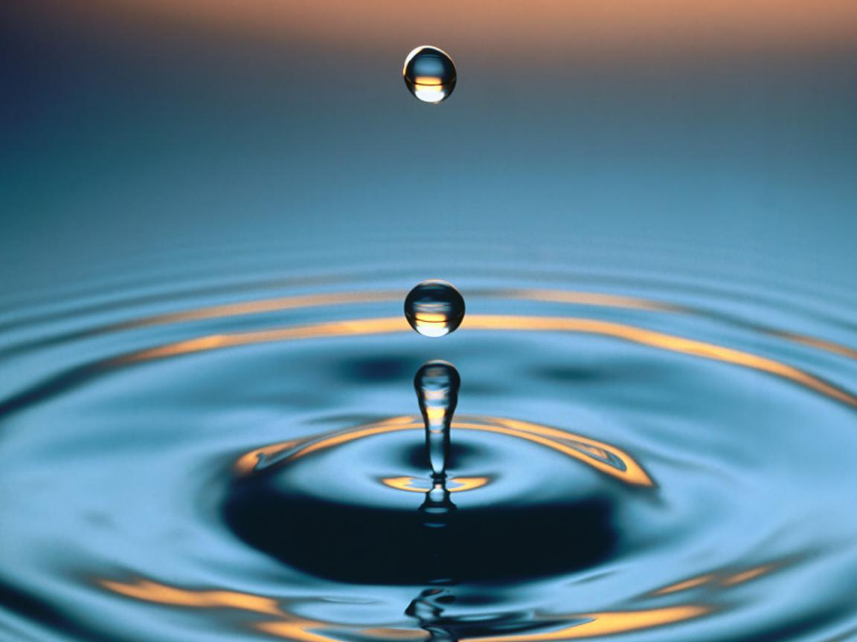
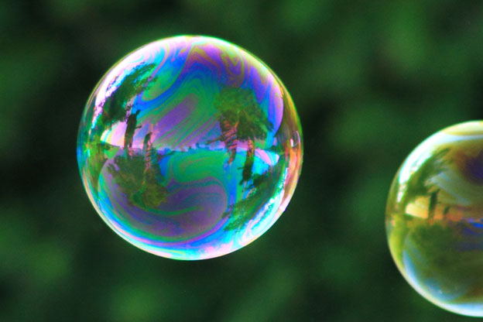
Droplet, bubble

Slide 8
Droplet, bubble
Droplet
Bubble

Slide 9
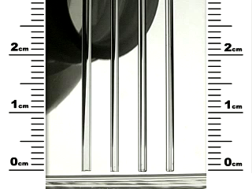
Surface tension - capillary tube

Slide 10
Surface tension - capillary tube
water: h ≅ 15 / R [mm]
mercury: -4,4 / R
Fluid (with glass) | Contact angle [deg]
water | ≈0
mercury | 130
kerosin | 26
Capillary elevation
Capillary depression

Slide 11
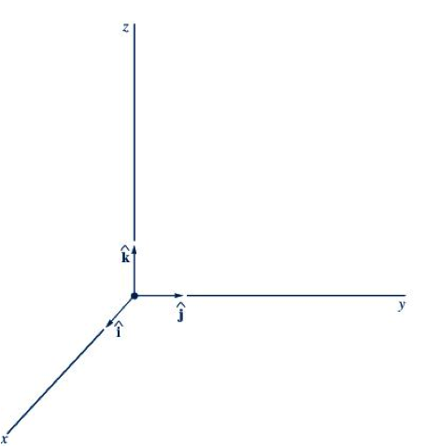
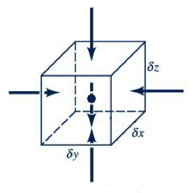
Statics – fluid in rest
Fluid
Density = Specific mass:
Specific weight:
Coordinates
Elementary volume

Slide 12
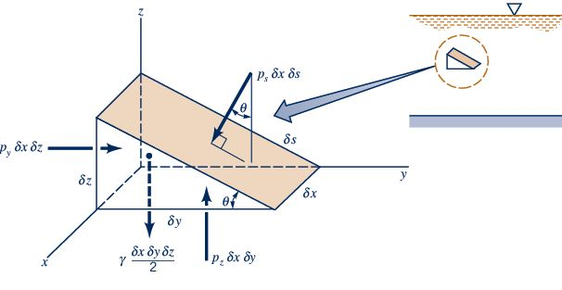
Point pressure – Pascal law
Pressure is scalar!
p_{x} = p_{y} = p_{z} = p_{s} = p
BUT pressure force is vector!

Slide 13
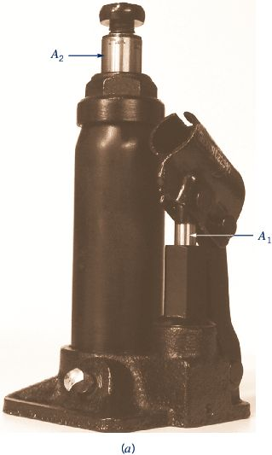
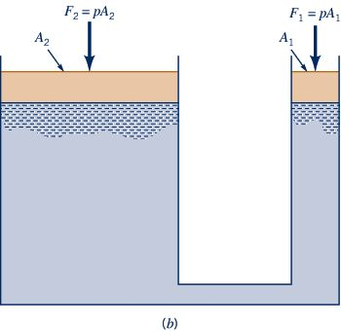
Hydraulic press
fig02_05a

Slide 14
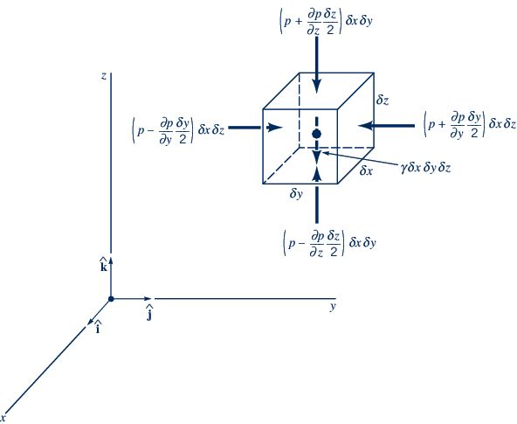
Pressure field – Euler equation of hydrostatics
Element – surface force

Slide 15
Pressure field – Euler equation of hydrostatics
Element – volumetric force

Slide 16
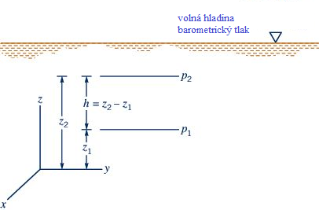
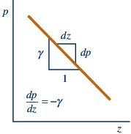
Incompressible fluid

Slide 17
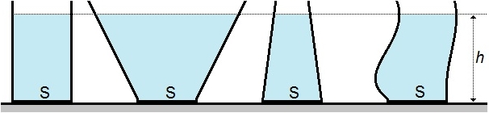
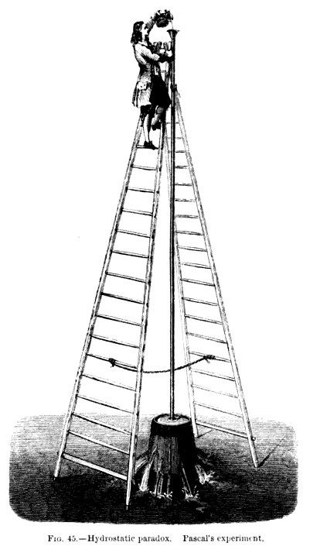
Hydrostatic paradoxon

Slide 18
Various fluids
known
Oil
Water
Glycerol
Mercury

Slide 19
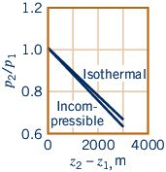
Compressible fluid
Ideal gas
Isothermal process

Slide 20
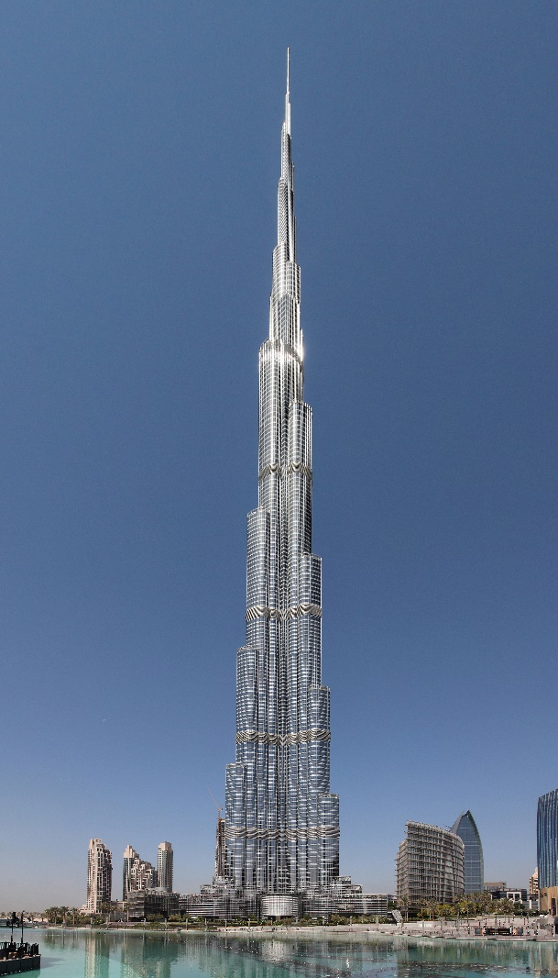
Compressible fluid – example
2
Burj Khalifa (Emirates, Dubai)
2010: 828m
Pressure difference:
Compressible
Incompressible
1

Slide 21
Earth atmosphere
Isotermic
Vertical temperature gradient
Adiabatic

Slide 22
Manometers
Luquid | k [Pa/mm]
Water | 9,81
Alcohol | 7,6
Mercury | 133

Slide 23
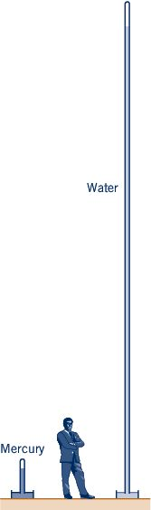
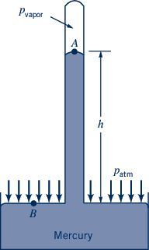
Manometers – barometer
p_{par} = 0,16Pa
Water
9,81m
Mercury
0,76m
Mercury

Slide 24
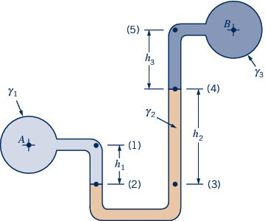
Manometers

Slide 25
External acceleration
Fluid
in rest

Slide 26
External acceleration - rotation
Fluid
in rest
Volume
Fluid
in rest
Axis

Slide 27
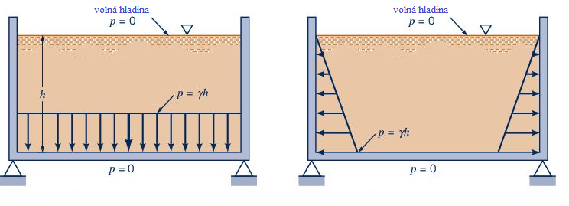
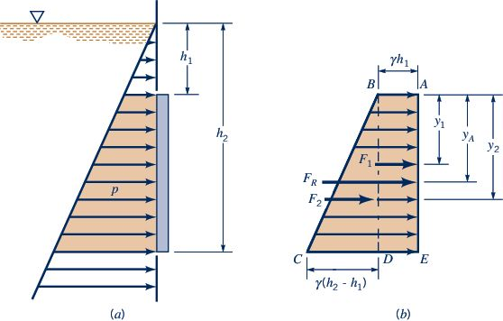
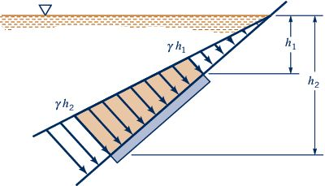
Hydrostatic force on plain wals
Free surface
Free surface

Slide 28
Hydrostatic force on plain surface

Slide 29
Hydrostatic force on plain surface

Slide 30
Hydrostatic force on curved surface
Horizontal component: force on surface vertical projection.
Vertical component: weight of fluid column above the surface (liquid + atmosphere).
Projection
on vertical plane

Slide 31
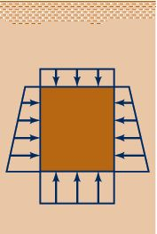
Buoyancy – Archimedes principle
A body immersed in a fluid experiences an upthrust equal to the weight of the fluid displaced.
Any object, totally or partially immersed in a fluid or liquid, is buoyed up by a force equal to the weight of the fluid displaced by the object.

Slide 32
Floating body
Free surface
Equilibrium:
buoyancy = weight
Must be collinear
Collinearity broken:
stable
instable
Force moment
METACENTRUM = intersection of buoyancy line and symmetry axis
Metacenter
under CG
STABILE
Metacenter
bellow CG
INSTABILE
restoring overturn
moment

Slide 33
Stability
Equilibrium
„Small“ deflection

Slide 34
Thanks for attention

