Slide 1
Fluid Mechanics
Prof. Václav Uruba
uruba@fst.zcu.cz
http://home.zcu.cz/~uruba/vyuka/FM/
UWB FME, KKE
Institute of Thermomechanics ASCR, CTU in Prague FME, CU FFM

Slide 2
Fluid Mechanics - lectures
Introduction, concepts, definitions
Statics
Kinematics
Dynamics
Bernoulli equation
Shear regions
External flows
Internal flows
Flow machines
Turbulence
Compressible flows and acoustics
Physical modelling
Mathematical modelling

Slide 3
Fluid Mechanics - lectures
Introduction, concepts, definitions
Statics
Kinematics
Dynamics
Bernoulli equation
Shear regions
External flows
Internal flows
Flow machines
Turbulence
Compressible flows and acoustics
Physical modelling
Mathematical modelling

Slide 4
Kinematics
  Flow visualization
  Description: Euler and Lagrange (streamline and trajectory)
  Derivation definition (material derivation)
  Kinematics (Helmholtz theorem)
  Vortices (vorticity, circulation, rotation, Kelvin-Helmholz vortex theorems, Biot-Savart law)
  Potential flow

Slide 5
Velocity distribution

Slide 6
Kinematics in fluid mechanics
Description of flow-field – velocity field
Do not care about reasons (forces)
Observation – visualization
  Trajectory
  Streakline
  Timelines
  Streamlines

Slide 7
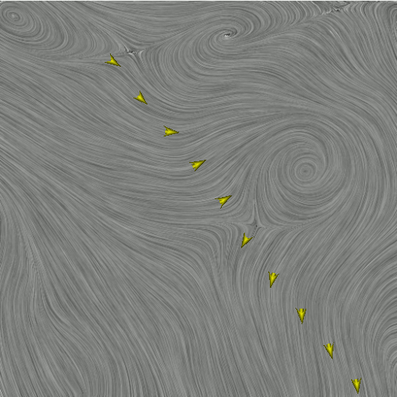
Trajectory – Pathline
Particle path
For time interval

Slide 8
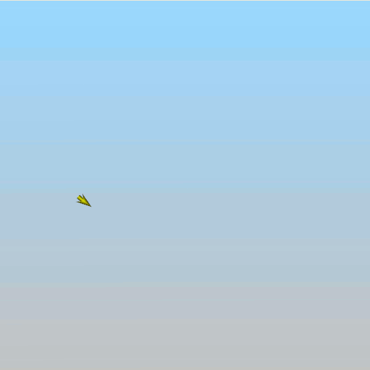
Streakline
Material line
Particles, passing successively through a reference point in space
Shown for a given time, moment

Slide 9
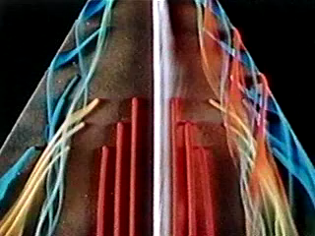
Streaklines

Slide 10
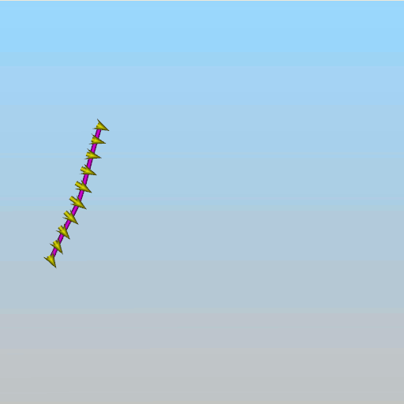
Timeline
Material line
Reference region (line segment) – marked particles in t0
It consists of particles which passed the reference area in t0
Shown for a given time, moment

Slide 11
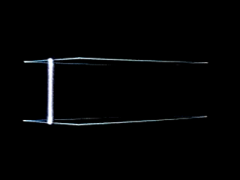
Timelines

Slide 12
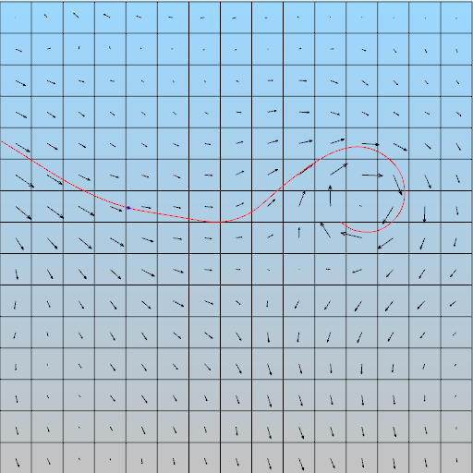
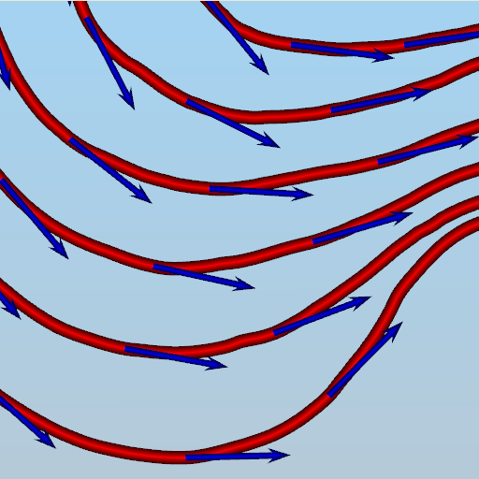
Streamlines
Vector-lines of the velocity vector-field
Shown for a given time, moment
NOT averaged velocities!

Slide 13
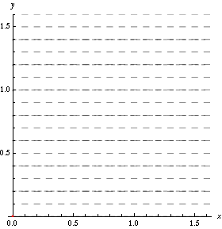

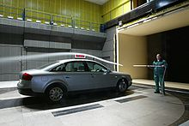
Streamlines, streaklines and trajectories
Streamlines
Streakline
Trajectory

Slide 14
Description of flowing fluid
Attention: NOT molecules!
Lagrangian description: observed individual material particles of fluid („billiard balls“)
  Material fluid particle
  Control volume of fluid
Eulerian description: control volume is defined, descriptive quantities are in the form of fields.
  Elementary control volume of space
  Control volume of space (finite)
Moves with fluid
Do not moves with fluid

Slide 15
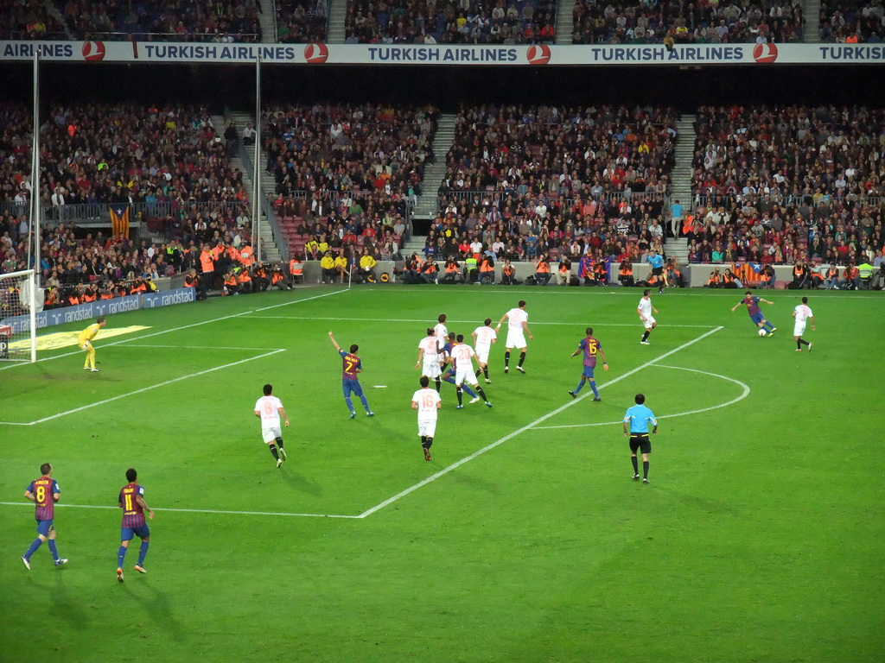
Euler x Lagrange
Lagrange
  Particles of fluid
  Control volume of fluid
  Motion of fluid in space (quantities are linked to fluid mass)
Euler
  Elementary volume of space
  Control volume in space
  Quantity field (pressure, velocity) in space
EULER
LAGRANGE

Slide 16
Lagrangian description
Fluid particles
System of particles
Trajectory

Slide 17
Eulerian description
Elementary volume
Vector field
Streamline
Vector lines of velocity field

Slide 18
Velocity and acceleration of a particle
Velocity:
Acceleration:

Slide 19
Substantial derivative
Acceleration:
Substantial, material, individual derivative (total):
Local part (unsteady):
Convective, advective part:

Slide 20
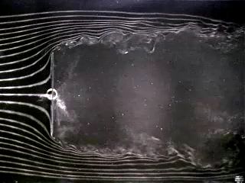
Steadiness
Flow
  Unsteady
    Streamline
    Trajectory
    Streakline
  Steady
    Streamline
    Trajectory
    Streakline
various
identical
Local acceleration vanishes
BUT
Convective not !!!

Slide 21

Helmholtz decomposition
General motion of a fluid particle
Translation
Rotation
Deformation
  Linear
  Angular (Shear)
Vector of rotation rate
Tenzor of velocity rate

Slide 22
Helmholtz decomposition theorem
Any fluid movement around a point in space could be decomposed into translation, rotation around a given point and deformation (linear and shear)

Slide 23


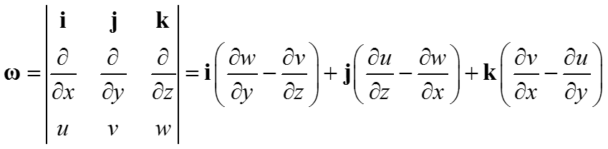



Vorticity, circulation
Rotation of a particle
Vorticity
Circulation – vortex „strength“

Slide 24
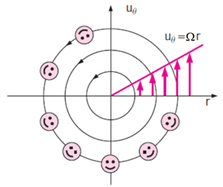
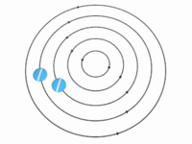
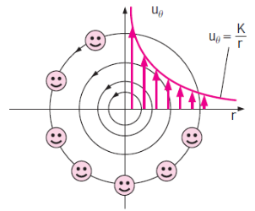
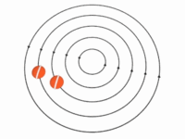
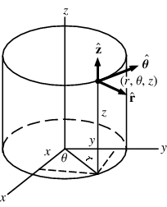
Vortex
„Rigid“ body
Vortex without vorticity
Potential vortex

Slide 25
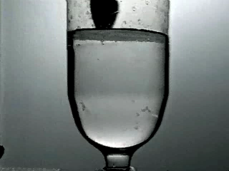
Real vortex

Slide 26
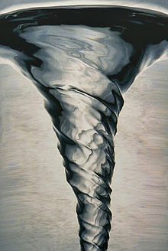
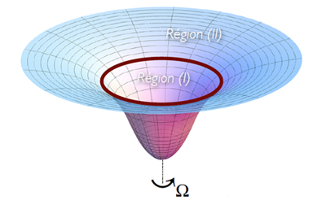
Rankin vortex
Rigid core
Outside potential vortex
ω

Slide 27
Vorticity in boundary layer

Slide 28
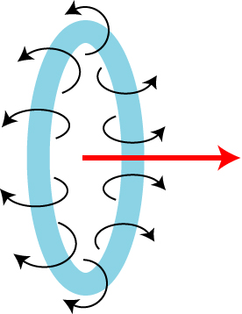
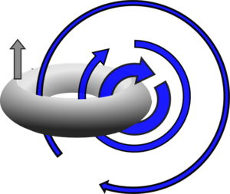
Biot-Savart law
Vortex core line
Induced velocity field
Movement of vortex ring

Slide 29
Kelvin (Thomson) circulation theorem
Inviscid fluid (ideal gas)
Barotropic fluid (density is function of pressure only)
Conservative forces (e.g. gravitation, no Coriolis)
Material curve: it consists of the same fluid particles (time line)
„In a barotropic inviscid fluid in conservative forces the circulation along a closed curve advected by a fluid is conserved in time.“

Slide 30
Helmholtz‘s vortex theorems
Vortex lines in 3D
Inviscid fluid
3 Helmholtz’s theorems
The strength of a vortex line is constant along its length.
A vortex line cannot end in a fluid; it must extend to the boundaries of the fluid or form a closed path.
A fluid element that is initially irrotational remains irrotational.
In space and time
Applies also on vorticity
Vortex consists of the same particles

Slide 31




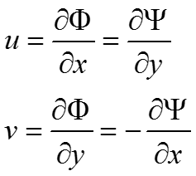
Potential flow
Flow
  Incompressible
  Inviscid
  Non-rotational
Potential
Flow function
UNREAL
Streamlines
Equipotentials
FORCES COULD NOT BE EVALUATED
Constant potential lines are perpendicular to streamlines

Slide 32
Thanks for attention

Slide 33
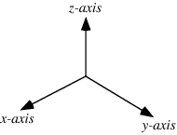
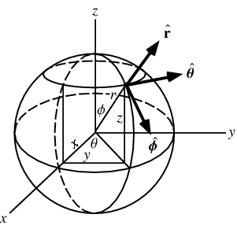
Coordinate system
Cartesian
Cylindric (polar)
Spheric

Slide 34
Substantial derivative

Slide 35
Vorticity

