Slide 1
Fluid Mechanics
Prof. Václav Uruba
uruba@fst.zcu.cz
http://home.zcu.cz/~uruba/vyuka/FM/
UWB FME, KKE
Institute of Thermomechanics ASCR, CTU in Prague FME, CU FFM

Slide 2
Fluid Mechanics - lectures
Introduction, concepts, definitions
Statics
Kinematics
Dynamics
Bernoulli equation
Shear regions
External flows
Internal flows
Flow machines
Turbulence
Compressible flows and acoustics
Physical modelling
Mathematical modelling

Slide 3
Fluid Mechanics - lectures
Introduction, concepts, definitions
Statics
Kinematics
Dynamics
Bernoulli equation
Shear regions
External flows
Internal flows
Flow machines
Turbulence
Compressible flows and acoustics
Physical modelling
Mathematical modelling

Slide 4
Navier-Stokes equation
  Continuity equation
  Momentum equation
  N-S eq. properties, properties of real flows
  Engineering approaches – incompressible, inviscid (Euler e.), extremely viscous (Stokes e.), 2D,…

Slide 5
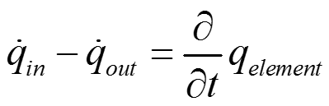
Balance equations in fluid mechanics
Mass balance m
Momentum balance h = m . V
Energy balance E
System is open
conservation
Momentum is not conserved – force balance
conservation
Time unit
input
System
accumulation
m_{e}, E_{e}
output
m_{in}, E_{in}
m_{out}, E_{out}

Slide 6
Continuity equation
Mass conservation:

Slide 7
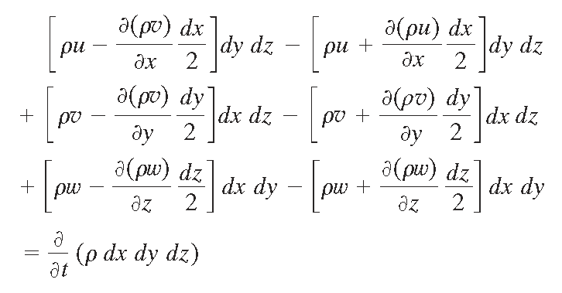
Continuity equation

Slide 8


Continuity equation
Incompressible fluid
Velocity vector field is for incompressible fluid
divergence-free, SOLENOIDAL

Slide 9
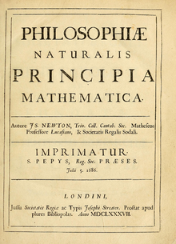
Newton's laws of motion
A body remains at rest, or in motion at a constant speed in a straight line, unless acted upon by a force.
Inertia:
Force:
Action and reaction:
Inertial system
- no external forces
definition:
Inertial force
When a body is acted upon by a net force, the body's acceleration multiplied by its mass is equal to the net force.
If two bodies exert forces on each other, these forces have the same magnitude but opposite directions.
Equilibrium of forces: forces on a body are in equilibrium
ANYTIME and Everywhere
>>> solitary force could not exist !!!
1687

Slide 10
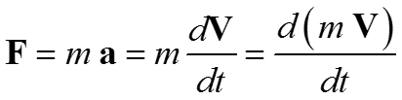
Equilibrium of forces
Momentum
Law of force:
Forces acting on elementary volume in space:
Volumetric
Surface

Slide 11

Equilibrium of forces
direction x:
Cauchy

Slide 12
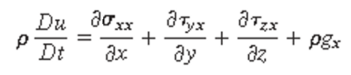
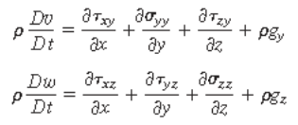
Equilibrium of forces
3 comts x:
y:
z:
Tensor (matrix) of deformation rate >>> stress tensor:
Constitutive relations
Symetrical:

Slide 13
Navier-Stokes equation
Laplace operator,
Laplace:
3 + 1 = 4
3 + 1 = 4
Unknown: V(x,t), p(x,t)
Equations: N-S, continuity
OK

Slide 14
Interpretation of N-S E
Convective
acceleration
Pressure
term
Local
acceleration
PDE, 1st order in time, 2nd order in space
Non-linear
Non-integrable
Governing parameter: Reynolds number
Representing:
  Equilibrium of forces
  Balance of momentum
Viscous
term
External
acceleration
Reynolds number
Ratio of scales (length- or time-)
Characteristics of convection and diffusion.

Slide 15
Initial and boundary conditions
Initial conditions:
Boundary conditions:
  Wall :
  IN :
  OUT :
no slip

Slide 16
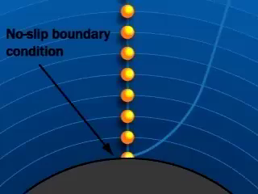
No-slip condition

Slide 17
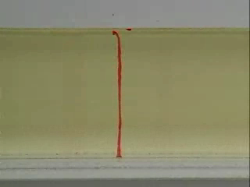
No-slip condition

Slide 18
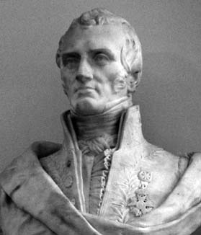
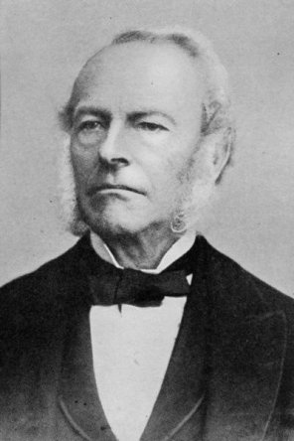
N-S equation
Claude Louis Marie Henri Navier, 1820
Sir George Gabriel Stokes, 1842
Millennium Prize Problems
  Clay Mathematics Institute, Cambridge, Massachusetts
  7 mathematical problems for 3rd millennium, 24.5.2000, Paris
  No.6: Navier–Stokes existence and smoothness
$1 000 000

Slide 19
Energy equation
First law of thermodynamics
  Heat transfer Q
  Mechanical work W
  Total energy (change) ΔE = Q + W
Ideal (inviscid) gas:
Dissipation function
Coefficient of thermal conductivity
Coefficient of thermal diffusivity,
Temperature conductivity
+ state equation:

Slide 20
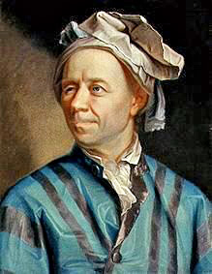
Simplification N-SE
Euler equation
  Inviscid fluid
E.r. of hydrostatics
  Statics
Stokes equation
  Slow motion (creep)
Reynolds equation
  Averaged N-S
o.p.:
V_{w,normal} = 0
V_{w,tangential} ≠ 0 !!!
No-slip condition on wall does not hold !!!
Linear !!!
See „Turbulence“

Slide 21
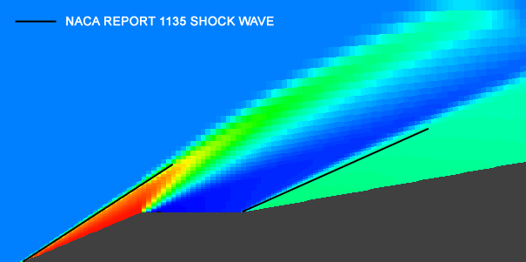
Euler equation
Viscosity neglected
Appropriate for shock waves modelling
To be added:
  Energy e.
  State e.

Slide 22

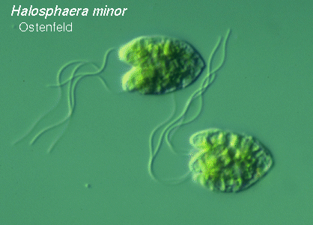
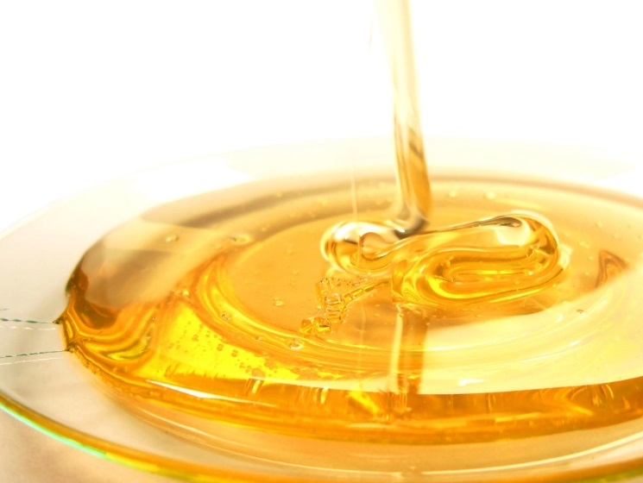
Stokes equation
Very slow flow – „creep“ – small Reynolds number
  Small U: glacier
  Small L: micro-world
  Big ν: honey
Solution with help flow function (potential flow)
Steady – b.c.

Slide 23
Mathematical modelling
Incompressible case
  Unknown:
    3 velocities
    Pressure
  Equations:
    continuity
    3 momentum
Compressible case
  Unknown:
    3 velocities
    Pressure
    Density
    Temperature
  Equations:
    Continuity
    3 momentum
    Energy
    State
Momentum e.
  Navier-Stokes e.
  Euler e.
  Stokes e.
4
4
6
6

Slide 24

Stokes flow

Slide 25
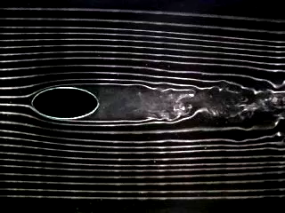
„Normal“ flow

Slide 26
Thanks for attention

Slide 27
Continuity equation

Slide 28
N-S equation

Slide 29
N-S equation

Slide 30
Energy equation

Slide 31
Stress tensor

