Slide 1
Fluid Mechanics
Prof. Václav Uruba
uruba@fst.zcu.cz
http://home.zcu.cz/~uruba/vyuka/FM/
UWB FME, KKE
Institute of Thermomechanics ASCR, CTU in Prague FME, CU FFM

Slide 2
Fluid Mechanics - lectures
Introduction, concepts, definitions
Statics
Kinematics
Dynamics
Bernoulli equation
Shear regions
External flows
Internal flows
Flow machines
Turbulence
Compressible flows and acoustics
Physical modelling
Mathematical modelling

Slide 3
Fluid Mechanics - lectures
Introduction, concepts, definitions
Statics
Kinematics
Dynamics
Bernoulli equation
Shear regions
External flows
Internal flows
Flow machines
Turbulence
Compressible flows and acoustics
Physical modelling
Mathematical modelling

Slide 4
Bernoulli equation
  Derivation from N-SE
  Forms of BE
  Conditions of application, results interpretation
  Examples of BE application: outflow from a vessel, overfall, flow in a pipe

Slide 5
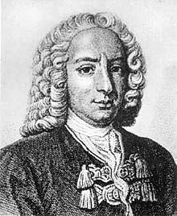
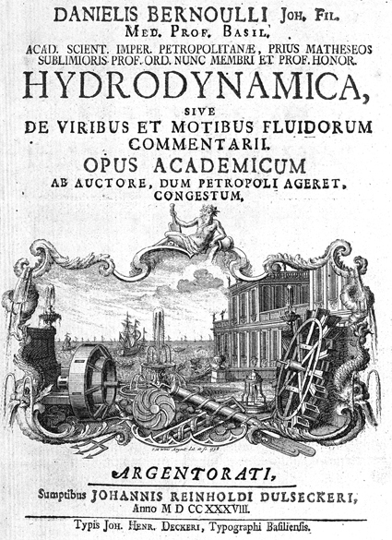
Daniel Bernoulli
Hydrodynamica (1738)
8.2. 1700, Groningen – 17.3. 1782, Basilej

Slide 6
Bernoulli equation
N-SE
Fluid
  Incompressible ρ = const.
  Inviscid ν = 0
  Stationary flow
Vector identity
Along streamline:
V
ds
force>>> work(energy) !!!

Slide 7
Bernoulli equation
Differential e.:
Integration between points „1“ a „2“:
  Pressure energy
  Kinetic energy
  Potential (gravitational) energy
Law of mechanical energy conservation for steady flow of incompressible inviscid fluid in 1-D (along a streamline)
ATTENTION: Navier-Stokes e. is force equilibrium, Bernoulli e. is energy conservation

Slide 8
Initial presumptions
Incompressible fluid: Ma < 0.3
Inviscid fluid: no shear, effect of walls
Stationary flow: const. b.c. in time, no turbulence
Along a streamline: every streamline different „constant“
No work exhibited: on the streamline there is no pump or turbine
No heat transfer: adiabatic process

Slide 9
BE validity
Model in a wind tunnel
Tunnel drive
Furnace

Slide 10
Bernoulli constant
Bernoulli „constant“ H
Substitution:
H is constant in the flow-field:
  Along a streamline
  Along a vortex line
  Everywhere, if
    Flow is vorticity-free
    Vortex lines and streamlines are identical

Slide 11
BE forms
Energy
Height
Pressure
Static pressure
Hydrostatic pressure
Dynamic pressure
Total pressure

Slide 12
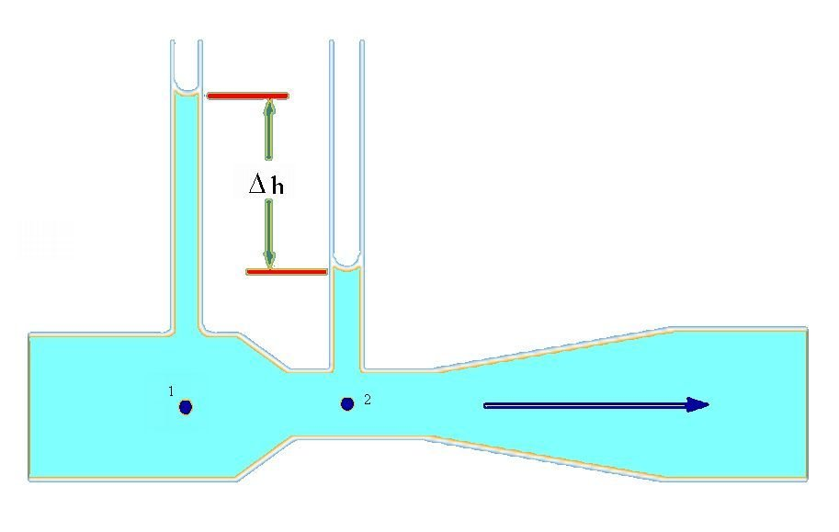
Hydrodynamic paradoxon

Slide 13
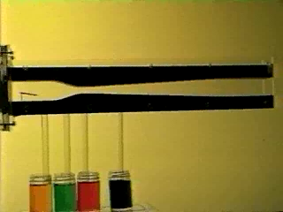
Hydrodynamic paradoxon

Slide 14
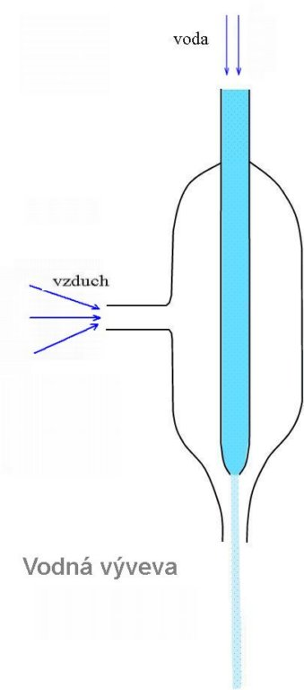
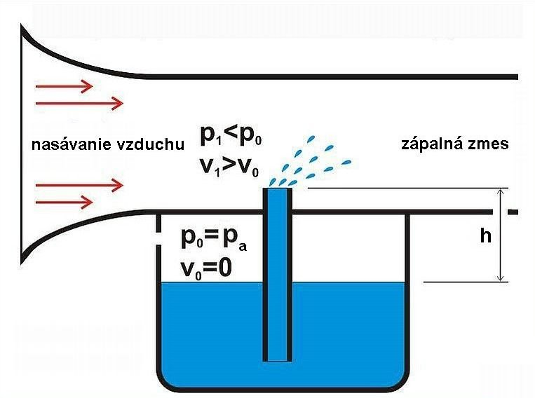
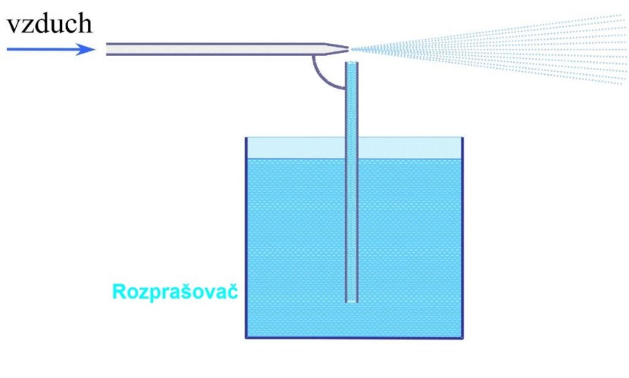
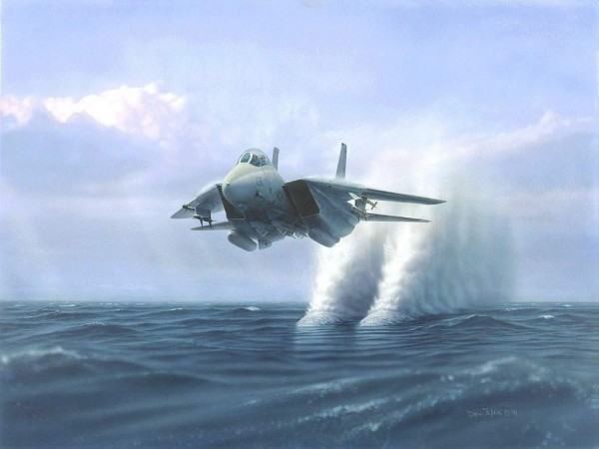
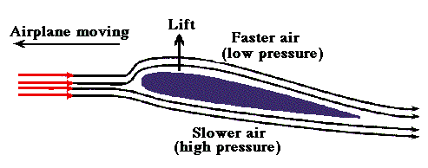
Applications
Vacuum pump
Carburetor
Sprayer
Wing - lift

Slide 15
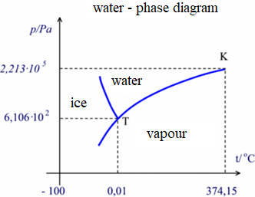
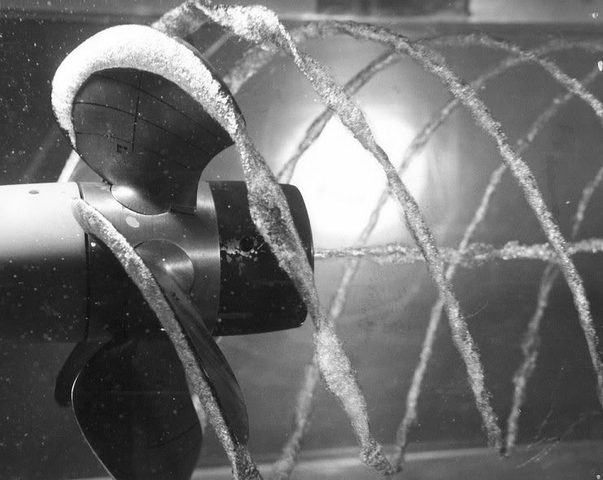
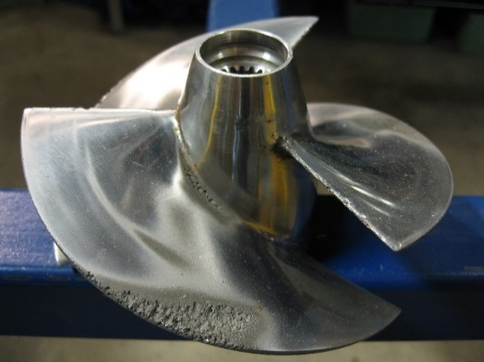
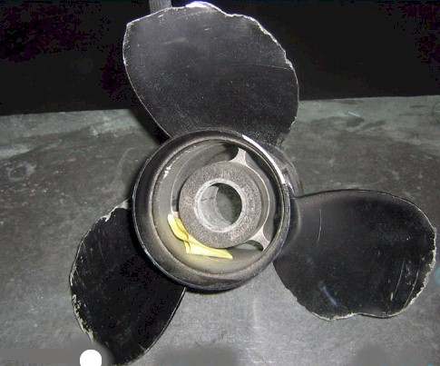
Cavitation
boiling
cavitation
Saturated vapor pressure
  Water, 18°C: p_{np} = 2 kPa
V > V_{crit}, p < p_{np}
Bubles !!!

Slide 16
Ideal case
h_{B}
Energy head (Bernoulli)
Hydraulic head
h_{H}

Slide 17
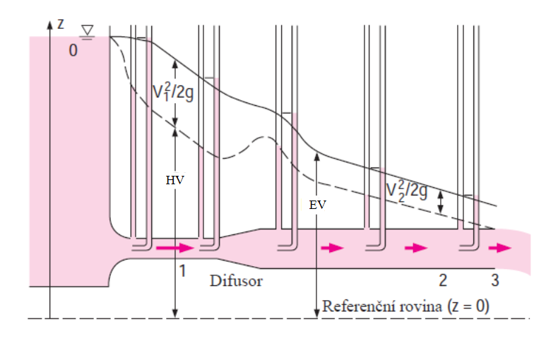
Reality
ENERGY LOSS
Nominal level of EH
ENERGY LOSS
Reference level

Slide 18
BE generalization
BE – mechanical energy of a flow
  Potential
  Pressure
  Kinetic
Generalization:
  Internal energy, entalpy
  Transferred heat
  Work
  Friction losses

Slide 19
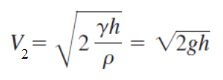

Outflow
1: atmosphere p_{atm}, V₁ = 0
2: outflow p_{atm}, V₂
3: p₃ = (h - l) ρg, V₃ = 0
4: p₄ = p_{atm}
5: p₅ = p_{atm}
Torricelli 1643

Slide 20

Horizontal outflow
Horizontal outflow
„Vena contracta“
p₁ = p₂ = p₃ = p_{atm}
h₁ < h₂ < h₃

Slide 21
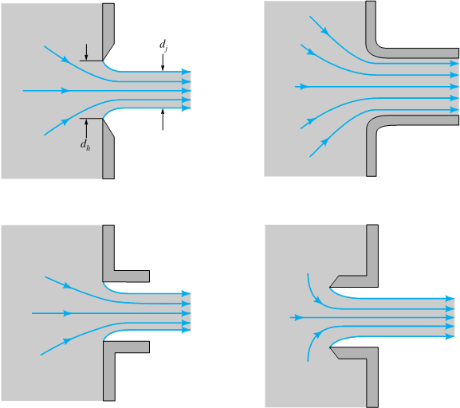
Contraction coefficient

Slide 22
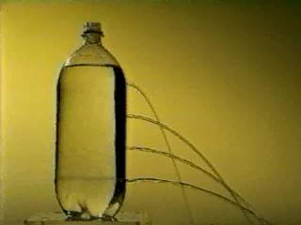
Outflow from a hole

Slide 23
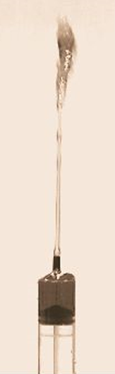
Energy balance
Potential energy
Pressure energy
Kinetic energy
Point\Energy | Potential e. | Pressure e. | Kinetic e.
1 | 0 | Big | Small
2 | Small | 0 | Big
3 | Big | 0 | 0

Slide 24
Velocity, pressure fluctuations
Velocity and dynamic pressure on a streamline:
Reynolds decomposition:
Averaging:
!!!
Pressure and velocity fluctuations:
averaged pressure
does not correspond to
averaged velocity!!!

Slide 25
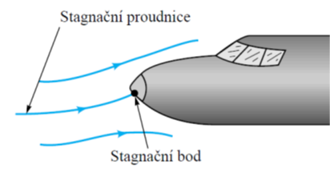
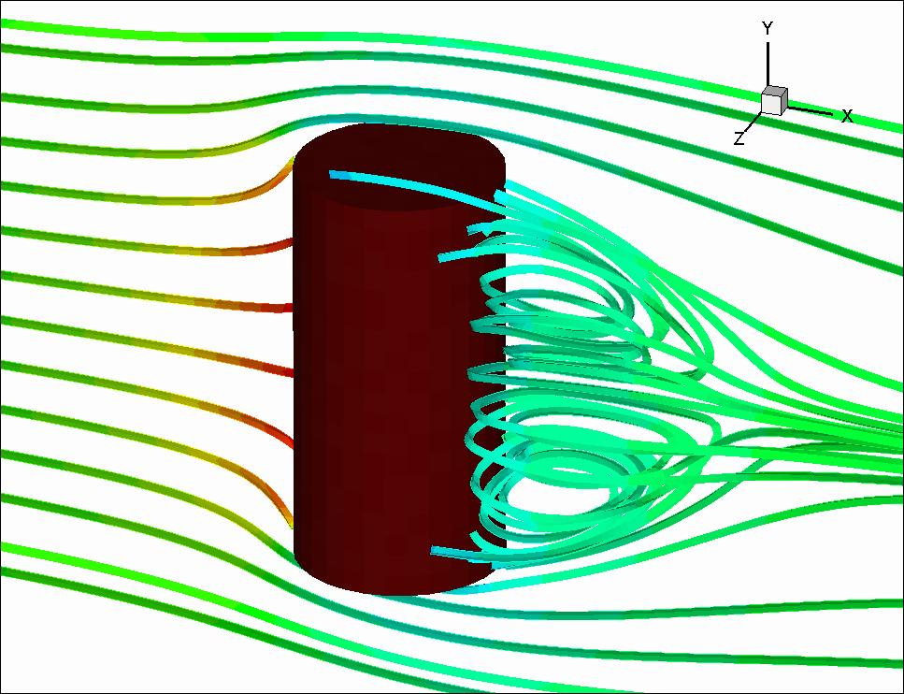
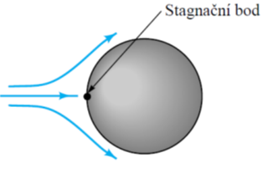
Stagnation point
Location on body surface (point, line, curve)
Relative velocity vanishes
Kinetic energy vanishes
Stagnation streamline

Slide 26
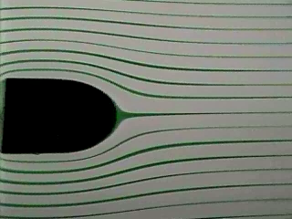
Stagnation point

Slide 27
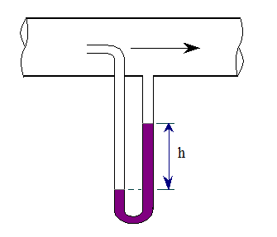
Pressures in flowing fluid
Static:
  (3): p₃ – h₄₋₃ ρg
  (1,2): p₁ – h ρg = p₃ – h₃₋₁ ρg
  Total, stagnation:
    (1,2): p₂ – H ρg
Dynamic:
  (1,2): total - static = 1/2 ρV²
Temperature:
  Static
  Total

Slide 28
Pressures evaluation
Air – gravitational potential energy is neglected:
  p_{d} = p₂ – p₁ = 1/2ρV²
  p₃ = p₂, p₄ = p₁
  p_{d} = p₃ – p₄

Slide 29
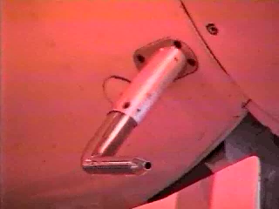
Velocity measurement

Slide 30
Thanks for attention

