Slide 1
Fluid Mechanics
Prof. Václav Uruba
uruba@fst.zcu.cz
http://home.zcu.cz/~uruba/vyuka/FM/
UWB FME, KKE
Institute of Thermomechanics ASCR, CTU in Prague FME, CU FFM

Slide 2
Fluid Mechanics - lectures
Introduction, concepts, definitions
Statics
Kinematics
Dynamics
Bernoulli equation
Shear regions
External flows
Internal flows
Flow machines
Turbulence
Compressible flows and acoustics
Physical modelling
Mathematical modelling

Slide 3
Fluid Mechanics - lectures
Introduction, concepts, definitions
Statics
Kinematics
Dynamics
Bernoulli equation
Shear regions
External flows
Internal flows
Flow machines
Turbulence
Compressible flows and acoustics
Physical modelling
Mathematical modelling

Slide 4
Shear regions
Types of SR (boundary layer, free SR, circulating SR – vortex)
BL thickness (conventional, displacement, momentum)
Structure of BL (laminar, turbulent)
BL separation

Slide 5
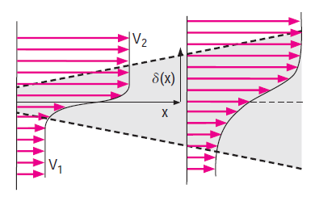
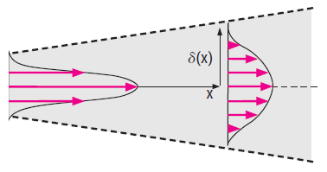
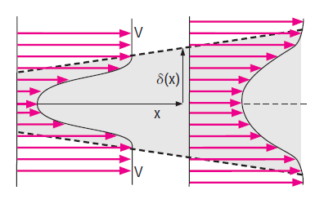
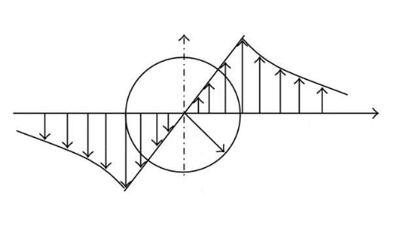
Shear regions
y
U
Free SR
Jet
Wake
Vortex
Boundary layer (wall SR)
No slip on a wall
U_{wall} = 0

Slide 6
Low Re – laminar BL
Fluid is (nearly) in rest

Slide 7
High Re – turbulent BL

Slide 8
Boundary layer
Laminar
Transitional
Turbulent
Transition lam-turb
REGION not POINT

Slide 9
Boundary layer
Laminar
Turbulent

Slide 10
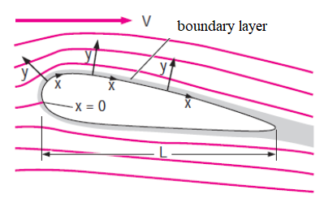
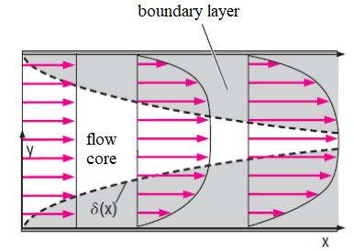
Boundary layer
Bodies in flow
External aerodynamics
Channels
Internal aerodynamics

Slide 11
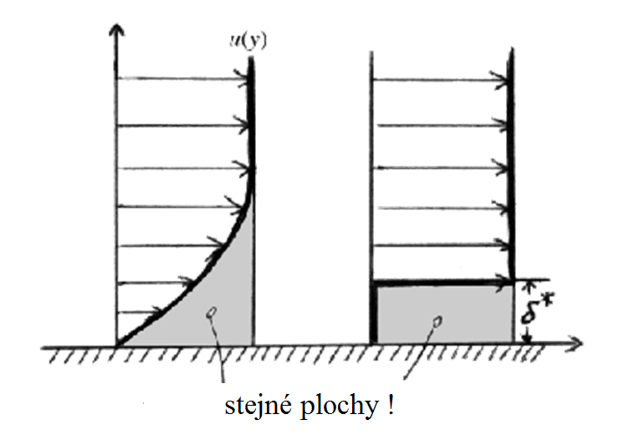
BL thickness
Conventional δ: u = 0,99 U
Displacement:
Impulse (momentum):
Shape parameter:
H = 2,6 LAM
1,3 TURB
equal area

Slide 12
Displacement thickness of BL
Reality – viscous BL
Euler model (inviscid)

Slide 13
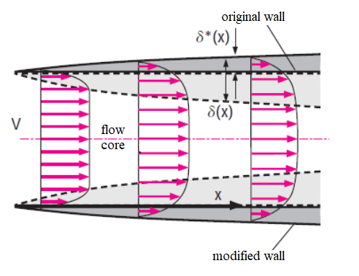
Displacement effect of BL
BL

Slide 14
Reynolds number
Length-scale in streamwise direction – convection
Length-scale in spanwise direction – diffusion
Physical meaning of Re:
Reynolds number represents length-scales of convection and diffusion of momentum ratio.
Alternatively:
Reynolds number represents time-scales of diffusion and convection of momentum ratio.
„normal“ value of Reynolds number: Re_{L} > 10 000
Typically millions
Reynolds number determinates topology and structure of SR.

Slide 15
Prandtl’s theory of BL
U
y
v
u
Asumptions:
N-SE:
x
Bernoulli
Outside BL:
Laminar BL

Slide 16
Prandtl’s equation of BL
Prandl 1904
Boundary conditions:

Slide 17
Laminar solution
Dimensionless variables
Blasius 1908
Numerical solution:
Boundary conditions:

Slide 18

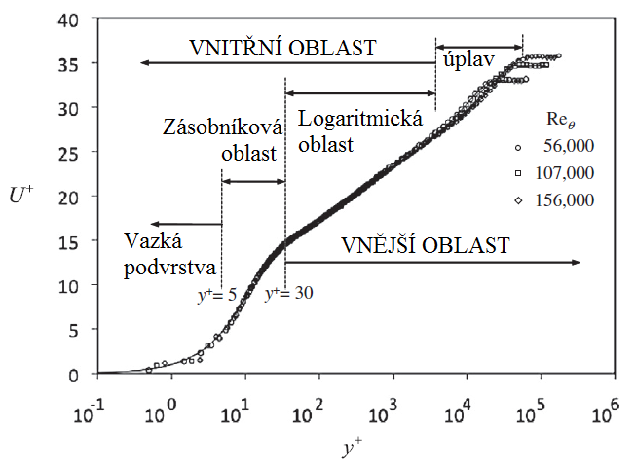


Turbulent BL
Friction velocity

Slide 19
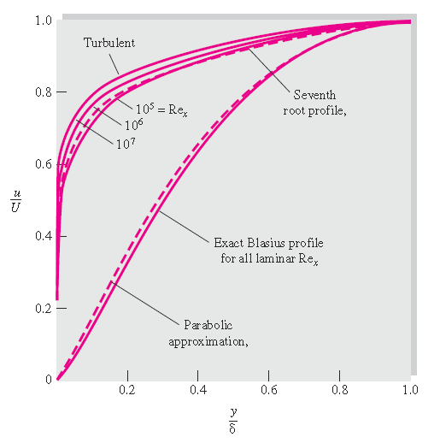
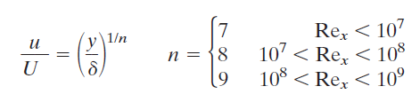
Mean velocity profile
Laminar:
Blasius
Parabola
Turbulent:
Seventh or higher

Slide 20
BL transition to turbulence
„Critical“ Re
Transition begins: Re_{x} ≈ 10⁵
Transition ends: Re_{x} ≈ 10⁶
Critical Re_{x} is affected by
Pressure gradient (streamwise)
„favorable“ – decrease (negative)
„adverse“ – increase (positive)
Bypass transition to turbulence – decreasing Re_{x} by an order of magnitude!
„big“ disturbances
In flow
On surface (roughness)
Typical situation in technical applications

Slide 21
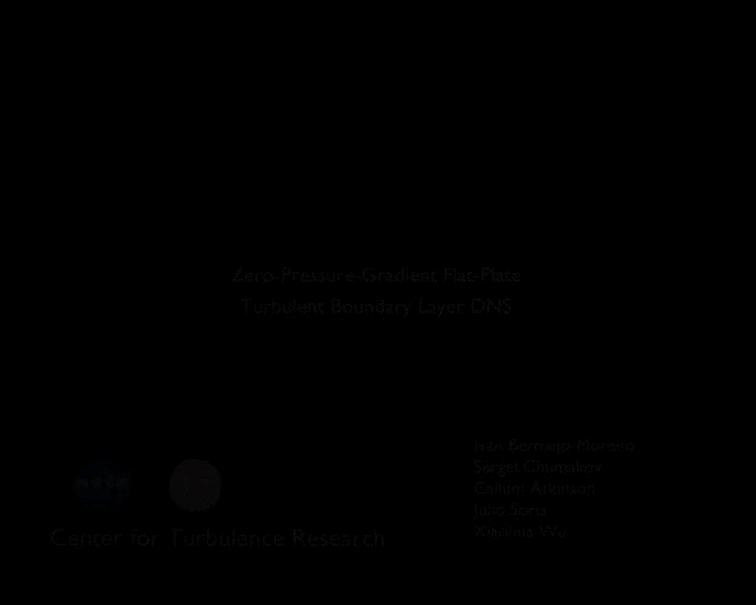
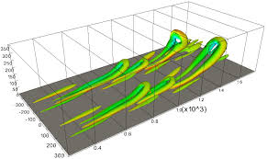
Turbulent BL – structure
Hairpin vortex

Slide 22
Pressure gradient
Bernoulli:
Pressure gradient
Zero
Favorable
Adverse
Inflection point on wall
No inflection point
Inflection point on velocity profile
STABILITY
LT transition
Separation

Slide 23
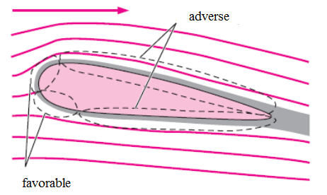
Pressure gradient
Favorable
Adverse
Favorable
FPG
Adverse
APG

Slide 24
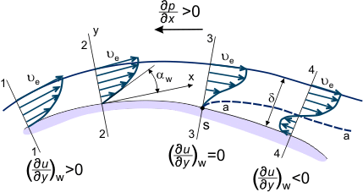
BL separation
Curved surface
FPG
APG
Separation point

Slide 25
Convergent-divergent channel
FPG
APG

Slide 26
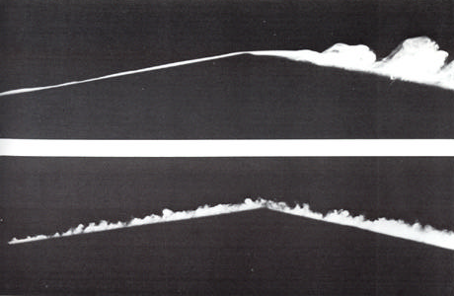
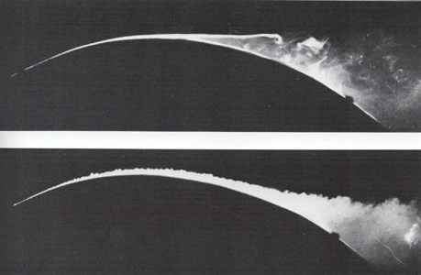
BL separation
Sharp edge
Rounded edge
L
T
Thomas Tutty, 2003

Slide 27
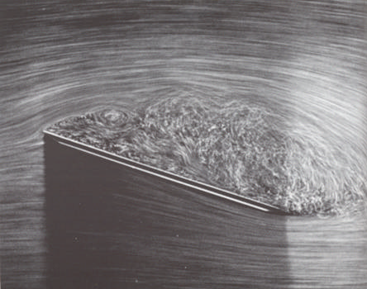
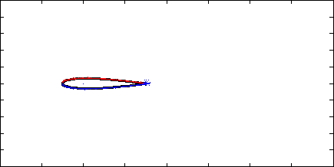
BL separation
STALL

Slide 28


Force on a wall
D(x) – drag force
b – plate width
Momentum change
Friction force

Slide 29

Plate friction force
b
L

Slide 30
BL parameters
BL parameters | Laminar | Turbulent
Conventional thickness
Displacement thickness
Impulse thickness
Shape parameter
Friction coefficient

Slide 31
BL thickness
BL thickness | Laminar | Turbulent
Displacement | 1/3 = 0,333 | 1/8 = 0,125
Impulse | 2/15 = 0,133 | 7/72 = 0,097
Shape parameter | 2,6 | 1,3
Note: δ is conventional BL thickness (99%)

Slide 32
Thanks for attention

