Slide 1
Fluid Mechanics
Prof. Václav Uruba
uruba@fst.zcu.cz
http://home.zcu.cz/~uruba/vyuka/FM/
UWB FME, KKE
Institute of Thermomechanics ASCR, CTU in Prague FME, CU FFM

Slide 2
Fluid Mechanics - lectures
Introduction, concepts, definitions
Statics
Kinematics
Dynamics
Bernoulli equation
Shear regions
External flows
Internal flows
Flow machines
Turbulence
Compressible flows and acoustics
Physical modelling
Mathematical modelling

Slide 3
Fluid Mechanics - lectures
Introduction, concepts, definitions
Statics
Kinematics
Dynamics
Bernoulli equation
Shear regions
External flows
Internal flows
Flow machines
Turbulence
Compressible flows and acoustics
Physical modelling
Mathematical modelling

Slide 4
Flow around bodies
Forces between surface and flow (pressure, shear)
Streamlined bodies and bluff bodies
Forces on a body (drag and lift)
Flow around cylinder (von Kármán-Bénárd vortex street)
Theory of thin wing – lift generation

Slide 5
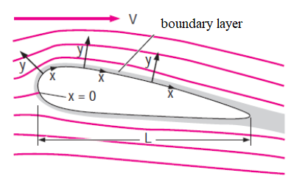
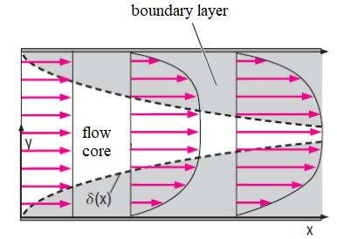
Boundary layer
Bodies in flow
External aerodynamics
Channels
Internal aerodynamics

Slide 6
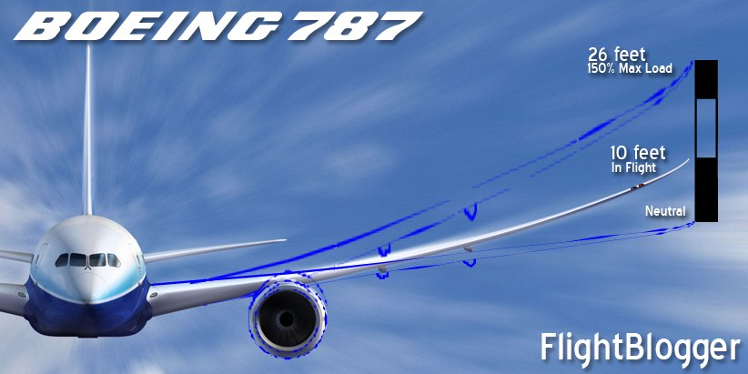

Interaction between a body and flow
Interaction = mutual effect
Body
Determinates b.c. for flow
Flow
Generates force on a body – body deformation – b.c. changed
Interaction
Static – aero(hydro)dynamics
Dynamical – aero(hydro)elasticity
Feed-back

Slide 7
Forces exerted on a body
Drag D, F_{D}
Streamwise
Lift L, F_{L}
Spanwise (upwards)
Parameters determining the forces
Geometry
Viscosity: Re
Compressibility: Ma
Attention the definition! Re = (UL)/ν
L could be chord or thickness

Slide 8
Force coefficients
Drag coefficient
Lift coefficient
Area
Dynamics pressure
Pressure force: the coefficients are close to be constant!

Slide 9
Forces between surface and flow
Friction force
Pressure force (shape)
tangential
normal
Drag
Lift

Slide 10


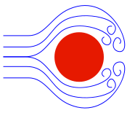
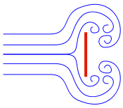
Drag
Tvar | Tvarový odpor | Třecí odpor
 | 0% | 100%
 | ∼10% | ∼90%
 | ∼90% | ∼10%
 | 100% | 0%
Streamlined
Body
No BL separation
Bluff
Body
wake
BL separation

Slide 11
Drag
Body type | Dominant mechanism | C_{D} - Re | F_{D} - U
Streamlined | Friction | C_{D} ∼ 1/Re | F_{D} ∼ U
Bluff | Pressure | C_{D} ≈ const. | F_{D} ∼ p_{d} ∼ U²

Slide 12
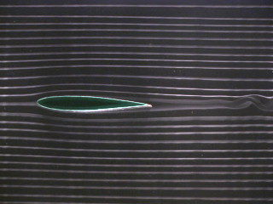
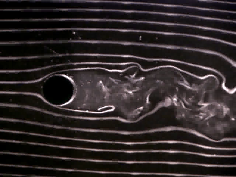
Streamlined bodies and bluff bodies – drag
Streamlined body – no BL separation
Friction force
Pressure force – small (negligible)
Bluff body – with BL separation
Friction force - small
Pressure force - dominant
wake

Slide 13
Bluff body – cylinder
Inviscid flow
Laminar BL
Turbulent BL
Forces vanish!!!
d’Alambert paradox
Big D
Small D

Slide 14
Drag 2D bodies
Pozor: log-log graf – přímka je mocninná závislost!

Slide 15
Drag 3D bodies

Slide 16
Drag 3D bodies

Slide 17
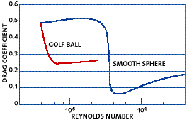
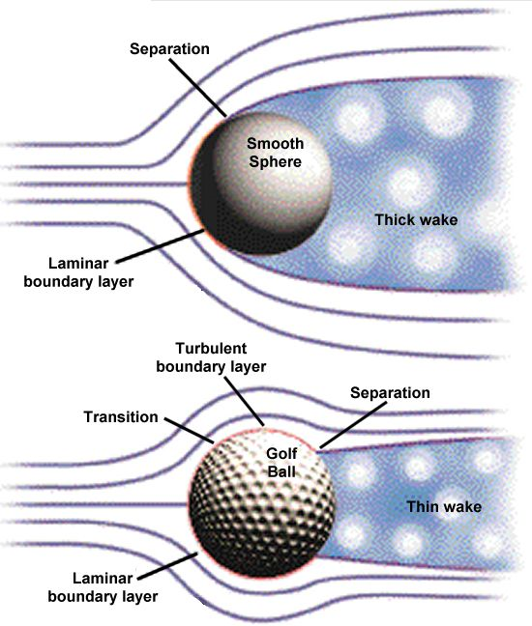
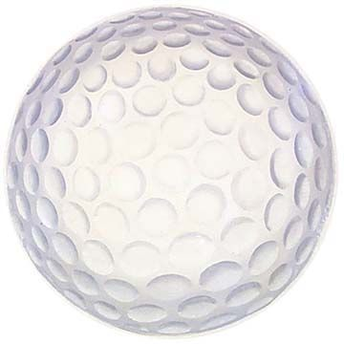
Golf ball
23 83 m/s
D = 43-45mm

Slide 18
Effect of Mach number (compressibility)
Shock waves
Drag increased

Slide 19

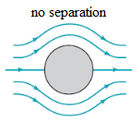
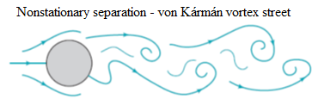
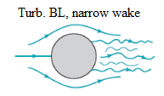
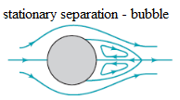
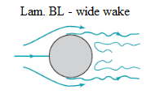
Circular cylinder
1
mm/s
1
cm/s
1
m/s
10
m/s
30
m/s
D = 0,1m
air

Slide 20
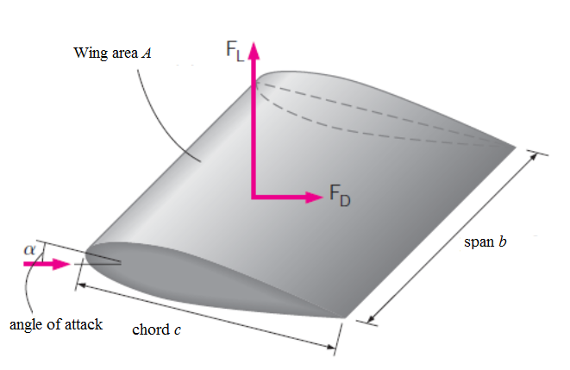
Wing
A = b.c area
A = b/c aspect ratio

Slide 21
Wing characteristics
A = b/c aspect ratio

Slide 22
Wing characteristics
Stall

Slide 23
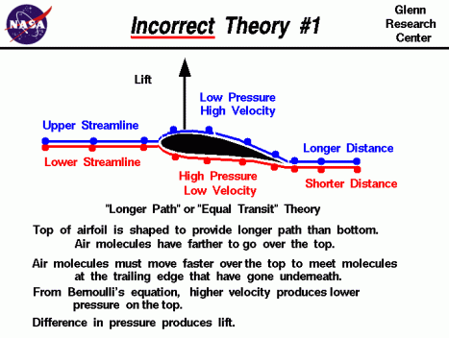
Theory of lift

Slide 24
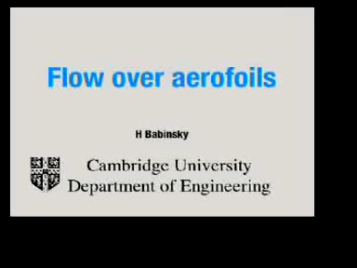
Lift mechanism

Slide 25
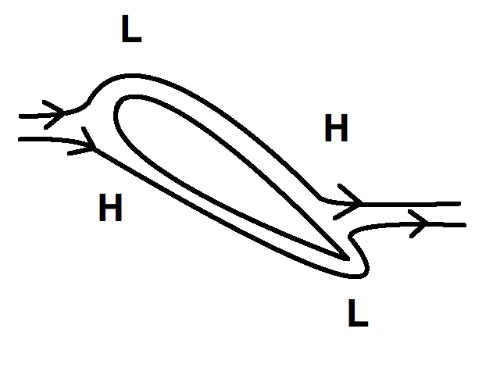
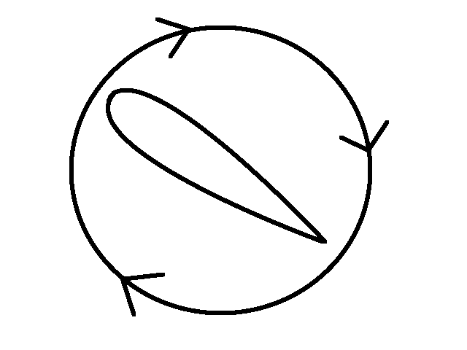
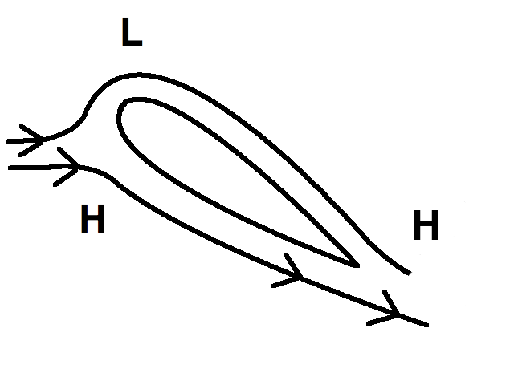
Theory Kutta (1902) – Joukovskii (1906)
2D potential flow – inviscid
d’Alambert
paradox
+
=
Lift force
Stagnation point – leading edge
width
Stagnation point – trailing edge
Drag:
Prandtls theory of BL

Slide 26


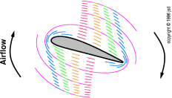
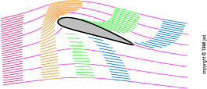

Theory Kutta – Joukovskii
Potential flow
Kutta - Joukovskii
+
=

Slide 27
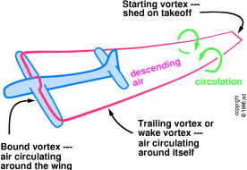
Theory Kutta – Joukovskii
Kutta – Žukovskij
Starting
vortex
Nevazké proudění

Slide 28
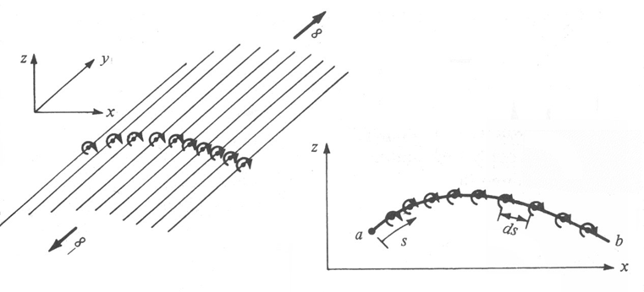
Method of vortex panels
Used today for wing design, based on Kutta – Joukovskii theory
Wing profile is simulated by vortices

Slide 29
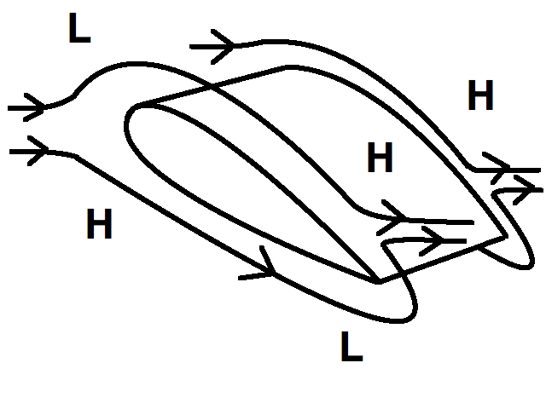
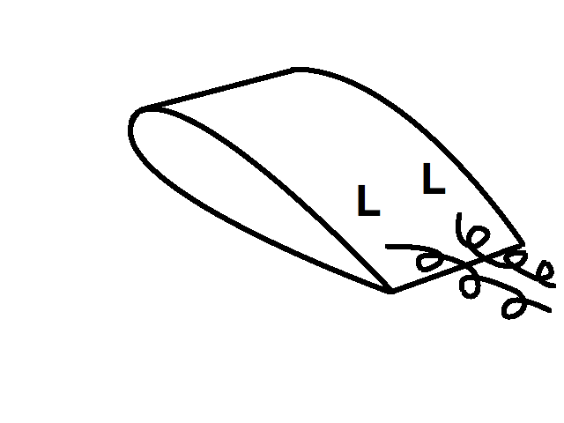
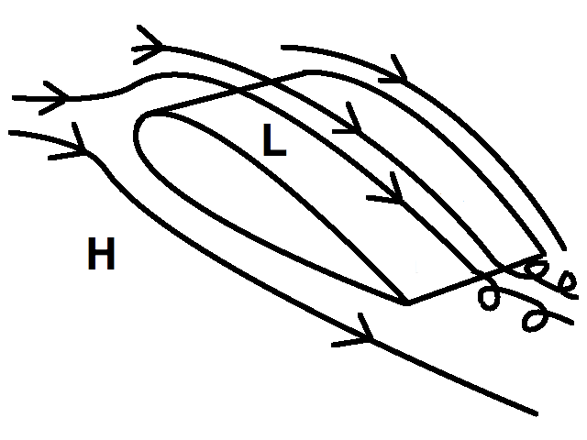
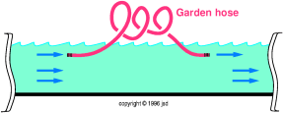
New theory on lift
Johan Hoffman a Claes Johnson, KTH Stokholm
2010
3D Potential flow
+
=
Streamwise vortices – 3D

Slide 30
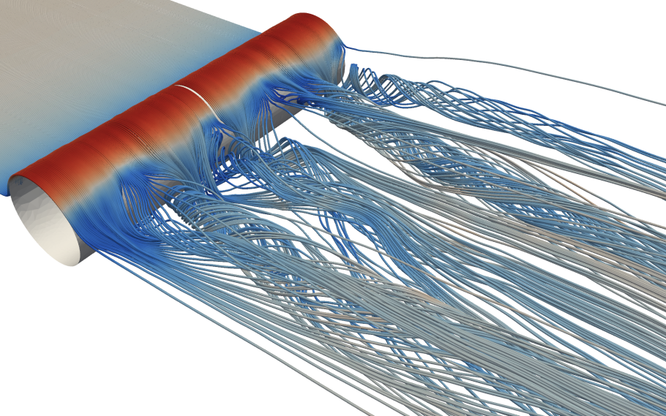
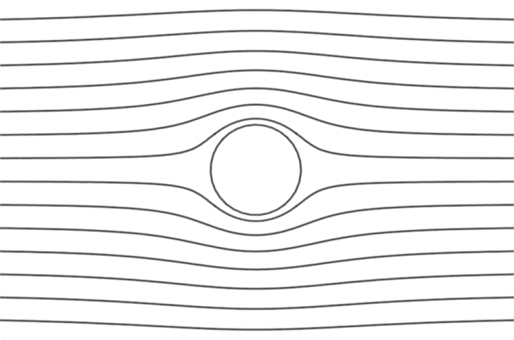
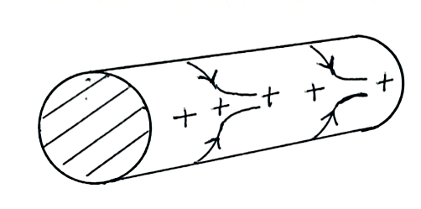
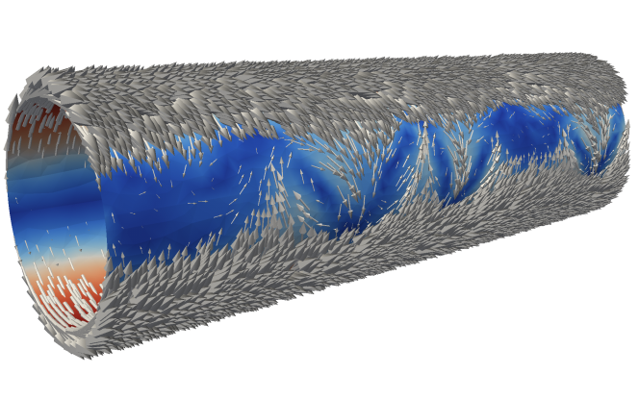
Laminar flow, low Re
Always 3D!!!

Slide 31
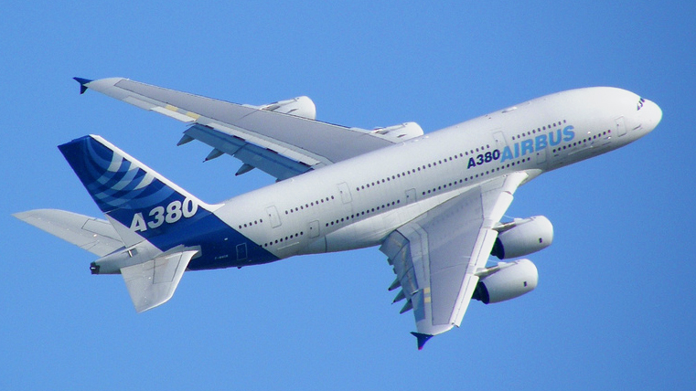
A 380

Slide 32
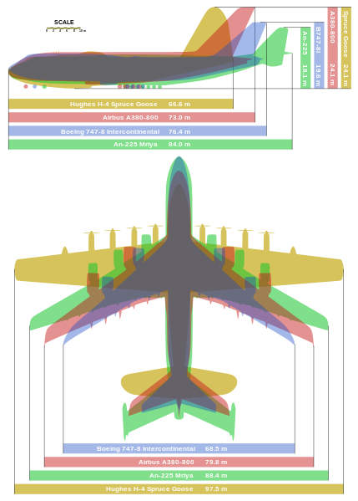
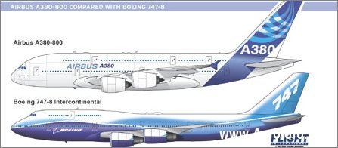
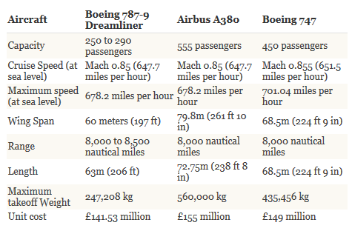

Slide 33
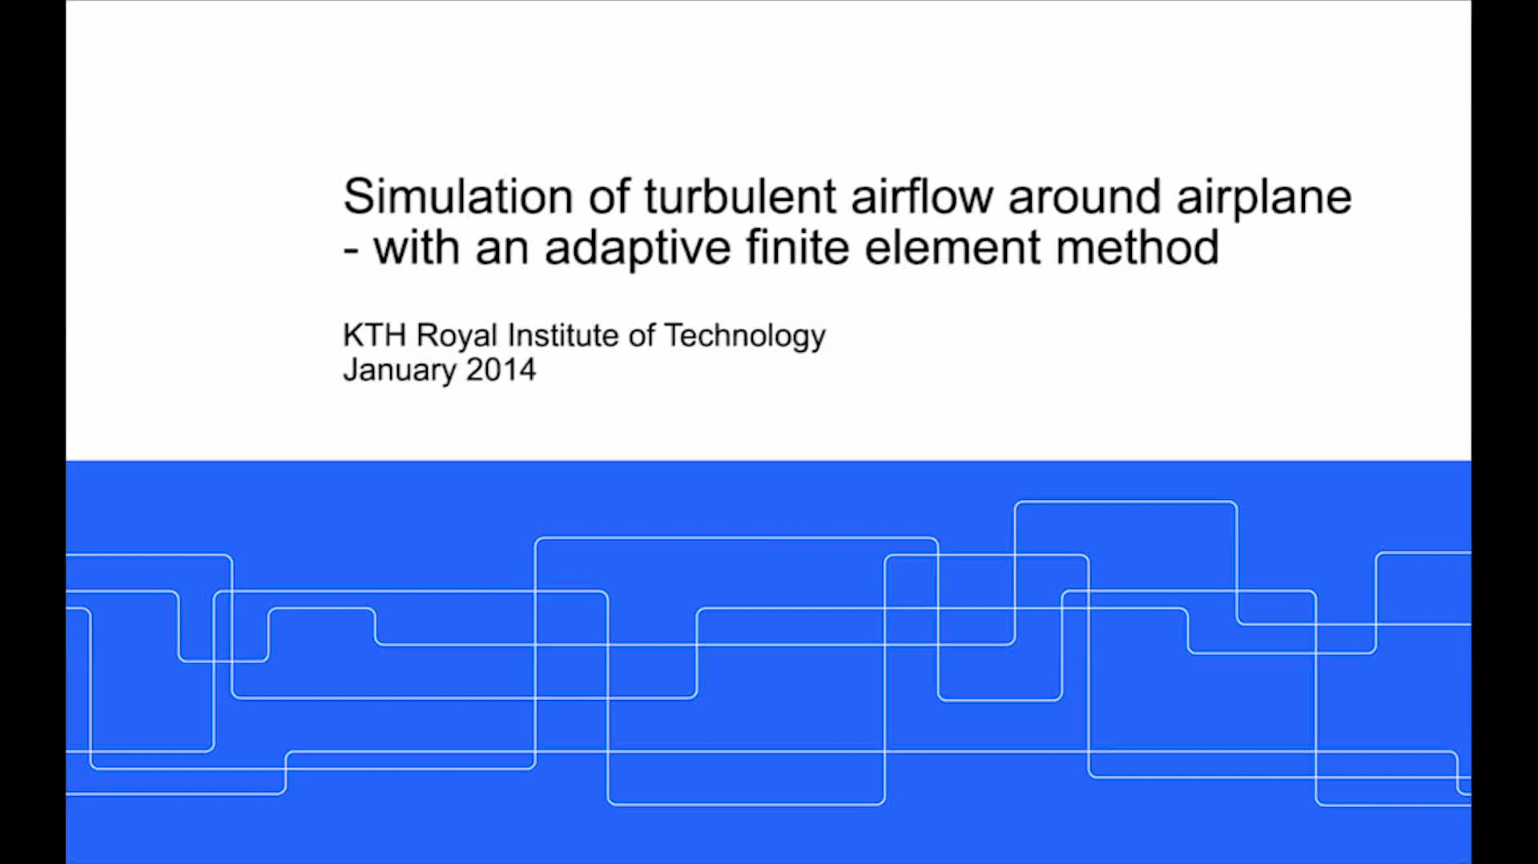
Simulation

Slide 34
Thanks for attention

Slide 35
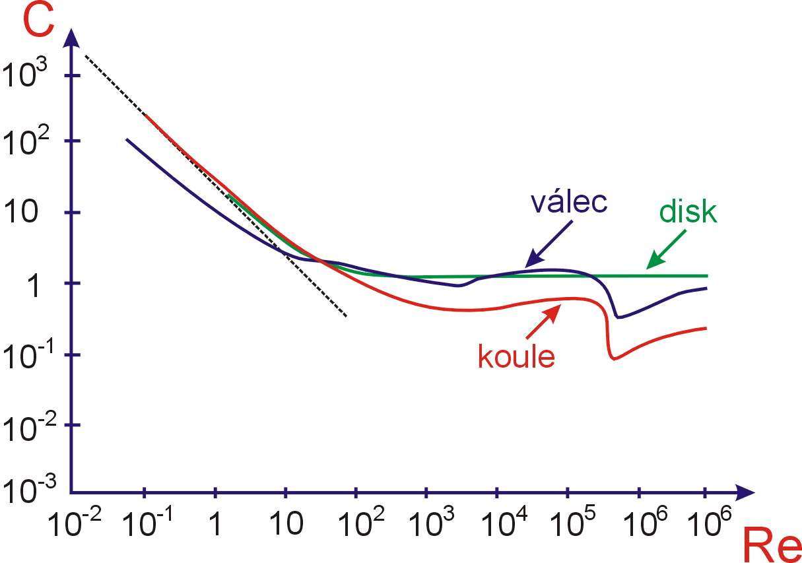
Drag
Krize odporu

Slide 36
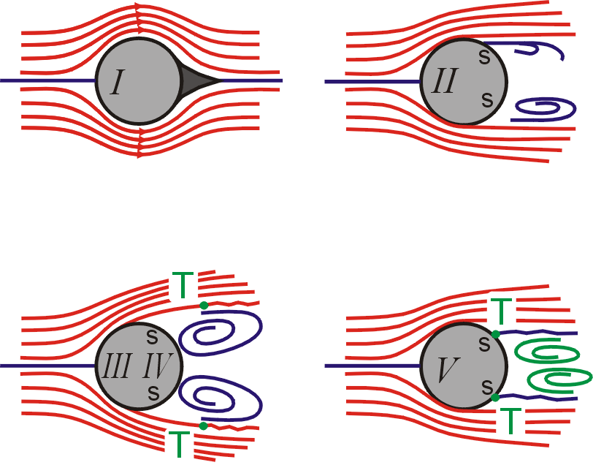
Reynolds number
Re = 1
Re = 100
Re = 100 000
subcritical
Re = 1 000 000
supercritical

Slide 37
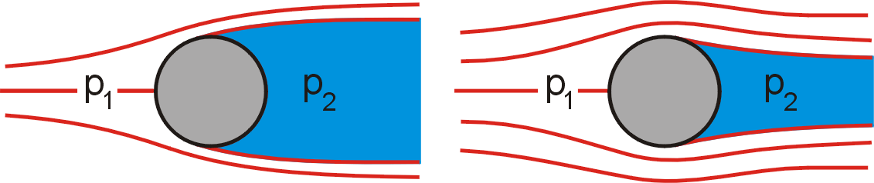
Cylinder in flow
Re = 100 000
subcritical
Re = 1 000 000
supercritical

