Slide 1
Fluid Mechanics
Prof. Václav Uruba
uruba@fst.zcu.cz
http://home.zcu.cz/~uruba/vyuka/FM/
UWB FME, KKE
Institute of Thermomechanics ASCR, CTU in Prague FME, CU FFM

Slide 2
Fluid Mechanics - lectures
Introduction, concepts, definitions
Statics
Kinematics
Dynamics
Bernoulli equation
Shear regions
External flows
Internal flows
Flow machines
Turbulence
Compressible flows and acoustics
Physical modelling
Mathematical modelling

Slide 3
Fluid Mechanics - lectures
Introduction, concepts, definitions
Statics
Kinematics
Dynamics
Bernoulli equation
Shear regions
External flows
Internal flows
Flow machines
Turbulence
Compressible flows and acoustics
Physical modelling
Mathematical modelling

Slide 4
Flow in channels and pipes
  Poiseuille a Couette flow
  Flow development in a channel
  Flow structure – laminar, turbulent, transition
  Losses determination
  Effect of rough walls (Moody, Prandtl function)

Slide 5
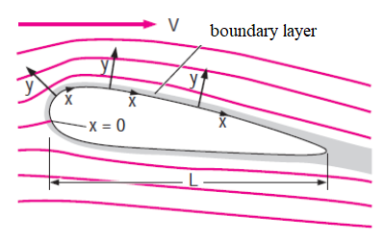
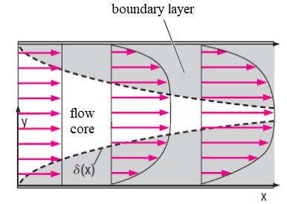
Boundary layer
Bodies in flow
External aerodynamics
Channels
Internal aerodynamics

Slide 6


Channel flow
Poiseuille (Hagen–Poiseuille) flow
  Pressure gradient
Couette flow
  Moving wall
V₂ = V₁
p₁, V₁
p₂ ?
p₂ < p₁
potrubí
V_{s}
p₁, V₁
p₂, V₂ = p₁, V₁
ložiska

Slide 7
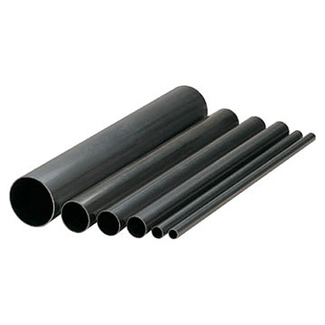
Channel geometry
3D – generally
2D
  Between flat plates
  Boundary effects
Rotary symmetrical (2D)
  Circular cross-section průřez
  No „fittings“

Slide 8
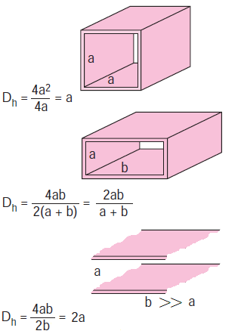
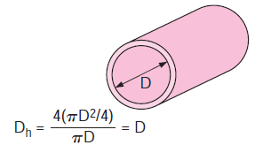
Noncircular cross-section
area
Hydraulic diameter:
„wetted“ perimeter

Slide 9
Flow development on inlet
Fully developed:
BR without losses:
friction
NOT VALID !

Slide 10

Flow development
Laminar
Turbulent

Slide 11
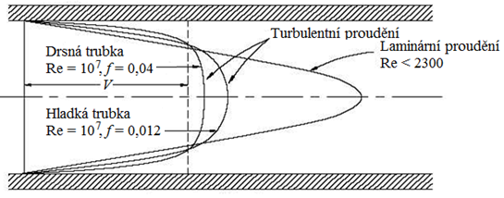
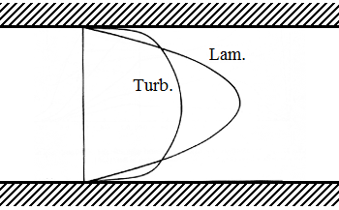
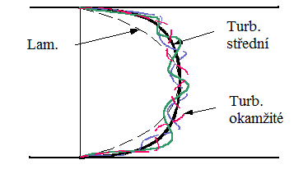
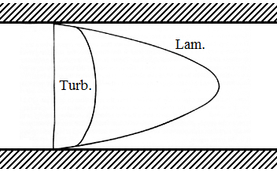
Flow structure
Laminar
Turbulent
Same flow rate
Same losses (pressure grad)
Laminar
Turbulent

Slide 12
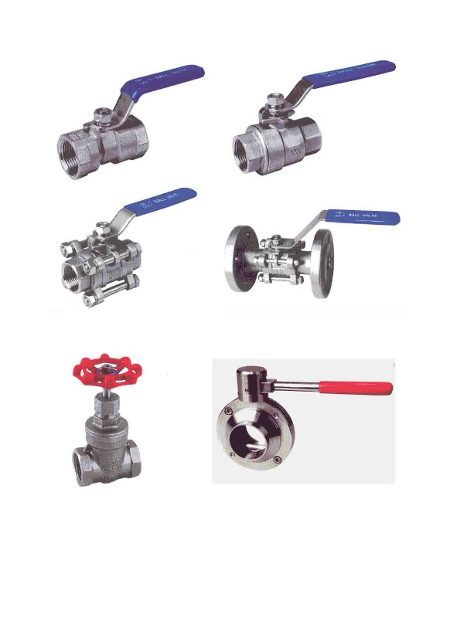
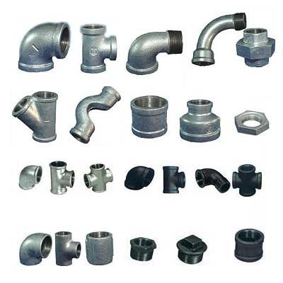
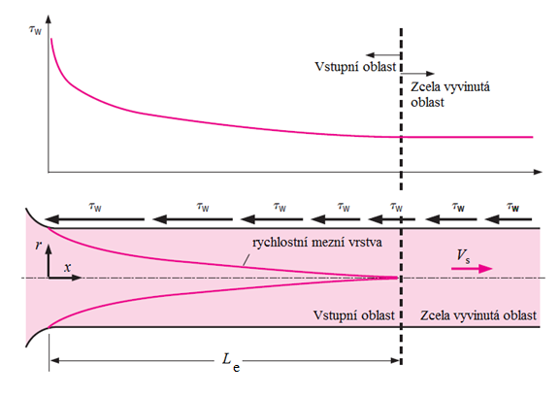
Losses in pipe
Friction losses
  Friction on walls (BL)
  Along whole pipe
Local loses
  Predominantly pressure
  In a given location („fittings“)
  Shock waves

Slide 13
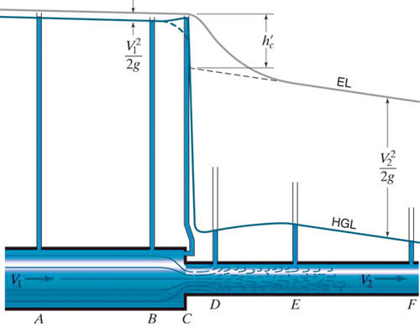
Loses in pipe
HGL
EH=const
BE:
EH no losses
Local losse C
Friction losse C-F
BE

Slide 14
Friction in pipe
Relevant quantities – 7
Physical dimensions – 3 [m,kg,s]
Buckingham: 7-3=4 parameters
Darcy-Weisbach, Hagen:
Darcy friction parameter:
f, λ, ζ

Slide 15
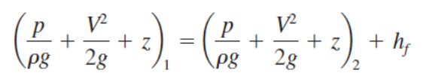
Bernoulli equation
Losse heigth (friction)
Turb. – Prandtl:

Slide 16
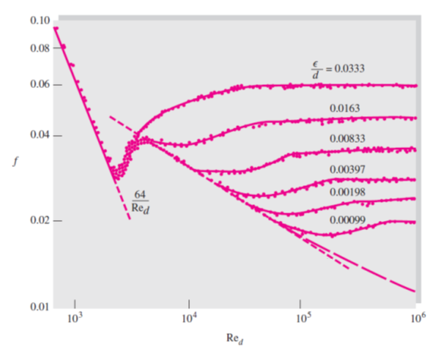
Effect of rough walls
Lam: NO
Turb: lose increase
Lam.
Turb.
Experiments
Nikuradze 1933
Prandtl fce:

Slide 17
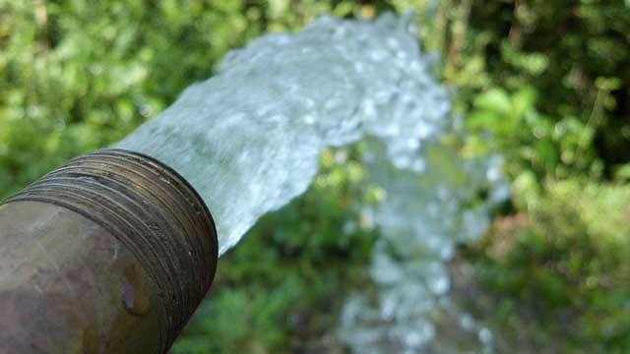
Friction coefficient
Laminar flow
Turbulent flow

Slide 18
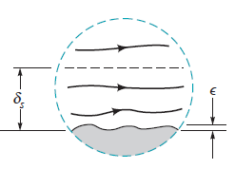
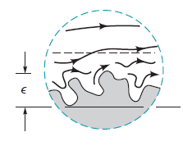



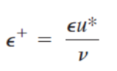
Wall roughness effect
Laminar BL - NO
Turbulent BL
  Hydraulically smooth: no effect
  Admissible roughness: Re_{d} effect
  Fully rough surface: no Re_{d} effect
Viscous sublayer thickness:
y⁺ = 5

Slide 19
Wall roughness effect
Colebrook equation 1939
  implicit – iterations
Moody diagram 1944
  Graphical form of CE
parameter

Slide 20
ASME, accuracy 15%

Slide 21
Surface roughness
Material | State | Roughness ε [mm]
Steel | Sheet, new | 0,05
 | Wall roughness effect, new | 0,002
 | Corroded surface | 2,0
Brass | Drawn | 0,002
Plasttic | Pipe | 0,0015
Glass |  | 0
Concrete | Smooth | 0,04
 | Rough | 2,0
Rubber | Smooth | 0,01
Wood | Rough board | 0,5
Pipe surface
Material
Processing
State

Slide 22

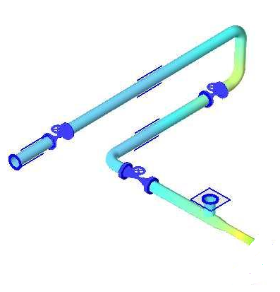

Local loses
K, K_{L}, ζ
Loss coefficient:
Loss height – total:
BE:
K₆
K₅
K₇
2
K₄
K₃
K₂
K₁
1

Slide 23
Local losses
Elbow-pipe

Slide 24
Pipe changes

Slide 25
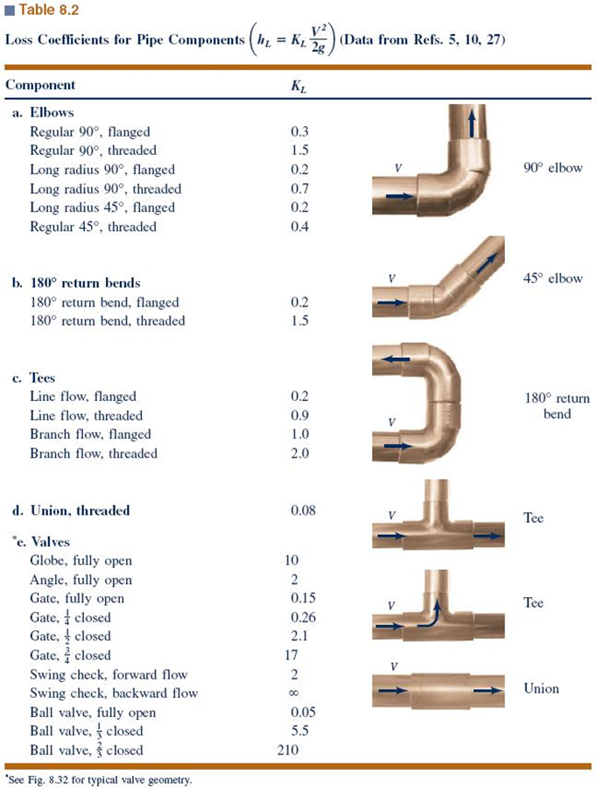

Slide 26
Tasks
Definition:
  Fluid (density, viscosity)
  Pipe (length, roughness)
Unknown:
  Pipe dia
  Flow rate (velocity)
  Pressure loss
1 quantity unknown,
2 must be known

Slide 27
Thanks for attention

