Slide 1
Fluid Mechanics
Prof. Václav Uruba
uruba@fst.zcu.cz
http://home.zcu.cz/~uruba/vyuka/FM/
UWB FME, KKE
Institute of Thermomechanics ASCR, CTU in Prague FME, CU FFM

Slide 2
Fluid Mechanics - lectures
Introduction, concepts, definitions
Statics
Kinematics
Dynamics
Bernoulli equation
Shear regions
External flows
Internal flows
Flow machines
Turbulence
Compressible flows and acoustics
Physical modelling
Mathematical modelling

Slide 3
Fluid Mechanics - lectures
Introduction, concepts, definitions
Statics
Kinematics
Dynamics
Bernoulli equation
Shear regions
External flows
Internal flows
Flow machines
Turbulence
Compressible flows and acoustics
Physical modelling
Mathematical modelling

Slide 4
Jet machinery
Theorem on momentum flux change
Radial and axial machines
Turbines and compressors (pumps)

Slide 5
Control volume
Balance of momentum
Differential equation (for element)
In general N-SE
1D BE
Integration – balance in „control volume“ (CV), „control surface“ (CS)
Sum of outer forces = CV momentum change rate + flux of momentum CS

Slide 6
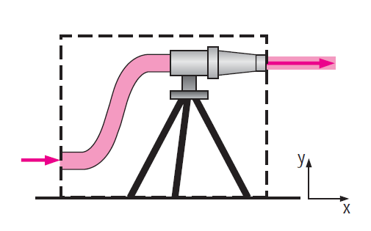

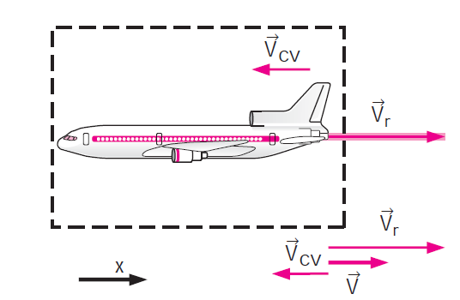

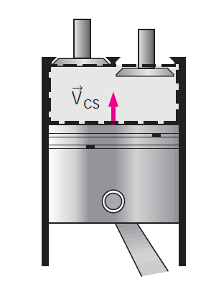

Control volume
Fixed
Moving
Deformable
V_{r} relative velocity

Slide 7
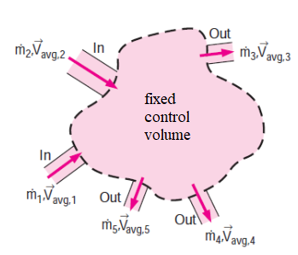
Stationary case
d/dt = 0
IN or OUT:

Slide 8
Velocity profile
Correction of momentum flux
(averaged momentum):
Correction coefficient

Slide 9
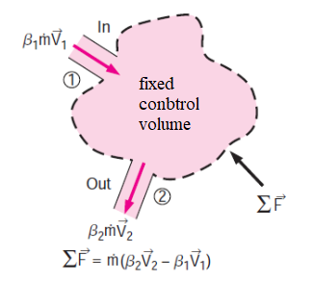
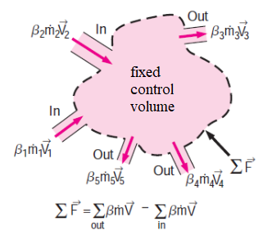
Stationary case
1 IN, 1 OUT:
In general:

Slide 10
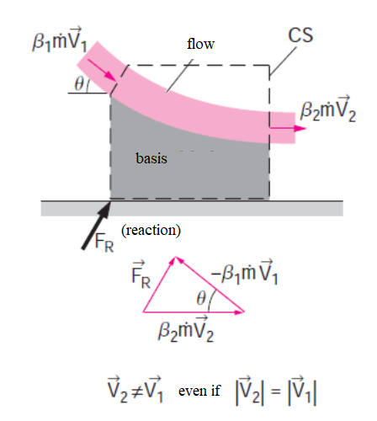
Flow direction

Slide 11
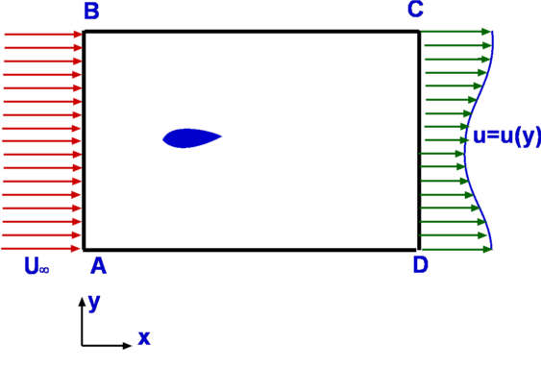

Drag force

Slide 12
Typical problems
Force

Slide 13
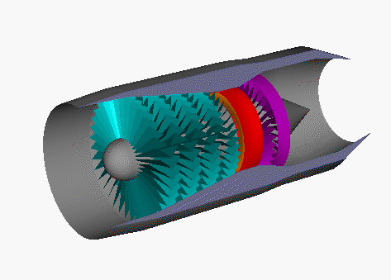
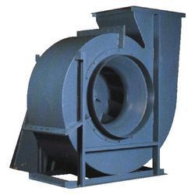
Jet machines
Function
Turbine (energy of flow – work)
Compressor (work – energy of flow)
Design
Axial
Radial
Inter-blade channel
Stator - stationary
Rotor - movable
For design: relative velocities

Slide 14
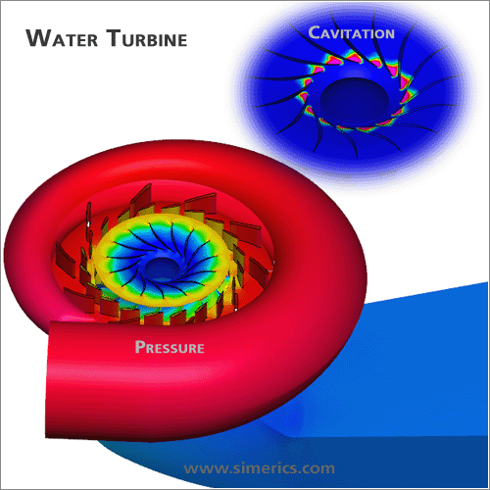
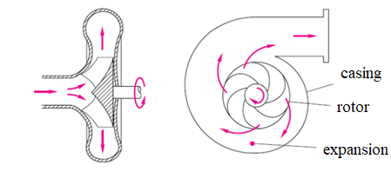
Radial machine

Slide 15
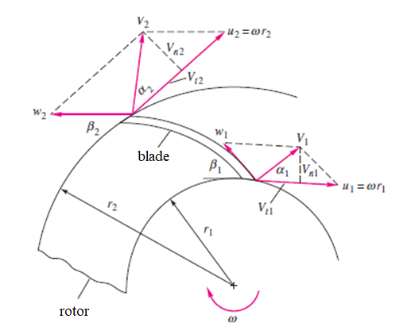
Radial machine

Slide 16
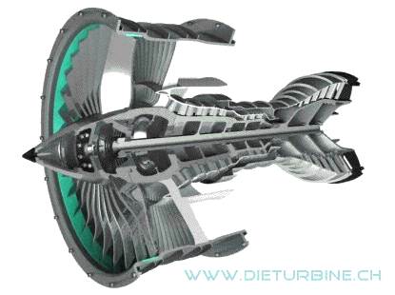
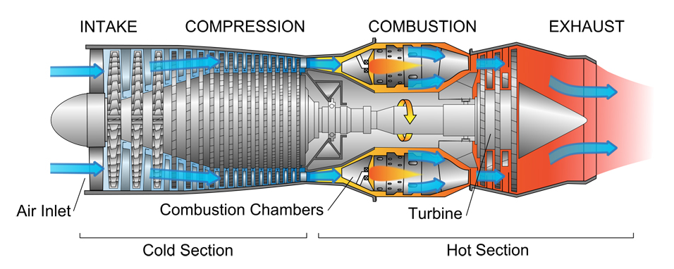
Axial machine

Slide 17
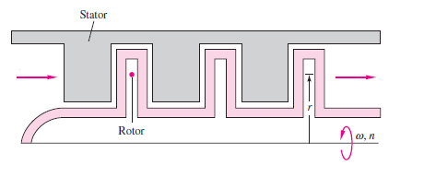
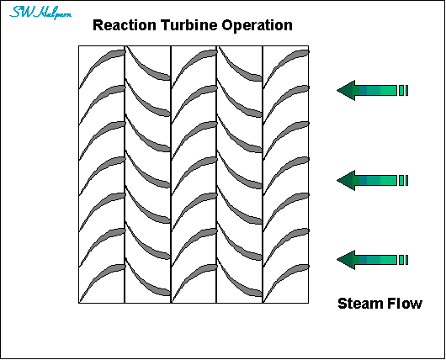
Axial machine

Slide 18
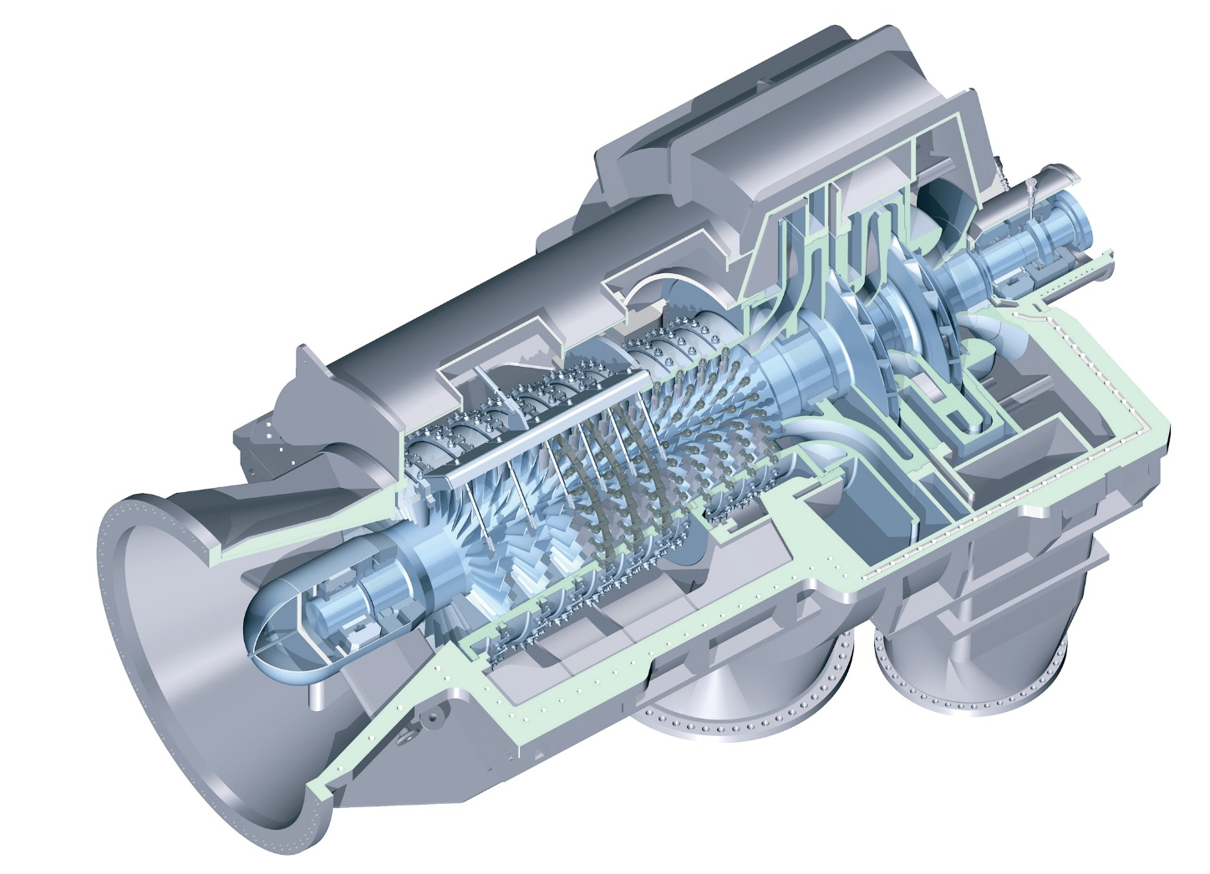
Axial-radial machine (compressor)

Slide 19
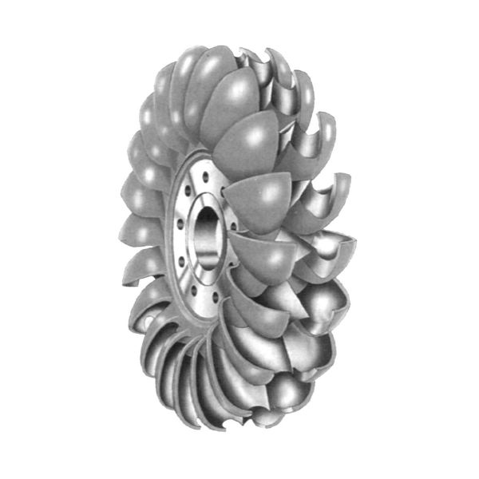
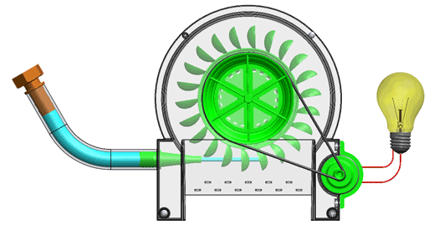
Pelton turbine

Slide 20
Thanks for attention

