Slide 1
Fluid Mechanics
Prof. Václav Uruba
uruba@fst.zcu.cz
http://home.zcu.cz/~uruba/vyuka/FM/
UWB FME, KKE
Institute of Thermomechanics ASCR, CTU in Prague FME, CU FFM

Slide 2
Fluid Mechanics - lectures
Introduction, concepts, definitions
Statics
Kinematics
Dynamics
Bernoulli equation
Shear regions
External flows
Internal flows
Flow machines
Turbulence
Compressible flows and acoustics
Physical modelling
Mathematical modelling

Slide 3
Fluid Mechanics - lectures
Introduction, concepts, definitions
Statics
Kinematics
Dynamics
Bernoulli equation
Shear regions
External flows
Internal flows
Flow machines
Turbulence
Compressible flows and acoustics
Physical modelling
Mathematical modelling

Slide 4
Turbulence
  Properties of turbulence (dynamics, randomness, vorticity, fractality, 3D, effective mixing)
  Turbulence origin (flow stability)
  Equations of turbulent flow RANS
  Solubility of turbulent flows

Slide 5
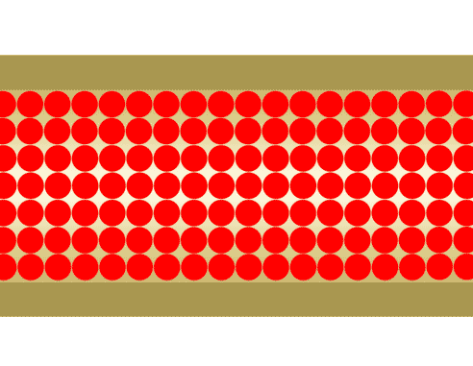

Laminar x turbulent flow
Laminar flow of viscous fluid
  Parallel streamlines (movement in layers)
  Spanwise only molecular diffusion
  „Limited“ vorticity
  Stationary (?)
  2D(?)
Turbulent flow
  Non-stationary
  3D
  Vortical
  …
Not potential flow !!!
(internal friction)

Slide 6

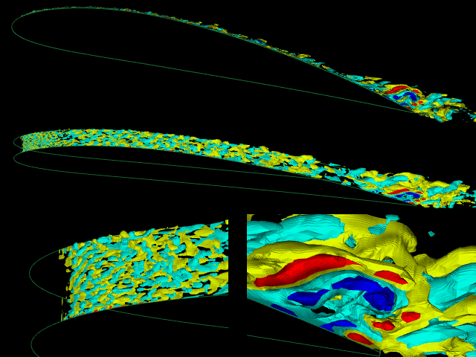
Turbulence – definition (attributes)
Jansen 2000
Complexity
Randomness (deterministic chaos)
Time-space character
Dynamics (waves)
Topology (3D)
Spectrum of scales (fractality)
Coherent structures
Vorticity (vortices)
Diffusivity
Dissipativity
Irreversibility
Non-linearity
…

Slide 7
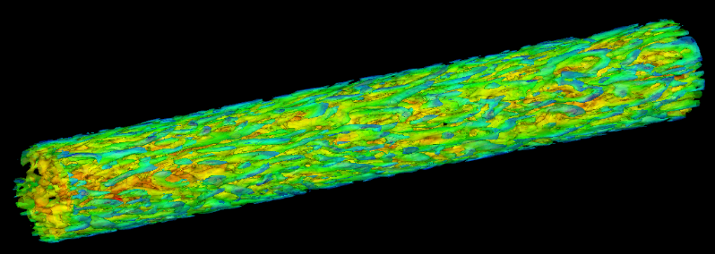
Flow in pipe
Water: Re_{crit} ≈ 2000 = > U_{crit} ≈ 2 .10⁻³/D
D [m] | U_{crit} [m/s] | Q [m³/s]
0.001 | 2 | 1.6 10⁻⁶
0.01 | 0.2 | 1.6 10⁻⁵
0.1 | 0.02 | 1.6 10⁻⁴
0.5 | 0.004 | 8 10⁻⁴
1 | 0.002 | 1.6 10⁻³
10 | 0.0002 | 1.6 10⁻²
Laminar
???
Turbulent

Slide 8

Thermal flow
TURBULENT !!!

Slide 9
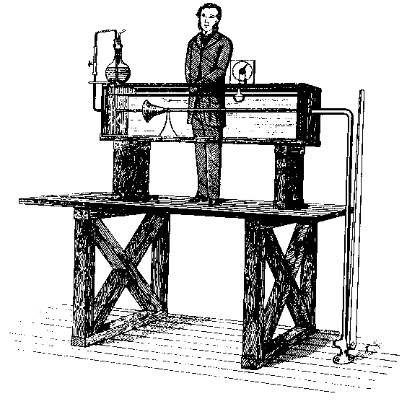
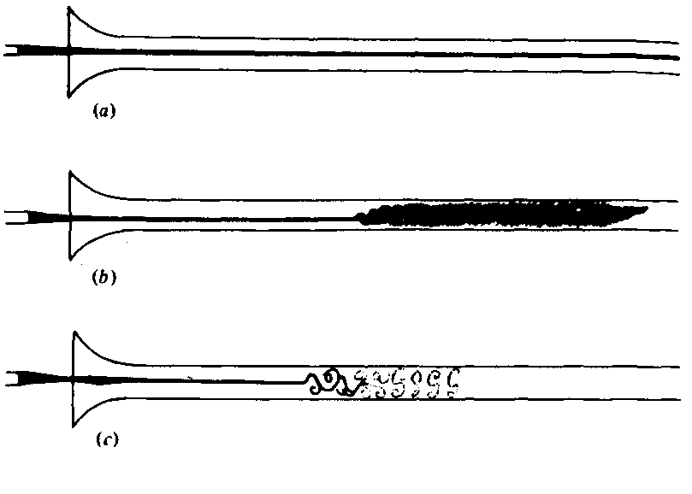
Reynolds experiment
Osborn Reynolds 1883

Slide 10
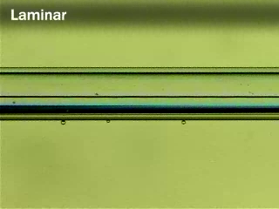
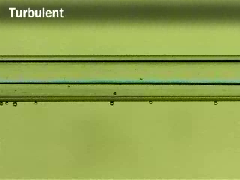
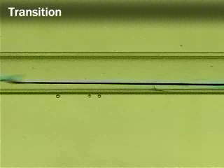
Reynolds experiment
Re = 1000
LAMINAR flow
Re = 3000
TURBULENT flow
Re = 2000, INTERMITENT flow

Slide 11
Stability
System response on perturbance
Potentially instable: SHEAR REGION
Perturbance:
  Turbulence of incoming flow
  Wall roughness
  Wall vibrations
  Wakes behind obstacles
  Thermal perturbances
  Particles in fluid
  Pressure fluctuations (acoustics)
  …
Laminar-turbulence transition promotion
stable
indifferent
instable
linearly
instable
non-linearly
Re

Slide 12
Shear regions
Potentially instable
Basic
  Free SR
  Wall SR (boundary layers)
Combined
  Jet
  Channel
  Wake
Re_{krit} ≈ 1000

Slide 13
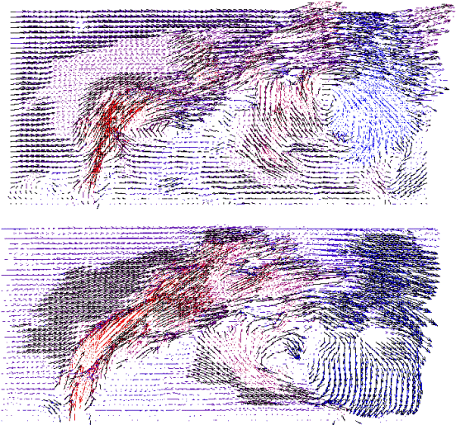
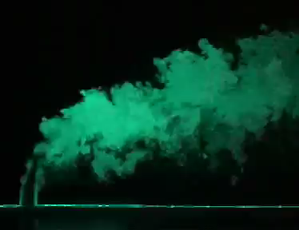
Turbulence
Jet in cross flow
Visualization
Instantaneous snaps

Slide 14
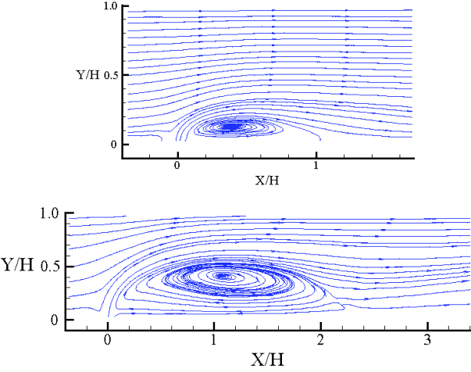
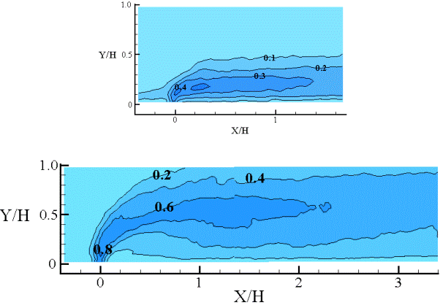
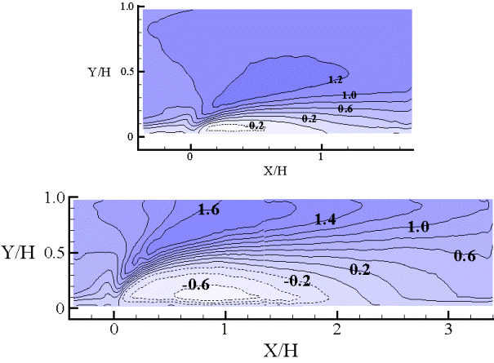
Turbulence
Engineering approach
Statistics – time averaged quantities
  Mean
  Variance

Slide 15
Reynolds decomposition
Decomposition
  Mean
  Fluctuation
Properties
Ansemble average
Ergodic process: time average

Slide 16
Averaging properties
Time function
Linearity
Commutativity
  with derivative
  With integration
Double averaging
Multiplication averaging
ATTENTION!!!
Constant

Slide 17
Velocity and pressure fluctuations
Velocity and dynamic pressure on a streamline:
Reynolds decomposition:
Averaging:
Non-linear relation
between p_{d} and V
!!!
Averaged dynamic pressure DO NOT correspond to dynamic pressure of mean velocity!!!

Slide 18
Continuity equation
Field of instantaneous velocities is solenoidal
Reynolds:
Operation
averaging
BOTH fields of mean velocities and fluctuations are solenoidal

Slide 19
Substantial derivative
NELINEÁRNÍ !
Operation averaging
?
Integration per-partés:
= 0 (continuity)
Extra term !

Slide 20
Reynolds equations
Reynolds 1894
N-S equations
Operation averaging
Reynolds
Eq.
0
Extra term !
Reynolds Averaged Navier Stokes

Slide 21
Solvability of RANS
Equations: 3 + 1
Unknowns:
3
1
6 (sym)
Total 10 PROBLEM!!!
Additional equations necessary (6)

Slide 22
Reynolds stress
Formal modification
stress
stress 1
Mean pressure
stress 2
Mean viscous
stress 3
Velocity fluctuations
Reynolds stress

Slide 23
Reynolds stress
Reynolds stress
Tensor 2nd order
  Symmetric
  Semidefinite
6 independent quantities

Slide 24
Reynolds stress
Physical meaning
Mean i-momentum flux component generated by velocity fluctuations in j-direction.
Mean j-momentum flux component generated by velocity fluctuations in i-direction.
Always 3D!

Slide 25
RANS solution
Anisotropic part R_{ij}
Joseph Valentin Boussinesq 1877
Turbulent viscosity hypothesis

Slide 26

Prandtl mixing length
Estimate
Shear stress
x₂
u₁
Boundary layer
x₁
x₂
BL boundary
τ_{eff}
τ_{turb}
x₁

Slide 27
Turbulent viscosity
Property of flow (not fluid)
In turbulence predominates molecular v. (order of magnitude)
Outside turbulence vanishes (approaches 0)
Close to wall (viscose sublayer) vanishes (approaches 0)
Distribution of turbulent viscosity in space:
  Input to solve RANS
  Flow solution
Problem!!!

Slide 28
Quantities in RANS
  Velocity
  Pressure
  Reynolds stress
  Kinetic energy
  Dissipation rate
  Specific dissipation rate

Slide 29
Turbulence modelling
Additional equations for Reynolds stress
Algebraical models:
  Mixing length l _{mix}
1-equation models
2-equations models
  Kinetic energy k
  Dissipation rate ε
  Specific dissipation rate ω = ε /k
Equations for Reynolds stresses R_{ij}

Slide 30
Turbulent flow solution - options
Direct Numerical Simulation – DNS
  Difference equations
Averaged N-S equations – RANS
  Mean values
  Turbulence modelling
Combined approach – URANS, LES (Large Eddy Simulation)
  Big structures – simulation (DNS)
  Small structures – modelling (RANS)
We do note have HW
Basic eng. approach
„Advanced“ eng. approach
More in lectures on mathematical modelling

Slide 31
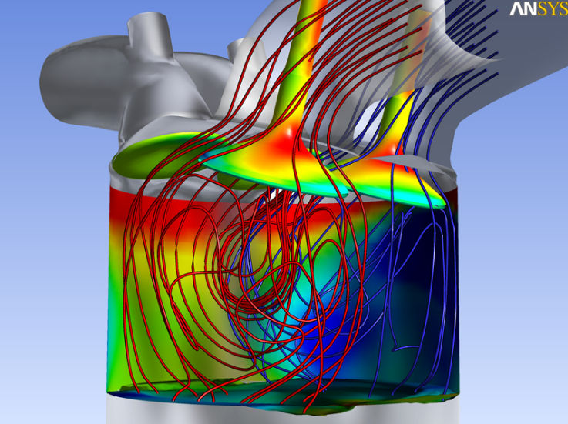
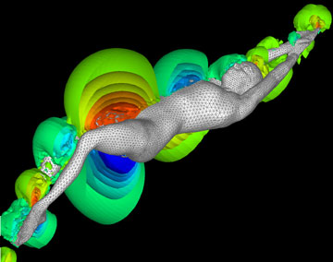
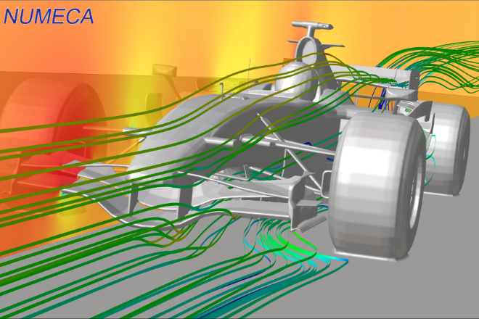
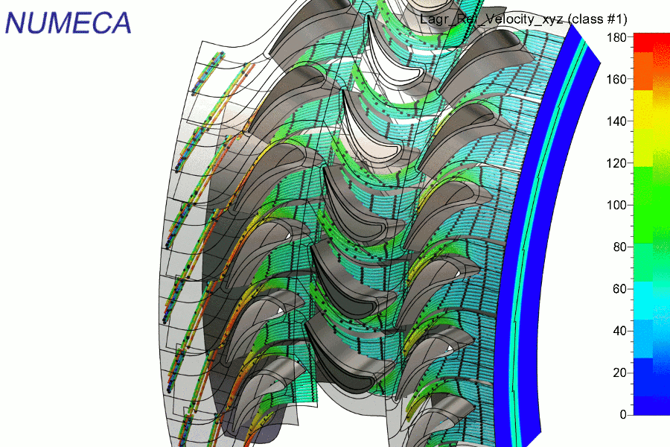
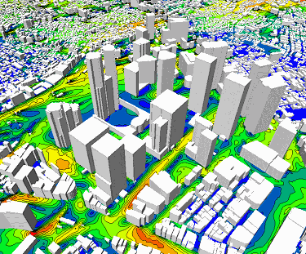
Engineering approach
Computer Fluid Dynamics CFD software
  ANSYS
    FLUENT
    CFX
  NUMECA FINE
  OpenFOAM

Slide 32
Thanks for attention

