Slide 1
Fluid Mechanics
Prof. Václav Uruba
uruba@fst.zcu.cz
http://home.zcu.cz/~uruba/vyuka/FM/
UWB FME, KKE
Institute of Thermomechanics ASCR, CTU in Prague FME, CU FFM

Slide 2
Fluid Mechanics - lectures
Introduction, concepts, definitions
Statics
Kinematics
Dynamics
Bernoulli equation
Shear regions
External flows
Internal flows
Flow machines
Turbulence
Compressible flows and acoustics
Physical modelling
Mathematical modelling

Slide 3
Fluid Mechanics - lectures
Introduction, concepts, definitions
Statics
Kinematics
Dynamics
Bernoulli equation
Shear regions
External flows
Internal flows
Flow machines
Turbulence
Compressible flows and acoustics
Physical modelling
Mathematical modelling

Slide 4
Compressible flow and acoustics
Compressibility in fluid dynamics (stratified barotropic fluid, compressible flow)
Shock wave origin, structure
Compressible flow in practice (subsonic, transonic, hypersonic)
Basics of acoustics

Slide 5
Compressibility in FD
Var pressure ⇒ SE ⇒ var density:
Var velocity ⇒ BE ⇒ var pressure:
Var density are „big“ (otherwise could be neglected)
Gas dynamics, „ideal gas“ is considered often

Slide 6
Fluid dynamics
Continuity equation
Momentum equation (NS, BE)
Energy equation
Equation of state
Incompressible
flow
Compressible flow

Slide 7
Barotropic fluid
Compressible
Thermodynamics is neglected
ρ = f(p)
Variable density and pressure - quasistatic
Meteorology: isobars = isopyknas
Similar effect: stratification
Atmosphere (temperature)
Sea water (salt concentration)
const. density
const. pressure

Slide 8

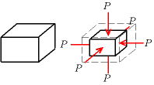
Speed of sound
General:
Ideal gas:
Air: c = 331,3 + 0,606 * t m/s
Water: c ≈ 1 500 m/s
K: coefficient of stiffness, the isentropic bulk modulus
Air: 1.1 10⁵ Pa
Water: 2.2 10⁹ Pa
Steel: 1.6 10¹¹ Pa
M = 0,0289645 kg/mol (molar weight)
R = 8,314510 J (K mol)⁻¹

Slide 9
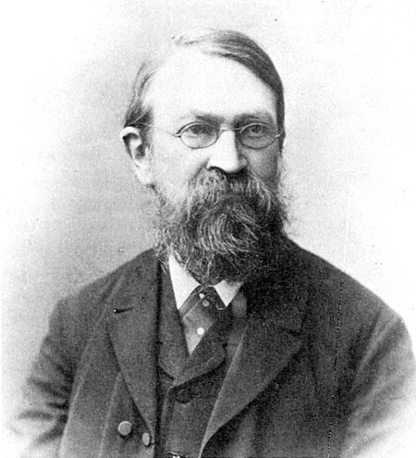
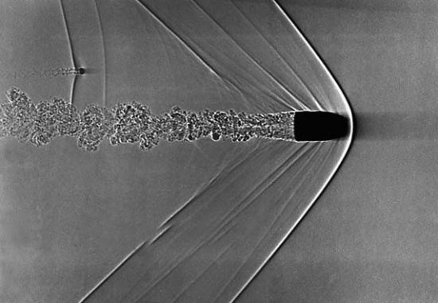
Mach number
Effect of fluid compressibility
Ernst Mach (1838-1916)

Slide 10
Sub-, trans-, super-, hypersonic
Subsonic, incompressible: Ma < 0,3
Subsonic compressible: 0,3 < Ma < 1
Transonic: 0,8 < Ma < 1,3 shock waves
Supersonics: 1 < Ma < 3
Hypersonic: 3 < Ma

Slide 11
Bernoulli equation for compressible flow
Entalpy
Internal energy
BE:
Big velocities, gas – potential e. neglected
Subsonic – isentropic process:
1,4 for 2 atoms ideal gas

Slide 12
Bernoulli equation for compressible flow
Integration between 1 and 2:

Slide 13
Bernoulli equation for compressible flow
Point 1: V₁ = V, p₁ static p
Point 2 is stagnation: V₂ = 0, p₂ = p_{tot} = p₀
Static density
Static pressure
Static temperature

Slide 14
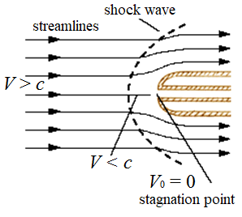
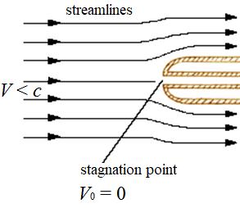
Bernoulli equation for compressible flow
isoentropic
isoentropic
Non-isoentropic

Slide 15
Air (isentropic, ideal gas)
γ = 1,4

Slide 16
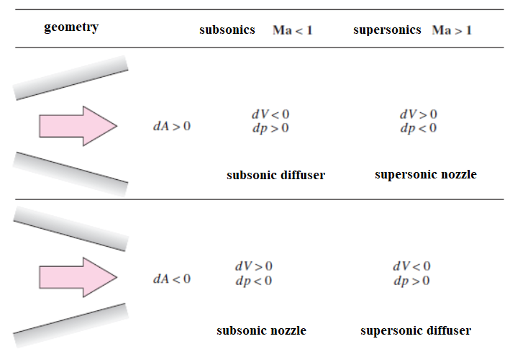
Diffusor x nozzle

Slide 17
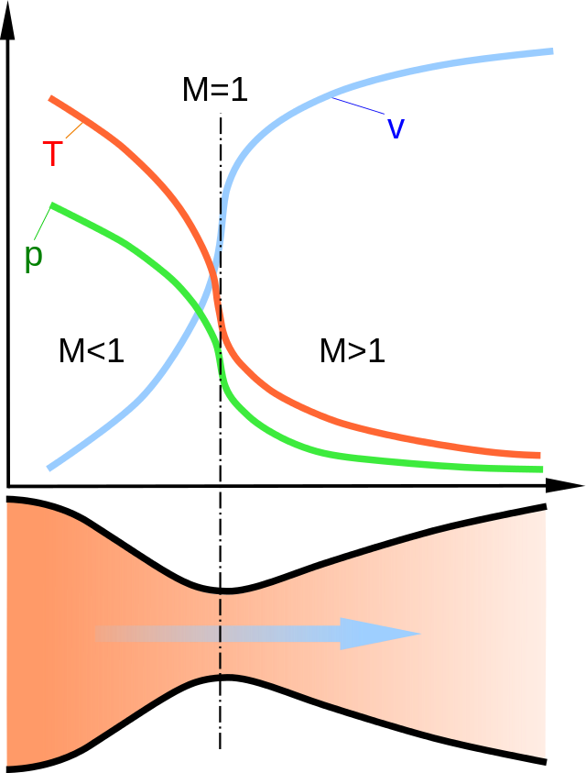
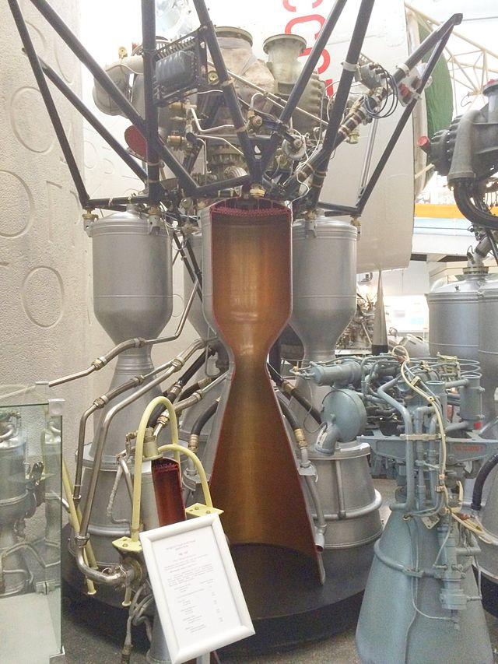
Laval nozzle
1
*
2

Slide 18
Shock waves
Separate subsonic and supersonic region
Bow SW
Oblique SW
Physical dimensions: thickness bellow 1μm

Slide 19
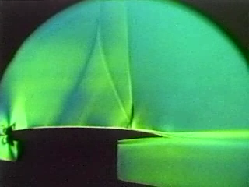
Bow shock-wave

Slide 20

Oblique shock-wave

Slide 21
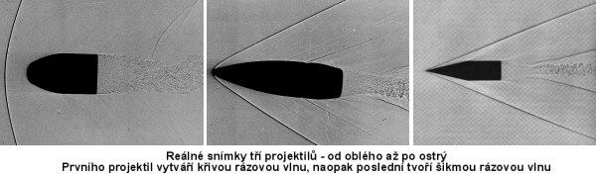
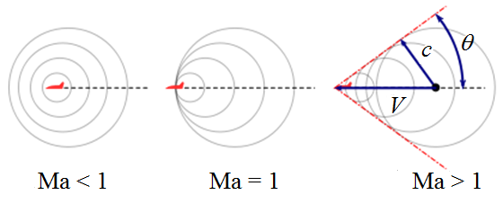
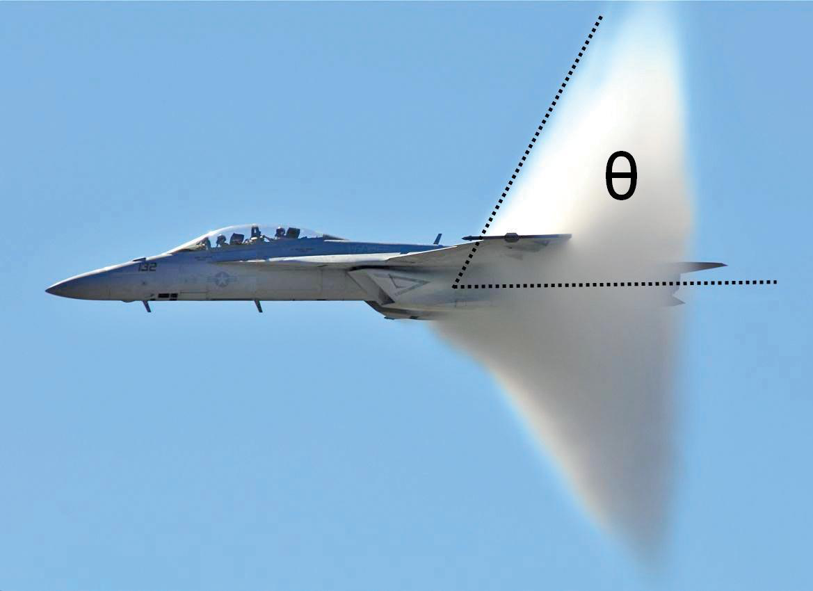
Mach cone, angle

Slide 22
Oblique shock-wave
Ma = 2

Slide 23
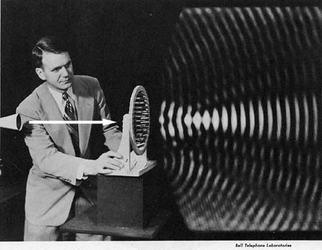
Basics of acoustics
Fluctuations:
Pressure p
Density ρ
Velocity V
Acoustic waves:
Wave-length λ
Frequency f
Sound velocity c

Slide 24
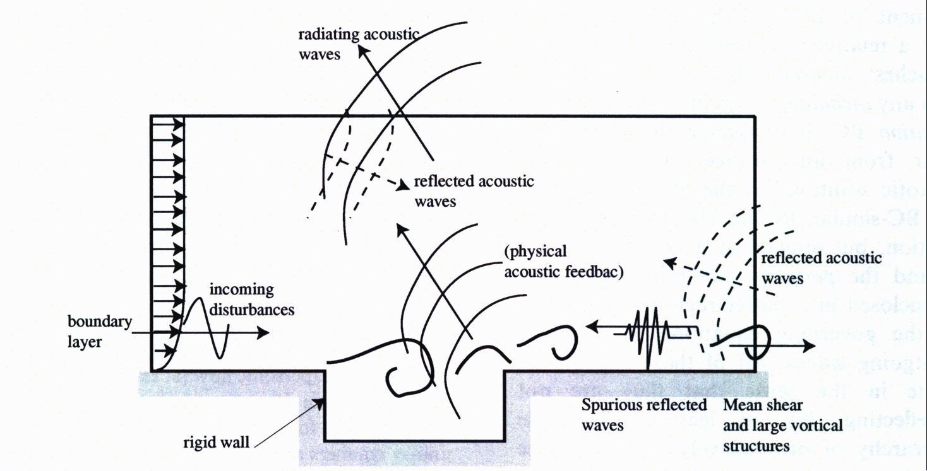
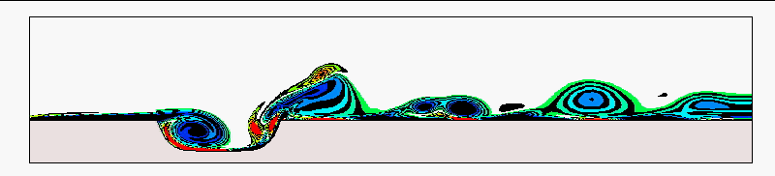
Generation of acoustic waves
Instationarities in flow
Waves
Periodical

Slide 25
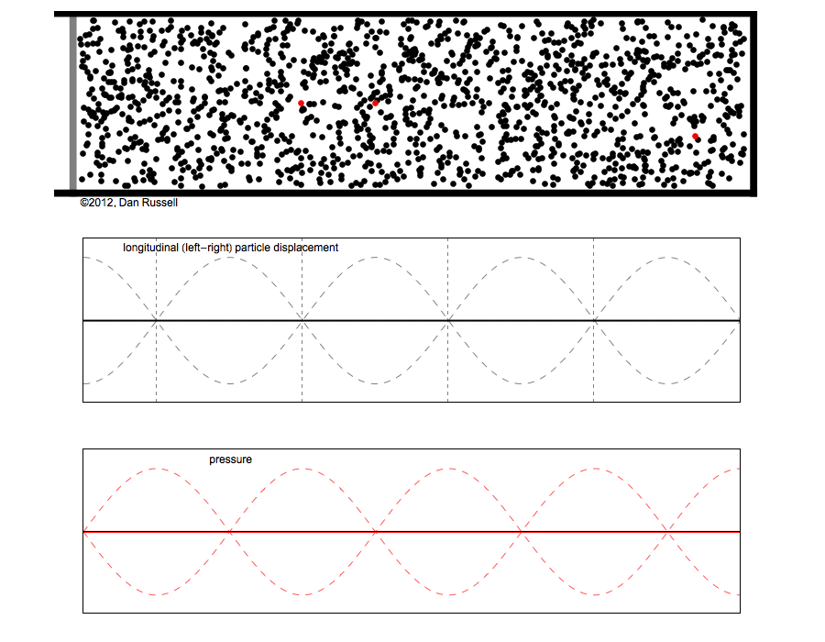
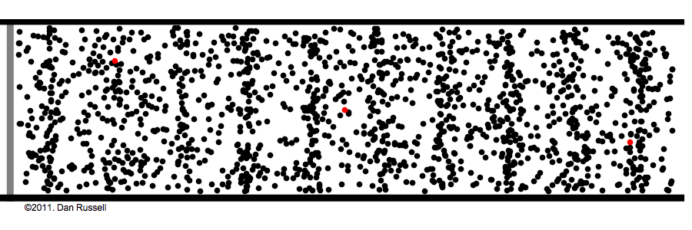

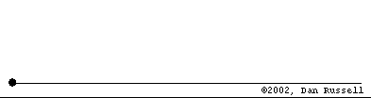
Acoustics in cavities
Resonator: integer multiples of wave-length
Dead end: node (movement), loop (pressure)
Free end: node (pressure), loop (movement)

Slide 26
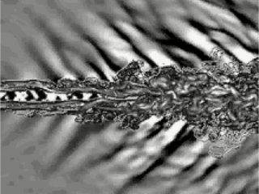
Supersonic jet - acoustics

Slide 27
Thanks for attention

Slide 28
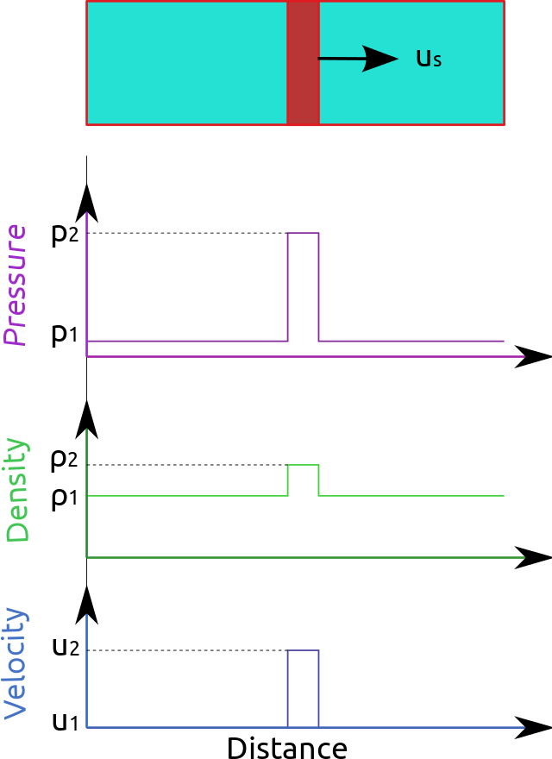
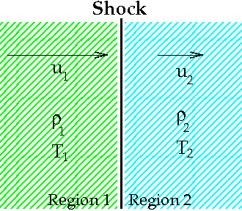

Shock wave
Rankine–Hugoniot

