Slide 1
Fluid Mechanics
Prof. Václav Uruba
uruba@fst.zcu.cz
http://home.zcu.cz/~uruba/vyuka/FM/
UWB FME, KKE
Institute of Thermomechanics ASCR, CTU in Prague FME, CU FFM

Slide 2
Fluid Mechanics - lectures
Introduction, concepts, definitions
Statics
Kinematics
Dynamics
Bernoulli equation
Shear regions
External flows
Internal flows
Flow machines
Turbulence
Compressible flows and acoustics
Physical modelling
Mathematical modelling

Slide 3
Fluid Mechanics - lectures
Introduction, concepts, definitions
Statics
Kinematics
Dynamics
Bernoulli equation
Shear regions
External flows
Internal flows
Flow machines
Turbulence
Compressible flows and acoustics
Physical modelling
Mathematical modelling

Slide 4
Physical modelling
Theory of similitude, physical modelling
Measured quantities (pressure, force, velocity, temperature)
Principles of selected experimental methods (Prandtl probe, hot sensors, optical methods)

Slide 5
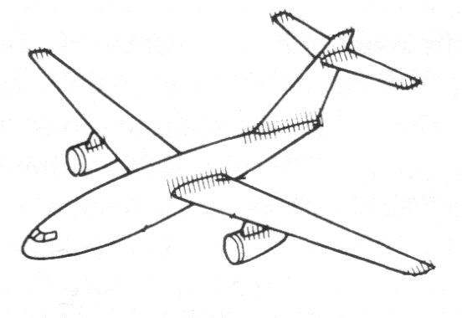

Physical modelling
object
model
parametry
výsledky
Similitude
Geometrical (simplex)
Physical (complex)

Slide 6
Physical dimensions system
SI: International System of Units
SI system - 7 basic physical units:
Kilogram
Meter
Candela
Second
Ampere
Kelvin
Mole
FM

Slide 7
Buckingham Theorem
Relevant quantities q₁ - q_{n}
Simplex p_{i} = q_{j}/q_{k}
Complex π_{i} = q₁^{b1} . q₂^{b2} . …. . q_{n}^{bn}
n physical quantities q₁,…,q_{n}
Model: f(q₁,…,q_{n}) = 0
k basic physical units
p = n – k dimensionless parameters complex π₁,…,π_{p}
Model: F(π₁,…,π_{p}) = 0
+ simplex P_{i}

Slide 8
Buckingham theorem
No need for mathematical model
Only “relevant” quantities
BT suggests methods
Dimensional matrix
Ambiguous solution – choice, physical meaning

Slide 9
Dimensionless parameters in fluid mechanics
Convection
Diffusion
Reynolds number
Mach number
Strouhal number
Force coefficients
Compressibility effect
Dimensionless frequency
Dimensionless force

Slide 10
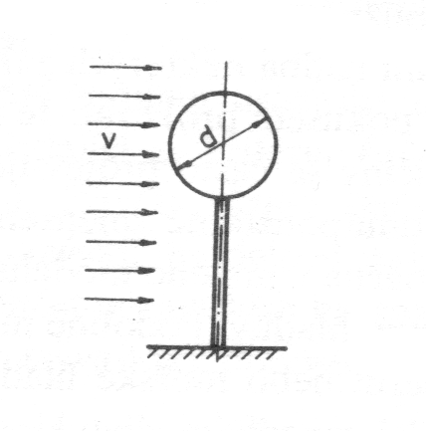
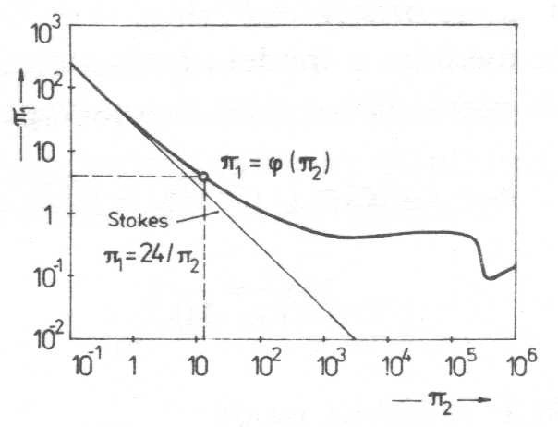
Example: sphere in flow
Relevant quantities: F[kg.m/s²], V[m/s], d[m], ρ[kg/m³], ν[m/s²] F = f(V,d,ρ,ν)
n = 5, k = 3, p = 2
Dimensionless parameters:
[m], [kg], [s]
Re
C_{D}

Slide 11
Measured quantities
Value
Static
Total
Dynamic
Pressure
Temperature
Speed
Force
Material parameters
Density
Viscosity
…
State quantities
Functions of the state quantities

Slide 12
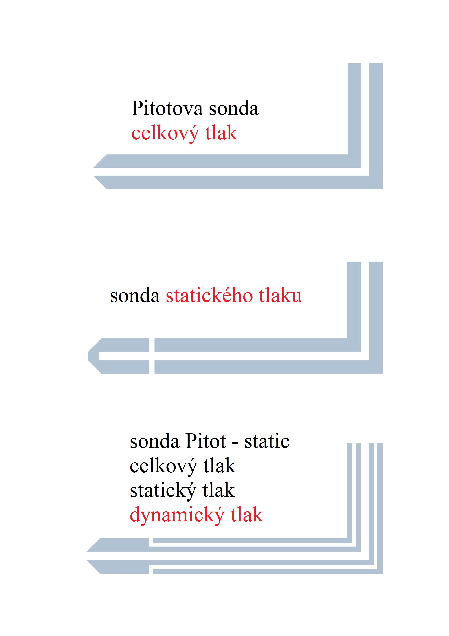
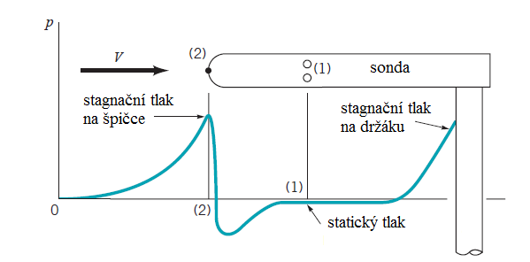
Pressures measurement
Static pressure on wall
Pressure
Static
Total
Dynamic
Directional probe
Probe: Pitot-static
(Prandtl)

Slide 13
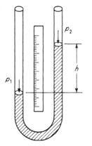
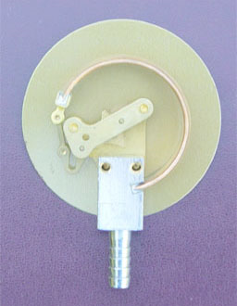
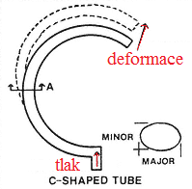
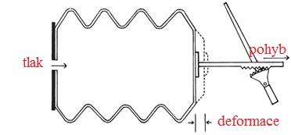
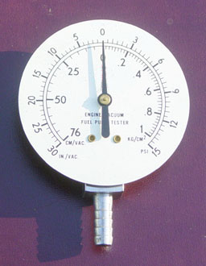
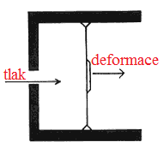
Pressures measurement
Manometers
Liquid
Bourdon tubes
Bellows
Membranes

Slide 14
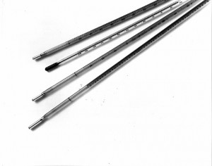
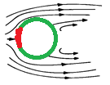
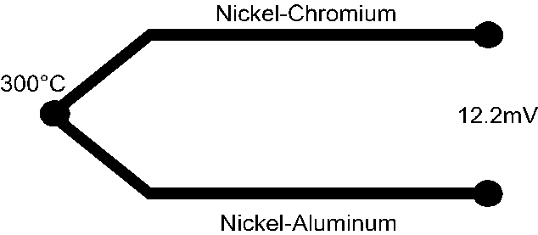
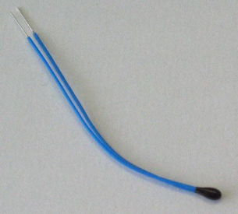
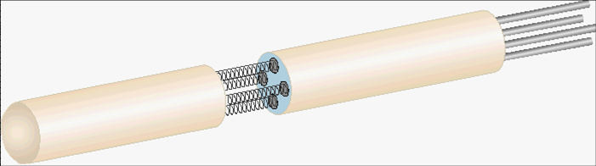
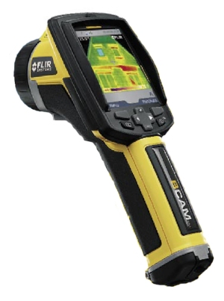
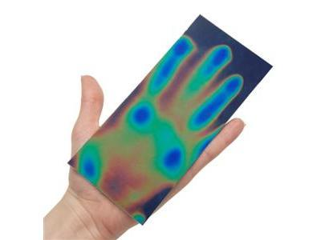
Temperature measurement
Temperature
Static
Total
Recovery
Thermometers
Expansivity
Thermocouple
Resistance (Pt)
Thermistors (semiconductors)
Liquid crystals
IR
Measures surface temperature and not the fluid !!!

Slide 15
Speed measurement
Pressures
Hot sensors
Optical methods
LDA
PIV
Point methods
The only 2D method

Slide 16
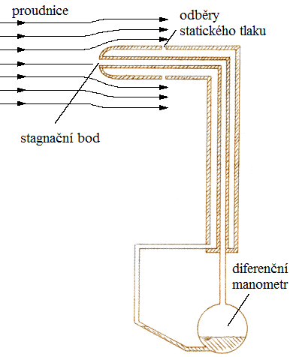
Speed from pressures
Pressure
Static
Total
Dynamic
Bernoulli equation

Slide 17
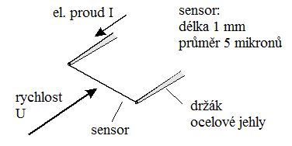
Hot sensors
Hot wire or film
Sensor is cooled: gas (thermal properties), temperature, speed
Measuring point:
The only method for frequency above 10kHz (up to 200kHz)

Slide 18
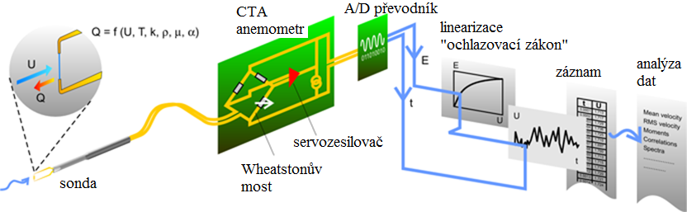
Constant Temperature Anemometry – CTA
Wire W, Pt dia 1-10 μm
Film on glass, Ni, Pt thickness 0,5-1 μm

Slide 19
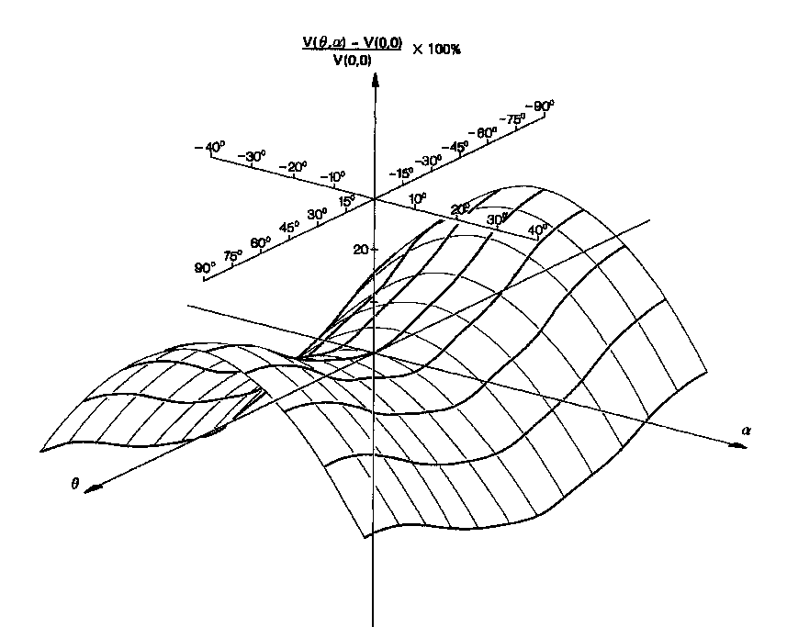
Directional sensitivity

Slide 20
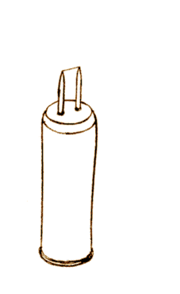
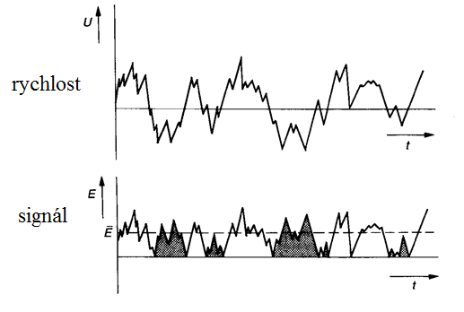
Orientation ambiguity

Slide 21
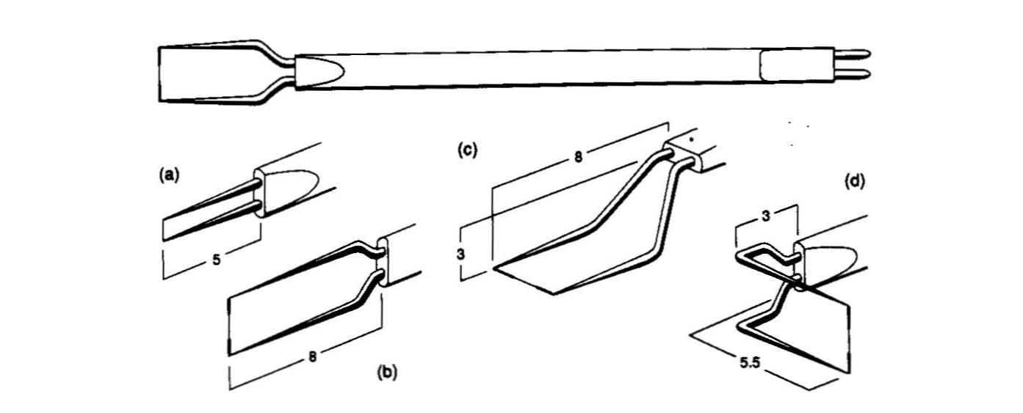
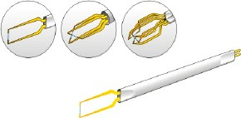
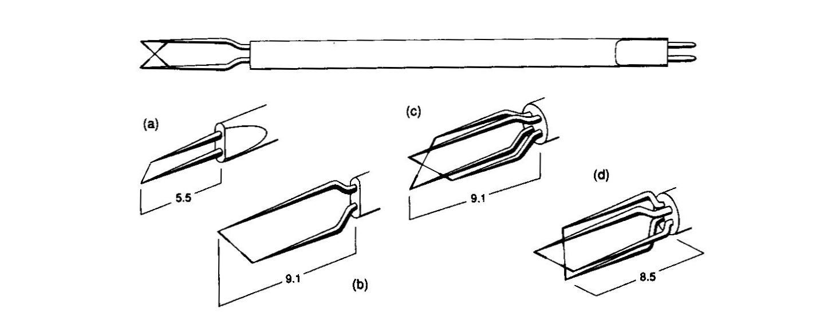
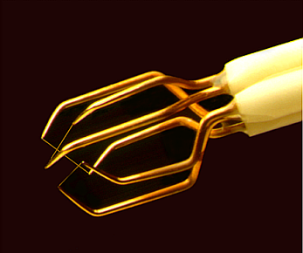
Probes

Slide 22
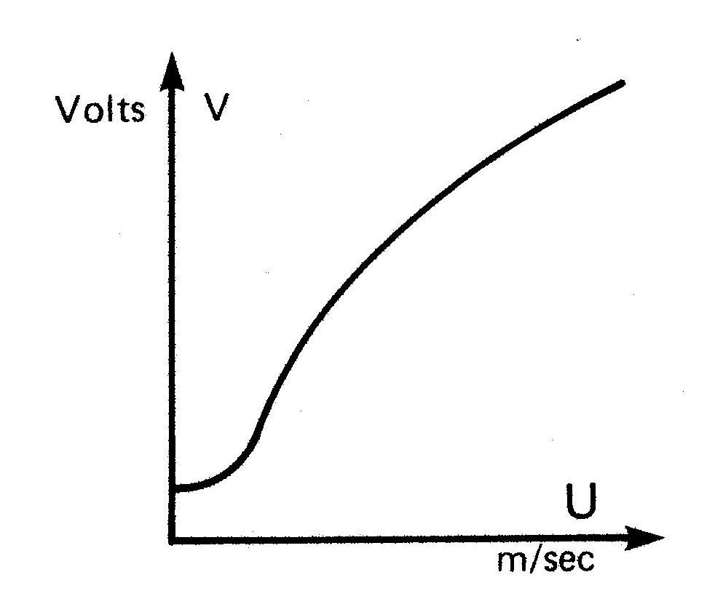
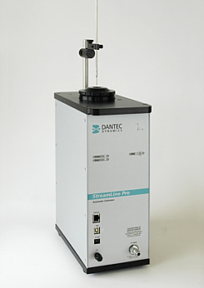
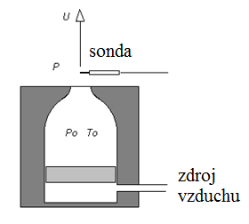
Calibration
Nastavení podle tlaků
Cooling law

Slide 23
Hot sensors anemometry
Malý měřicí bod
Dobrá citlivost
Vysoká přesnost (závisí na kalibraci)
Vysoké pfrekvence
Rozsah rychlostí (vzduch: 0.1m/s – 5M)
Citlivost k dalším veličinám (T, p, složení)
Intrusivní metoda
Choulostivá sonda
Problémy v průmyslovém prostředí
Nejistota v orientaci rychlosti
Je třeba kalibrace
Citlivost k dalším veličinám (T, p, složení)

Slide 24
Optical methods
Particles
Kapičky oleje
TiO₂, MnO
Polyamid
Částice by měly „kopírovat“ chování tekutiny
Ideal: same density
Methods:
Laser Doppler Anemometry – LDA
Particle Image Anemometry – PIV

Slide 25
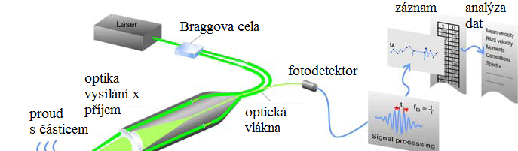
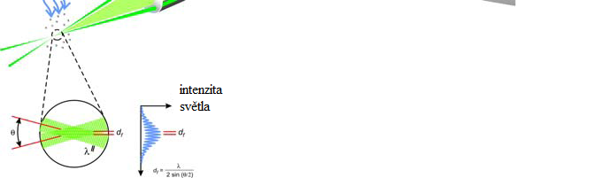
Laser Doppler Anemometry – LDA

Slide 26
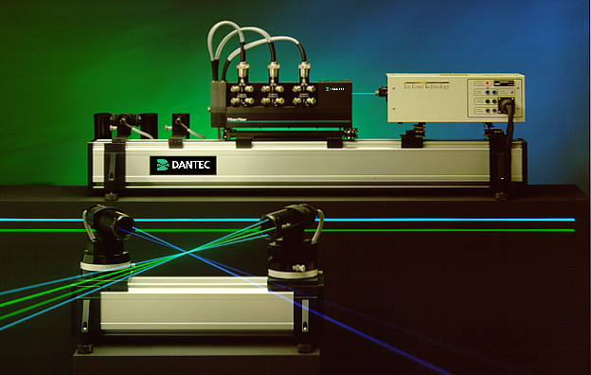
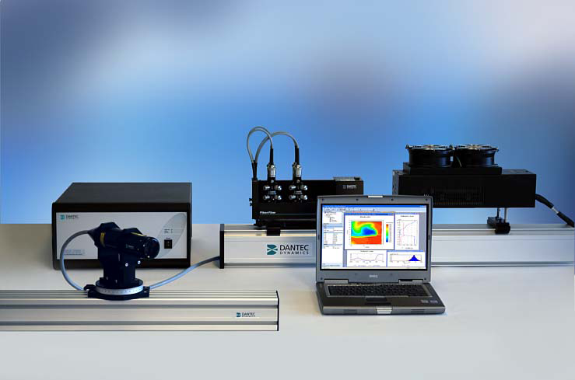
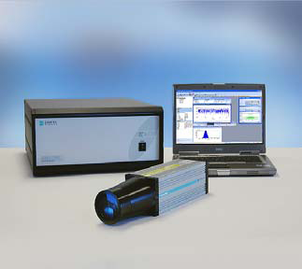
LDA system

Slide 27
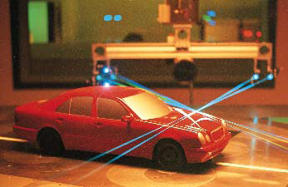
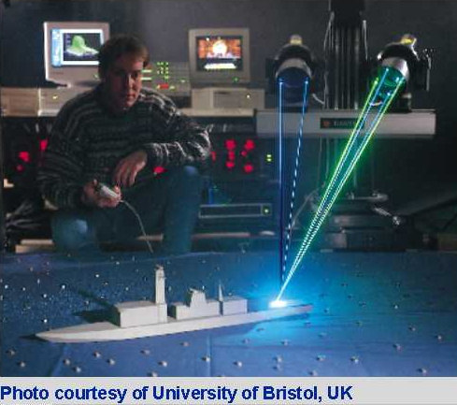
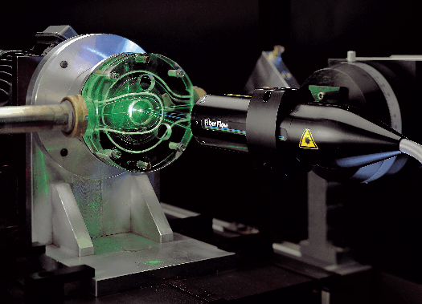
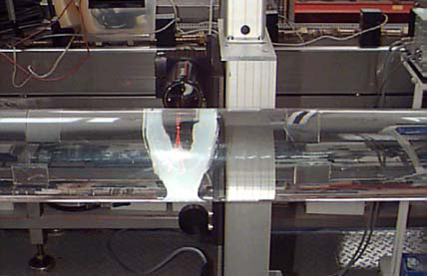
Application examples

Slide 28
LDA
High accuracy
No calibration needed
Not intrusive
Up to 3 velocity components
Small measuring point
Velocity orientation
Particles needed
Uneven sampling
Expensive

Slide 29
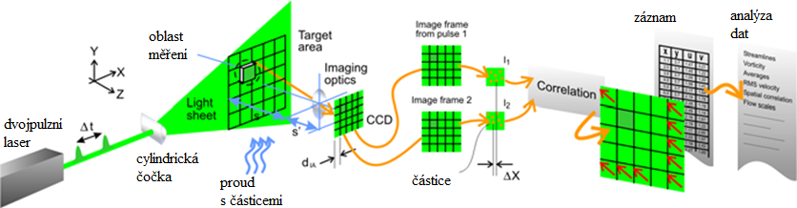
Particle Image Velocimetry – PIV
Measurement in 2D (3D) – space correlations

Slide 30
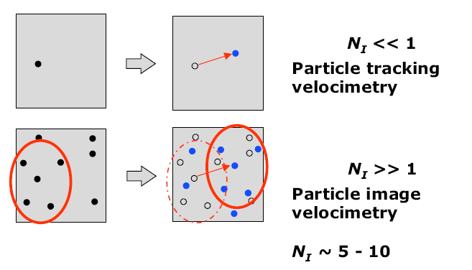
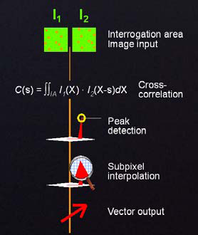
Velocity evaluation

Slide 31
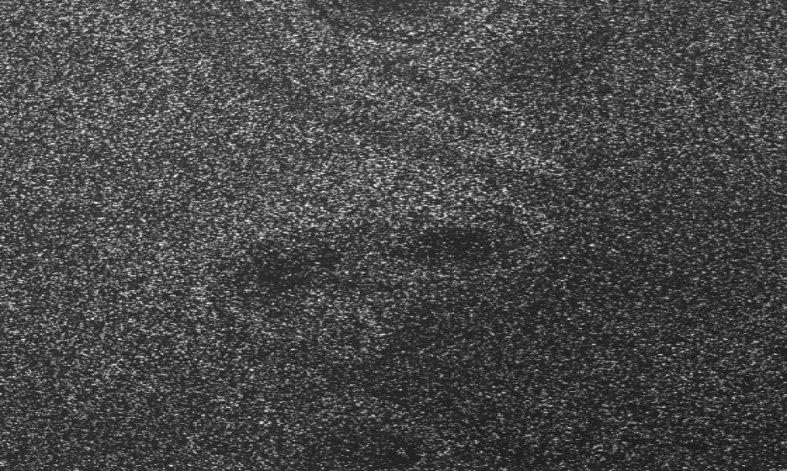
Snap A

Slide 32
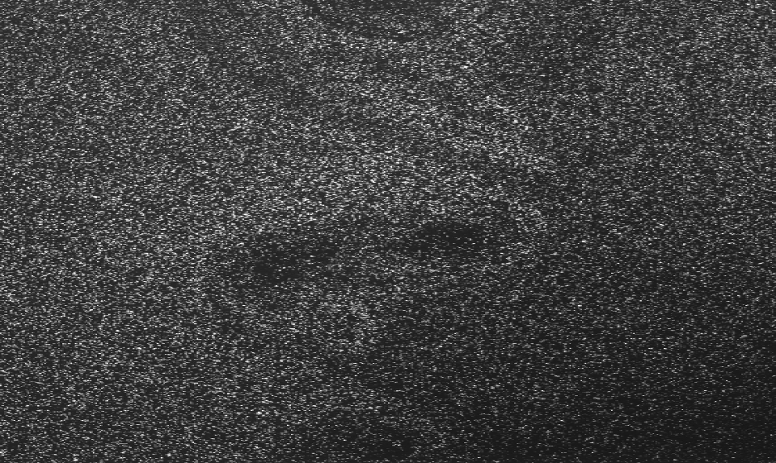
Snap B

Slide 33
Snap

Slide 34
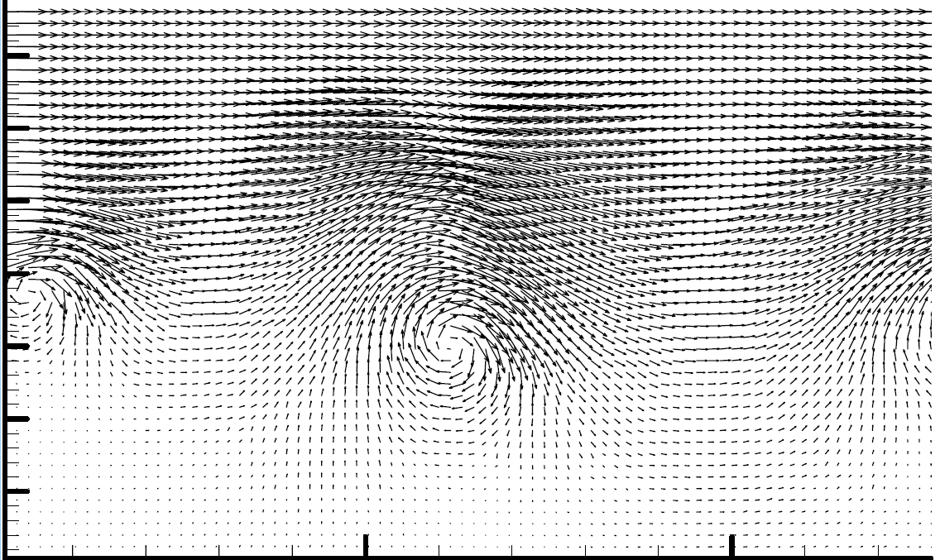
Vector field

Slide 35
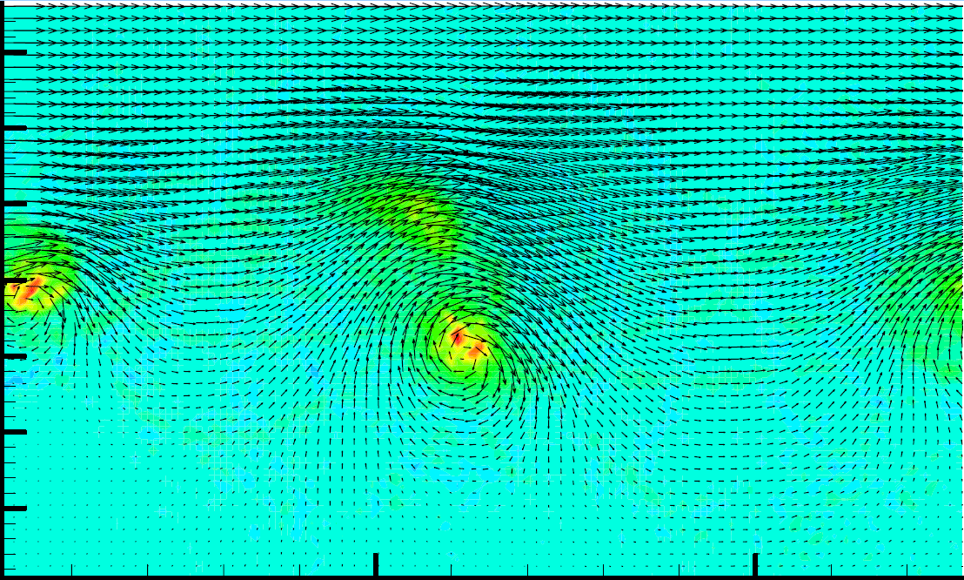
Vectors + vorticity

Slide 36
PIV
Space correlations
No calibration
Not intrusive
2 or 3 velocity components
Velocity orientation
Particles are needed
Lower accuracy
Expensive

Slide 37
Experimental facilities
Wind tunnels
Water facility
Shock tubes (hypersonic)

Slide 38
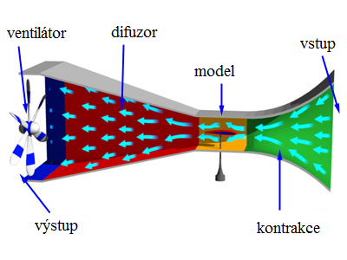
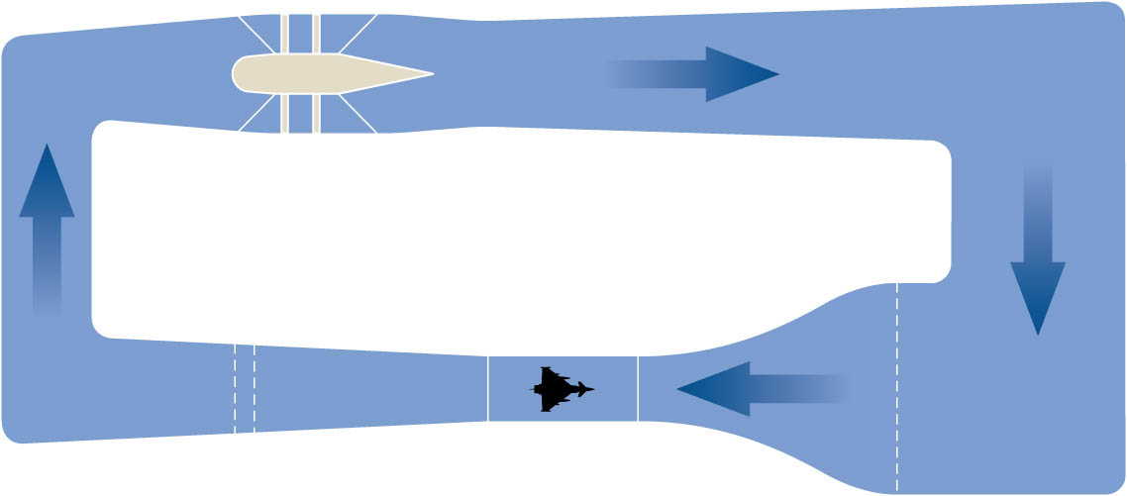
Wind tunnel
Open
Close-circuit

Slide 39
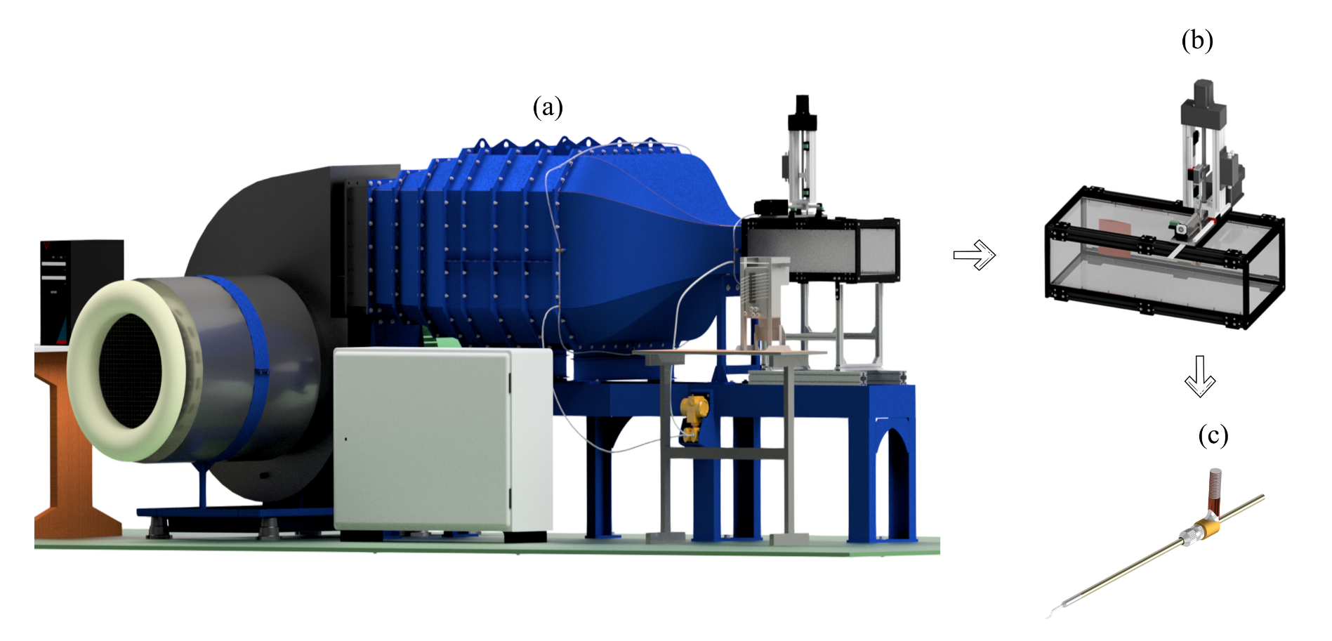
UWB flow-down facility

Slide 40

Garman-Duch tunnel (Marknesse)

Slide 41
Thanks for attention

