Slide 1
Fluid Mechanics
Prof. Václav Uruba
uruba@fst.zcu.cz
http://home.zcu.cz/~uruba/vyuka/FM/
UWB FME, KKE
Institute of Thermomechanics ASCR, CTU in Prague FME, CU FFM

Slide 2
Fluid Mechanics - lectures
Introduction, concepts, definitions
Statics
Kinematics
Dynamics
Bernoulli equation
Shear regions
External flows
Internal flows
Flow machines
Turbulence
Compressible flows and acoustics
Physical modelling
Mathematical modelling

Slide 3
Fluid Mechanics - lectures
Introduction, concepts, definitions
Statics
Kinematics
Dynamics
Bernoulli equation
Shear regions
External flows
Internal flows
Flow machines
Turbulence
Compressible flows and acoustics
Physical modelling
Mathematical modelling

Slide 4
Mathematical modelling of flow
Simulation of laminar and turbulent flow
Engineering methods (RANS, LES)
Validation x verification
Examples, software, results interpretation

Slide 5
Problem definition
Boundary conditions
Initial conditions (nonstationary)
Fluid properties
„Material“ properties (density, viscosity, heat conductivity,…)
Flow properties
Topology (1D, 2D, 3D)
Laminar x Turbulent, transitional
Simplifications
Mathematic model choice
N-S E, Euler E., Stokes E., Bernoulli E.

Slide 6
Solution strategy
Physical problem PP definition
Simplifications
Definition of simplified problem (only selected physical aspects considered) – mathematical model MM
Solution of simplified problem
Validation (code)
Verification MM
Result transfer from MM towards PP

Slide 7
Simplifications – MM design
Reality:
3D
Compressible
Viscous
Turbulent (mostly)
Geometry
3D – PP always!
2D plain geometry
Plain b.c.
Border effect neglected (important?)
Only statistics, instantaneous is 3D!
Often physically instable
1D solution „on streamline“, 1. (0.) approx. - BE
Fluid properties
Compressibility
Incompressible, Ma < 0.3, ρ = const., no thermodynamics
compressible: energy e.!
Viscosity
Inviscid, compressible
Integral balance estimate
(flow rate, force,…)
Incompressible and inviscid model
no relevant physical information!

Slide 8
Mathematical models
Physical problem PP
3D geometry
Dynamics (nonstationary) 3D
Turbulence
Shear regions, boundary layers
Friction forces, pressure forces (wake)
Shock waves
Acoustics
Thermodynamics
3D MM
Viscous MM
Compressible MM

Slide 9
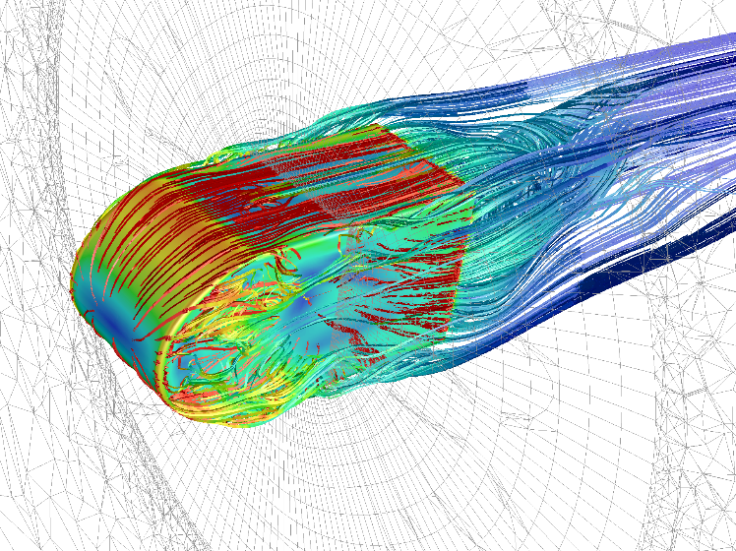
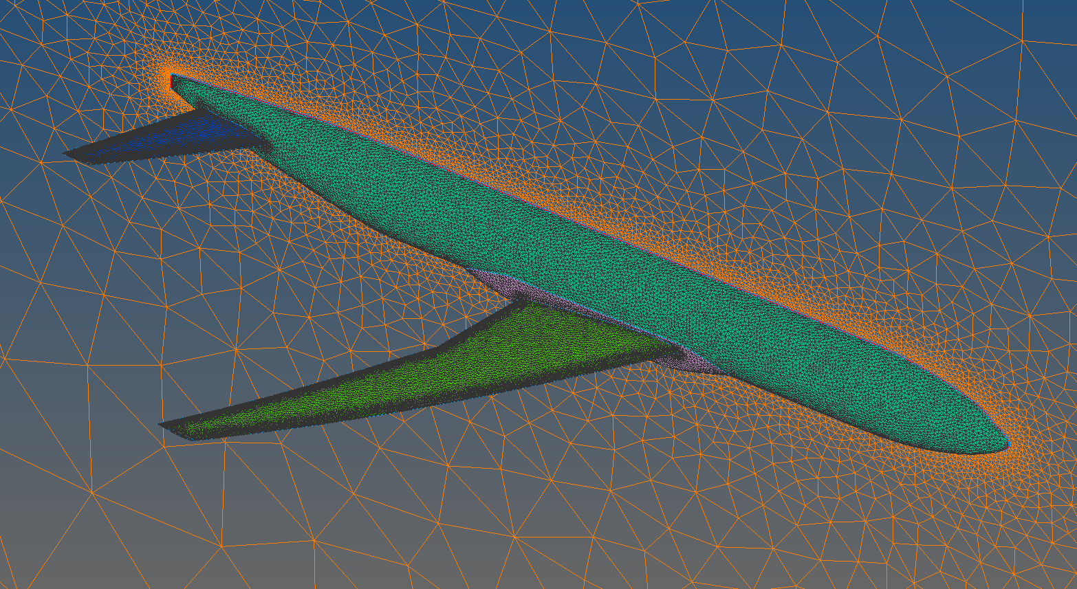
Dimension 3D
3D
Whole region
Part region (symmetry)

Slide 10
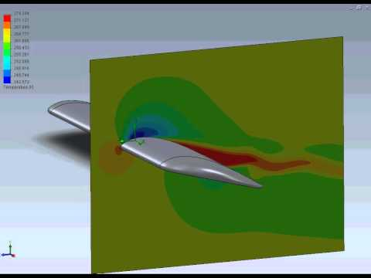
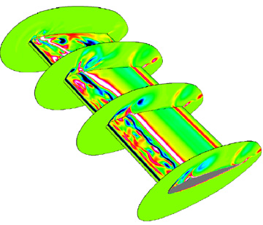
Dimension 2D - plain

Slide 11
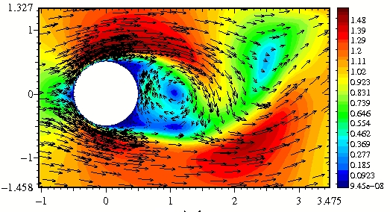
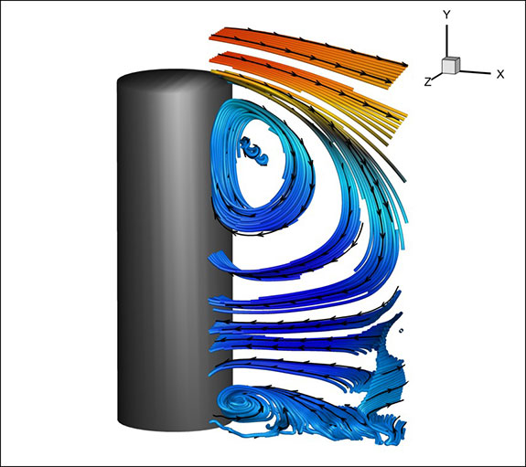
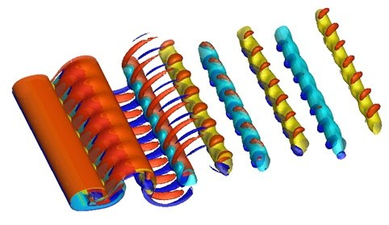
Cylinder in cross-flow
2D
3D

Slide 12
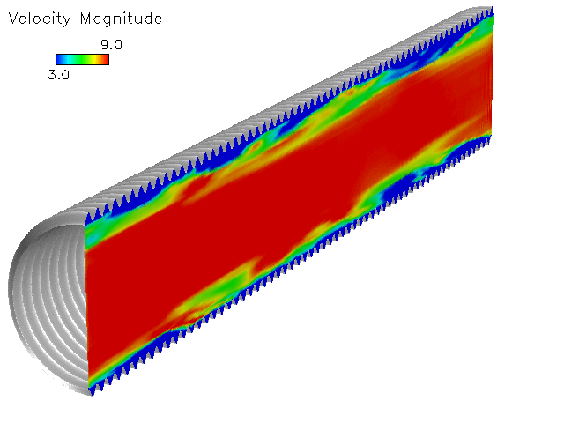
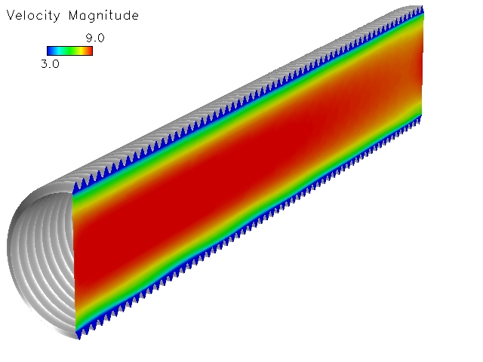
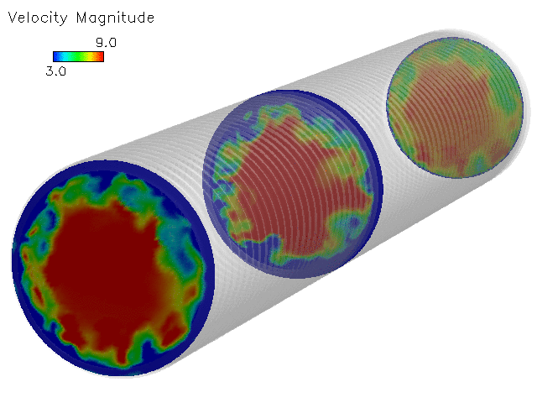
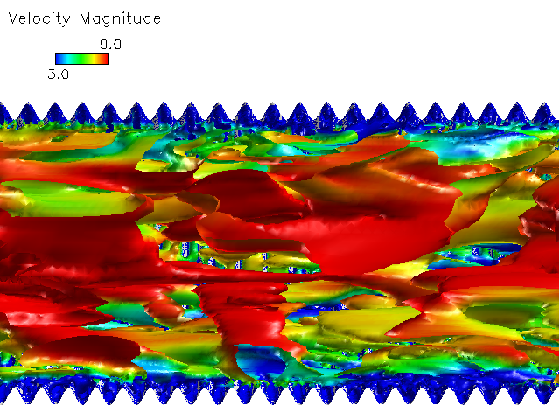
Dimension 2D - rotational symmetry
Statistics 2D
Dynamics 3D

Slide 13
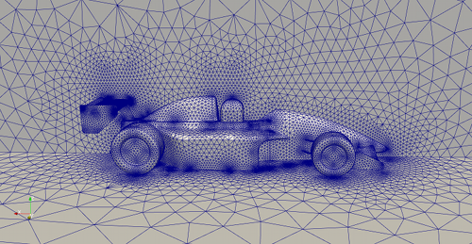



Discretization
In space
In time
Link! (Courant–Friedrichs–Lewy condition - CFL)
velocity
1D:
2D:
general:

Slide 14
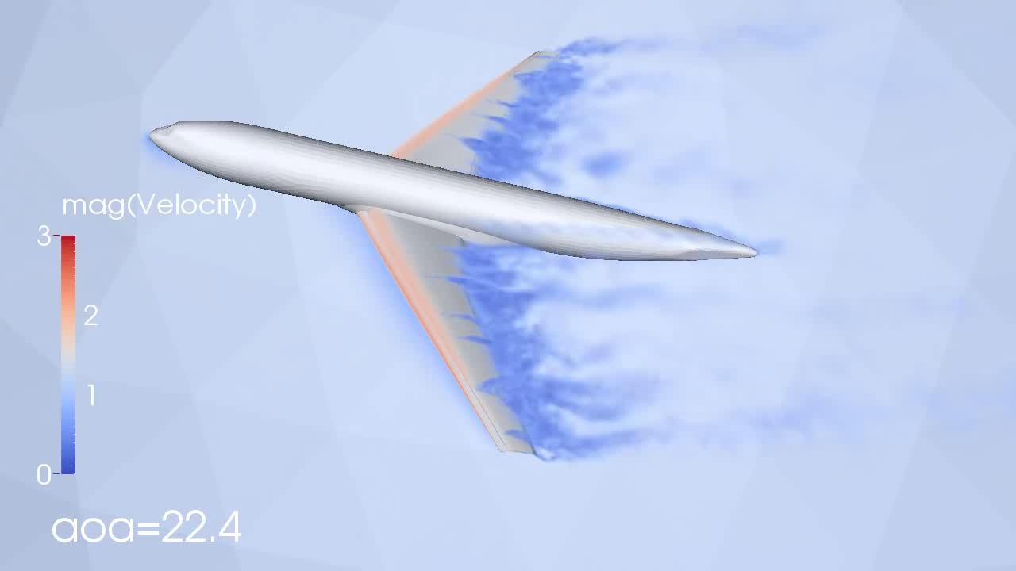
Real simulation

Slide 15

Turbulent flow solution options
CFD – Computer Fluid Dynamics
$${DOF \sim Re}^{9/4}$$
Direct Numerical Simulation of N-S E – DNS
Difference eq.
Averaged N-S E – RANS
Mean values
Turbulence modelling
Combined approaches – URANS, LES
Big structures – simulation (DNS)
Small structures – modelling (RANS)
We have not sufficient resources
Basic engineering approach
„Advanced“ engineering approach
DNS: Direct Numerical Simulation
N-S: Navier-Stokes
RANS: Reynolds Averaged Navier-Stokes
URANS: Unsteady RANS
LES: Large Eddy Simulation

Slide 16
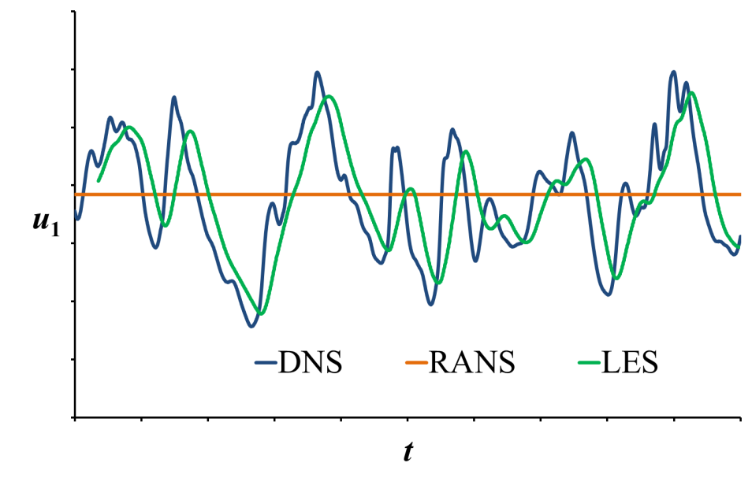
Mathematical modelling in a point
DNS
RANS
LES

Slide 17
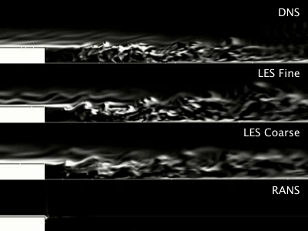
Mathematical modelling BFS
BFS – Backward Facing Step

Slide 18
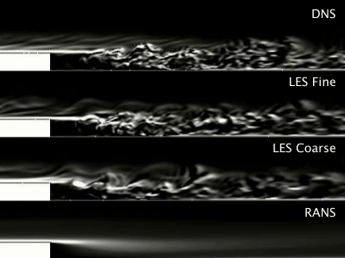
Mathematical modelling BFS

Slide 19
Mathematical modelling BFS

Slide 20
Mathematical modelling BFS

Slide 21
Mathematical modelling
objekts - processes - methods
Reality: real physical process, physical object and conditions
Conception model: all equations including b.c. and i.c. (PDE)
Computational model: implementation of CM into computer system (numeric)
Reality
Kvalifikation
Analysis
Simulation
Conception
model
Validation
Programming
Computational
model
Verifikation
Team work!!!:
physicians, theoreticians, experimentalists, mathematicians, programmers

Slide 22
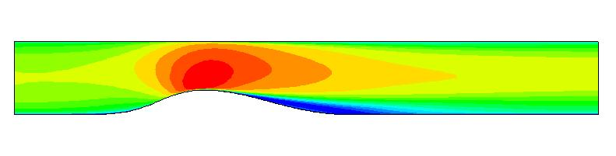
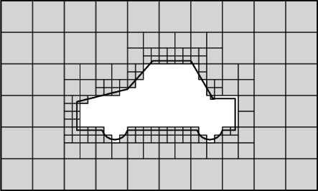
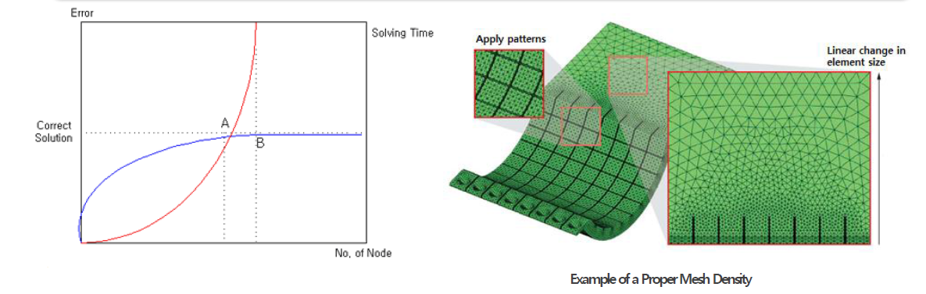
Validation x Verification
PHYSICS
Validation
Experiment – comparison in suitable locations
Verification
Discretization, no. of elements, distribution (density)
Type of elements (structured, unstructured, …)
Order of numerical scheme
MATHEMATICS

Slide 23
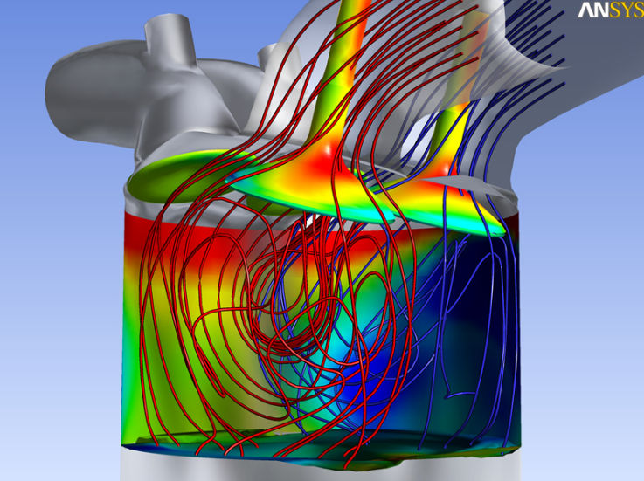
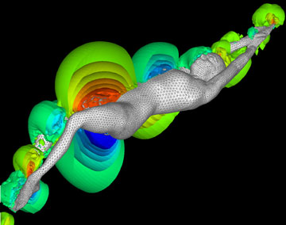
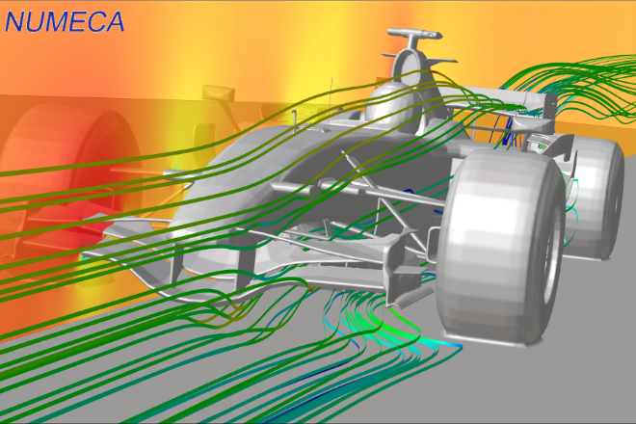
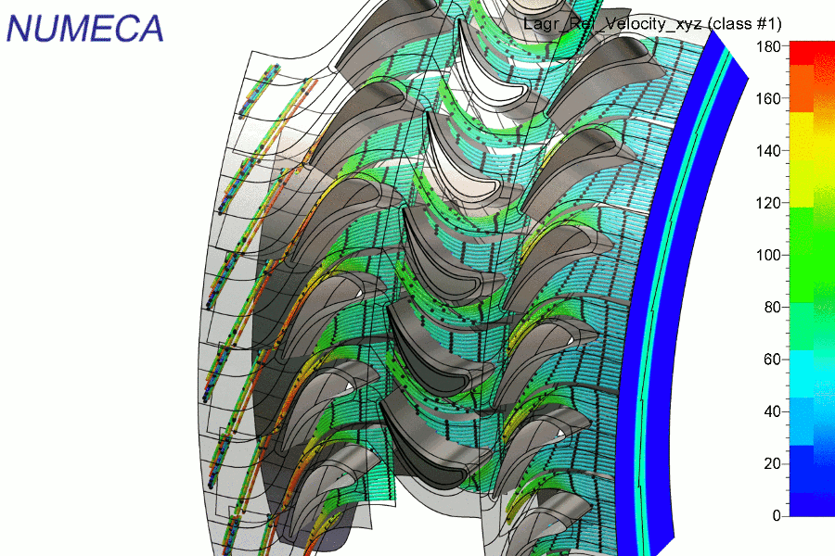
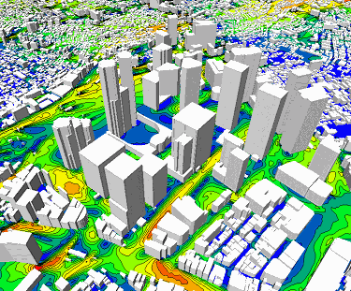
Practical solutions
Computer Fluid Dynamics CFD software
ANSYS
FLUENT
CFX
NUMECA FINE
OpenFOAM

Slide 24
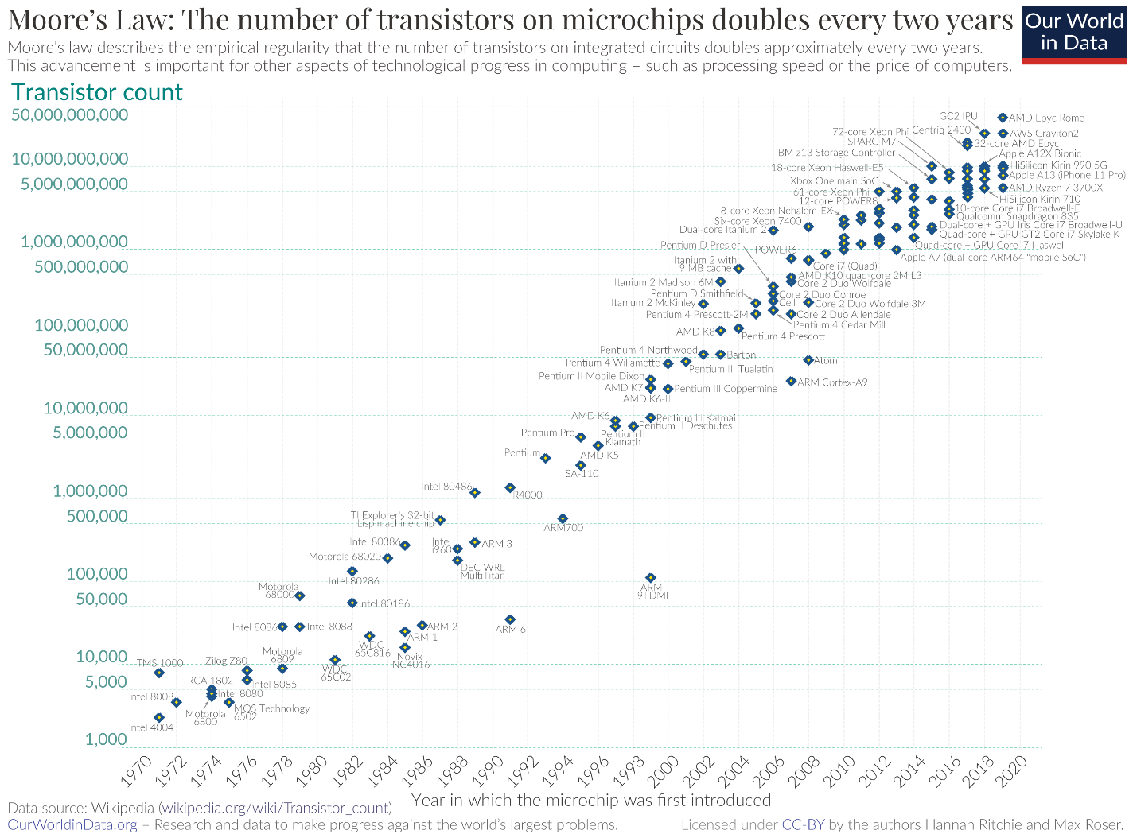
Computers power
Today:
PC: RANS, simple LES
Supercomputers: LES, trivial DNS

Slide 25
Thanks for attention

